Slide 1


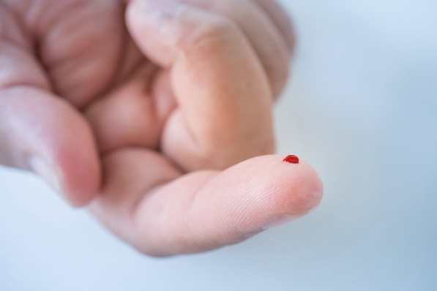
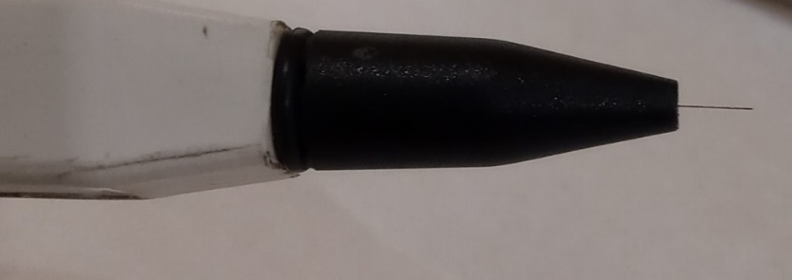
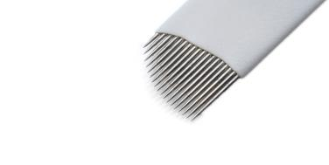
Section 9: Occupational Exposure Management and
Personal Protective Equipment (PPE)

Slide 2
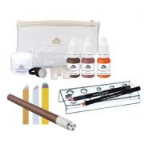
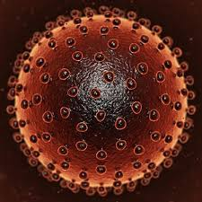
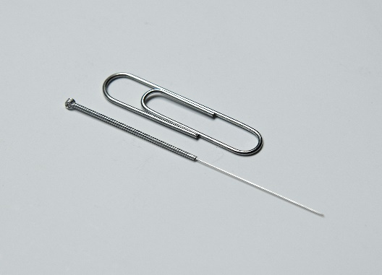
What should practitioners be protected from?
Infection – primarily BBVs
Physical injuries (needle stick injuries)
Allergens
(Chemicals)
How are practitioners protected from these hazards?

Slide 3
Putting PPE into perspective
Elimination
Substitution
Engineering controls
Administrative controls
PPE
Most effective
Least effective
However PPE is always the last resort in terms of controlling hazards (in this case infections).

Slide 4

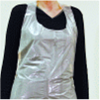
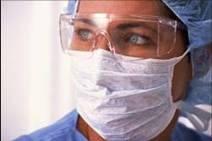
PPE used in special procedures
Single use gloves
Single use disposable aprons
  Provide an extra barrier of protection against BBVs
  Reduces the risk of infection from splashes or sprays
  of body fluids
Face and eye protection
  should be worn when there is a risk of spray/splash
  from body fluids to the eyes and mucous membranes
Disposable Hair net ?
Disposable Face mask ?
Over sleeves?
Uniform?

Slide 5
PPE related to level of exposure
Anticipated level of exposure | Wear disposable gloves | Wear plastic or fluid repellent apron | Wear eye and face protection
No exposure to blood/ body fluids anticipated | X | X | X
Exposure to blood/ body fluids anticipated but low risk of splashing | Yes | Yes | X
Exposure to blood/ body fluids anticipated with high risk of splashing to the face | Yes | Yes | Yes

Slide 6
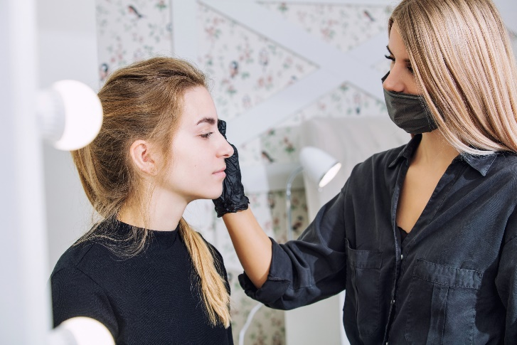
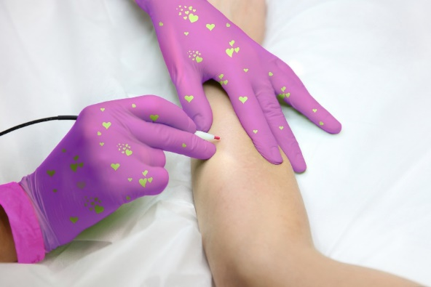
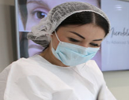
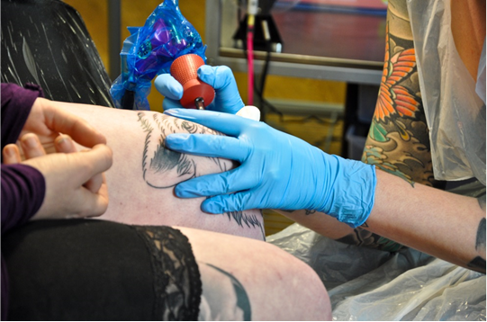
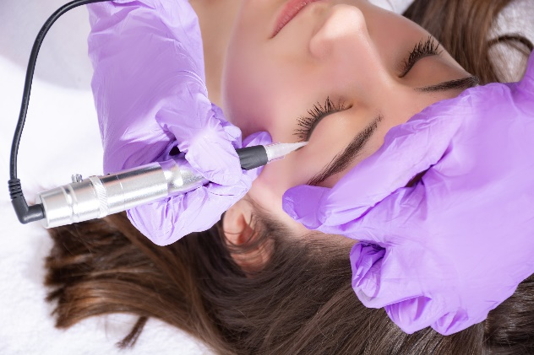
PPE- practical examples

Slide 7
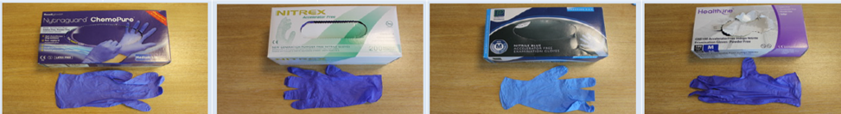
Glove Rules
Must be CE-marked for use with ‘biological agents’
Must be regarded as ‘single use’
Should be discarded as hazardous (clinical) waste after use
Put on immediately before client contact or procedure
Remove as soon as procedure is completed, or when leaving the client for any reason.
Change between different procedural activities for same client
Remove/replace if they become torn.
Should not be regarded as a substitute for good hand washing
Should be fit for purpose and selected to fit the user
Don’t make gloves a vehicle of transmission

Slide 8
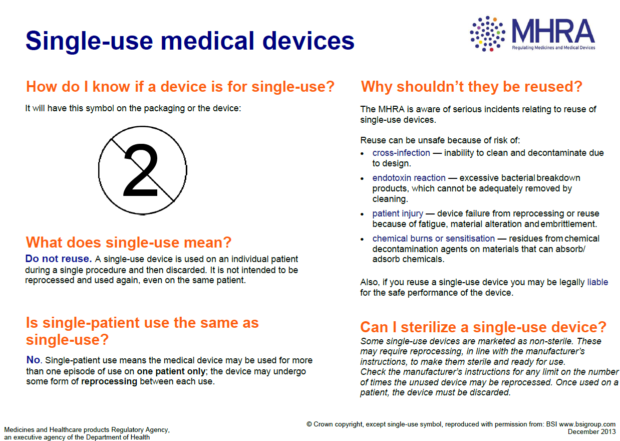

Slide 10
Sharps/needle-stick injuries
A sharps injury is an incident, which causes a needle, blade or other medical instruments to penetrate the skin.
A blood/body fluid injury/exposure incident includes:
A break in the skin involving a used needle or sharp instrument
A splash to the eye or mucous membrane
A bite, scratch or cut involving an exchange of blood or bodily fluid

Slide 11
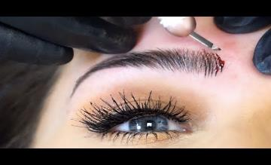
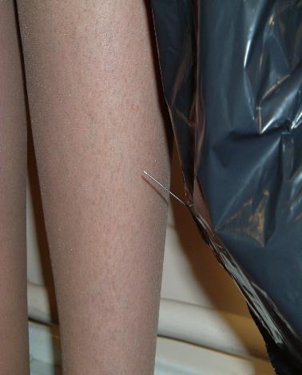
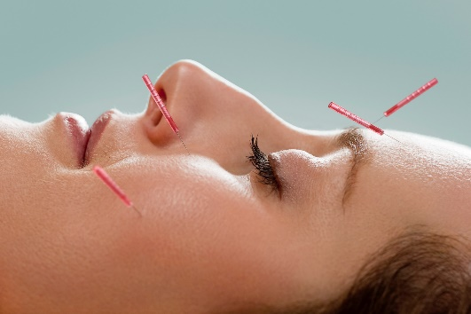
Needle Stick Injuries
A sharps injury is sometimes called a percutaneous injury.
85% of injuries are the result of incorrect disposal
Risk of infection following a needle stick injury:
1 in 3 when a source patient is infected with HBV and is classed as being highly infectious at the time.
1 in 30 when the patient is infected with HCV.
1 in 300 when the patient is infected with HIV
(HPA, 2008).

Slide 12
First aid response: needle stick injury
Encourage bleeding of the injury under clean running water
Wash gently with mild soap
Cover the wound with a clean dressing
Seek medical advice/attention immediately at A&E ideally within 1 hour or incident occurring and no later than 72 hours
Take the object and the name of the client.
Prompt response is critical
DON’T: suck wound, scrub wound

Slide 13
First aid response to exposure to blood or body fluids
When splashes of potentially infected bodily fluids come into contact with damaged skin or mucous membranes, follow the following procedure:
Rinse/irrigate the area with copious amounts of water.
If the eye is affected and contact lenses are present, remove them and then irrigate the eye.
If the mouth is affected, do not swallow the water used for mouth rinsing.

Slide 14
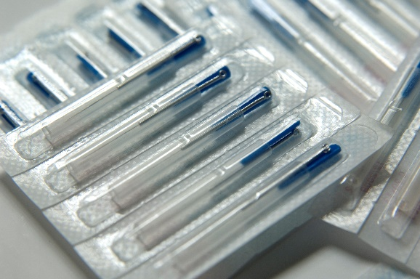
Management of sharps/exposure to blood
Receipt, use and disposal
Only sterile single use micro-blading tools should be used
Used directly from packaging or place on a sterile surface /tray for immediate use
Non-touch technique used to ensure blade does not get contaminated before use.
After procedure complete, dispose of the whole tool without touching/re-sheathing blade immediately into a yellow sharps box (hazardous waste)

Slide 15
Sharps Containers
Are they Labelled
Correctly located
Correct assembly
Store out of clients reach
Not overfilled

Slide 16
Avoiding sharps injury and staying ‘sharps safe’
• Do discard any sharps directly into the sharps container immediately after use and at the point of use. Close the aperture to the sharps container when carrying or if left unsupervised, to prevent spillage or tampering;
• Do carry sharps containers by the handle;
• Do lock the container when it is three-quarters full using the closure mechanism;
• Do label sharps containers with premises address prior to disposal;
• Do place any damaged sharps containers inside a larger sharps container - lock and label prior to disposal;
• Do keep all sharps waste in a designated, secure area until it is collected;
• Do dispose of disposable razors to a sharps bin immediately after use. Razors should never be re-sheathed after use;
• Do not try to re-sheath any used needles or leave sharps lying around and don’t try to retrieve items from a sharps container;
• Do not try to press sharps down in the container to make more room;
• Do not place sharps containers on the floor, window sills or above shoulder height, they should be stored above knee level and below shoulder level;
• Do not bend or break needles before discarding them.

Slide 17
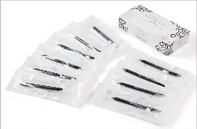
Occupational Exposure Management Policy
Arrangements, procedures, roles and responsibilities
Prevent and control exposure to practitioners
  Use and management of sharps
  Use of body fluid kits
  Storage and disposal waste
  Cleaning and decontamination
  Safe practices and procedures
  First aid response

Slide 18
Summary
Minimising exposure of practitioner and clients
Use and management of sharps
PPE and its purpose, when to be worn, single use
PPE - fit for purpose, role of each PPE, available to SPP and chosen to fit user
Gloves – changing
Needle stick injuries and actions
Occupational Exposure Management Policy

Slide 19
‘True or False’ Quiz
Question | True or False
Practitioners must change their gloves after completing a special procedure
The purpose of wearing PPE is to protect the client
Disposable gloves and aprons are examples of single use PPE
PPE should be chosen to fit the user
Single use gloves minimise the need to wash hands
Practitioners wear protective clothing to protect themselves from the risk of infection
Disposable protective aprons provide an extra barrier of protection against BBVs
Sharps include spatulas
The most effective way for practitioners to protect themselves against HBV is to get vaccinated

Slide 20
‘True or False’ Quiz - Answers
Question | True or False
Practitioners must change their gloves after completing a special procedure | True
The purpose of wearing PPE is to protect the client | False
Disposable gloves and aprons are examples of single use PPE | True
PPE should be chosen to fit the user | True
Single use gloves minimise the need to wash hands | False
Practitioners wear protective clothing to protect themselves from the risk of infection | True
Disposable protective aprons provide an extra barrier of protection against BBVs | True
Sharps include spatulas | False
The most effective way for practitioners to protect themselves against HBV is to get vaccinated | True

