Slide 1


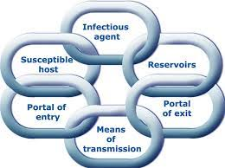
Section 5: The Chain of Infection
A series of events that have to happen to enable pathogenic micro-organisms to cause infection in a person.
We call this the ‘Chain of Infection’

Slide 2
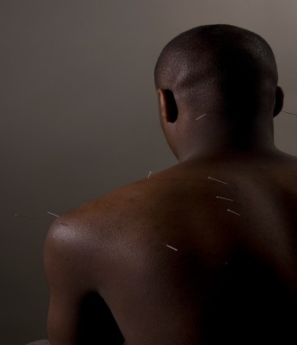
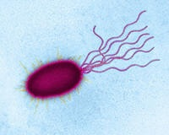
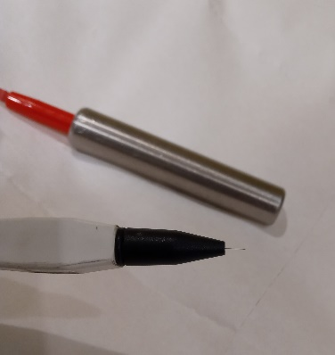

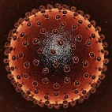

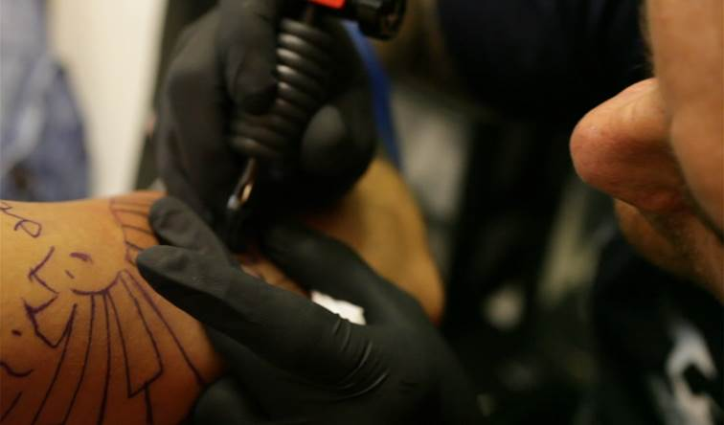
The Chain of Infection:
How the pathogen gets to or infects a person

Slide 3
Chain of Infection – how it works
Infectious Agent
Any micro organism capable of causing infection
Reservoirs
Where the infectious agent normally lives and multiplies
Portal of Exit
How the infectious agent leaves the reservoir
Mode of Transmission
How the infectious agent is spread from one site to another
Portal of Entry
How the infectious agent enters the body
Susceptible host
A person who is at risk of infection as they are unable to fight infection

Slide 4
The Chain of Infection
Infectious
agent
Portal of exit
Mode of transmission
Portal of entry
Susceptible
host
Reservoir

Slide 5
The Chain of Infection – How does it work for a respiratory virus?
Infectious
agent
Portal of exit
Mode of transmission
Portal of entry
Susceptible
host
Reservoir
Elderly people
Mouth and respiratory tract
Nose and mouth
Flu/Coronavirus
Air and contaminated hands
Respiratory tract

Slide 6
The Respiratory Virus Chain of Infection
Respiratory Virus | Chain of Infection
Influenza virus or Coronavirus | Infectious Agent
Respiratory tract (people) | Reservoir
Nose and mouth | Portal of Exit
Air and contaminated hands | Mode of Transmission
Mouth and respiratory tract | Portal of Entry
Elderly people | Susceptible Host

Slide 7
A ‘Special Procedures’ Example - HBV
Infectious
agent
Portal of exit
Mode of transmission
Portal of entry
Susceptible
host
Reservoir

Slide 8
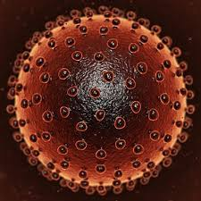
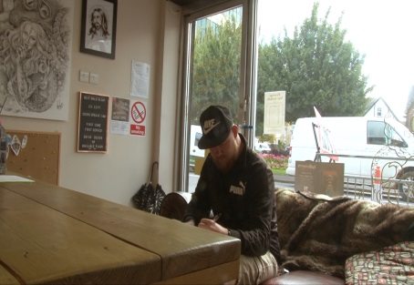
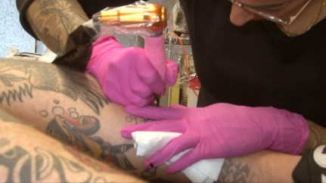
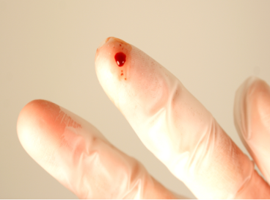
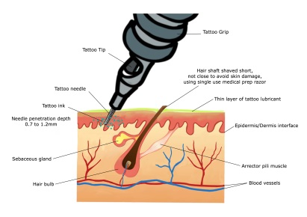
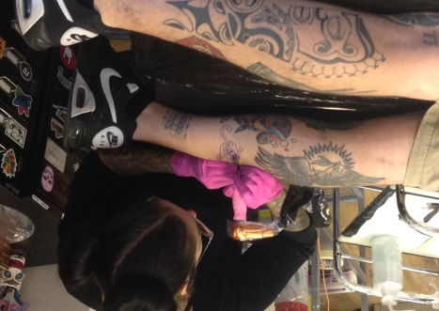
Infectious Agent
Susceptible host
Reservoir
Portal of Entry
Portal of Exit
Mode of transmission

Slide 9
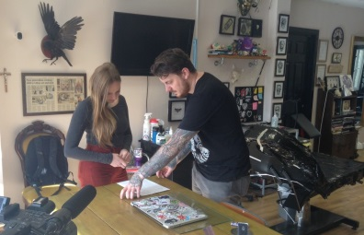

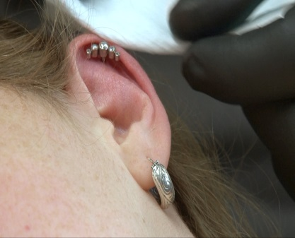
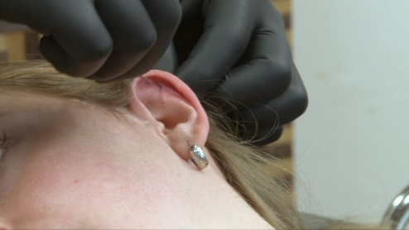
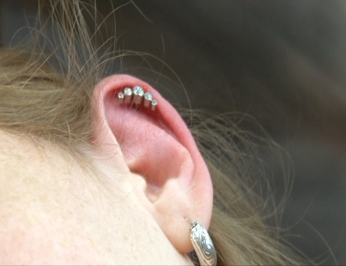
Infectious Agent
Susceptible host
Reservoir
Portal of Entry
Portal of Exit
Mode of transmission

Slide 10
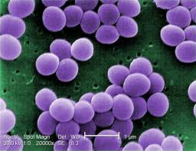



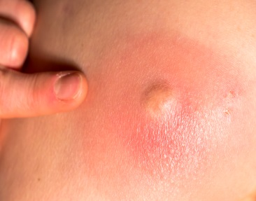

Infectious Agent
Susceptible host
Reservoir
Portal of Entry
Portal of Exit
Mode of transmission

Slide 11
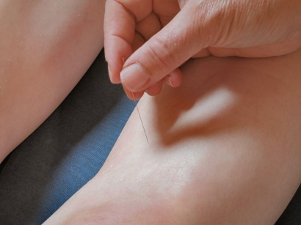
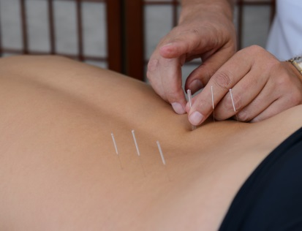
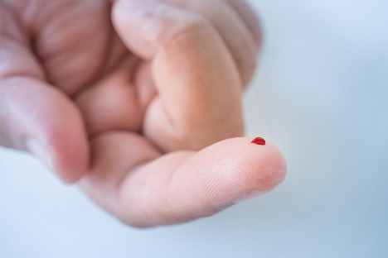
Infectious Agent
Susceptible host
Reservoir
Portal of Entry
Portal of Exit
Mode of transmission

Slide 12
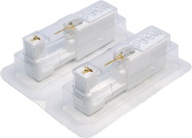
Infectious Agent
Susceptible host
Reservoir
Portal of Entry
Portal of Exit
Mode of transmission

Slide 13
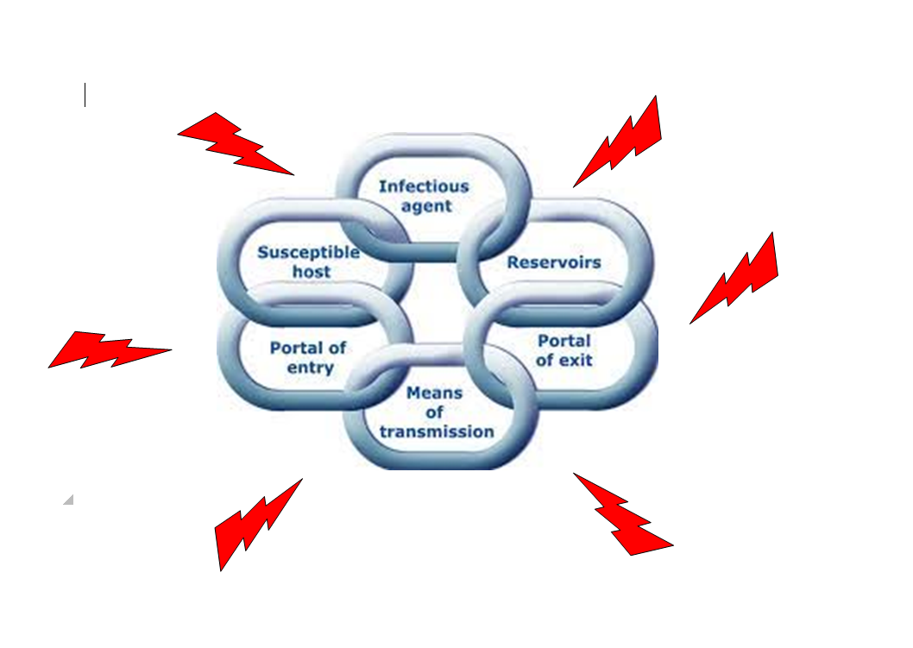
Breaking the Chain of Infection will prevent the spread of infection
Notes:
How can you break the chain of infection in your studio

Slide 14
Standard Infection Control Precautions
(SICPs) break the Chain of Infection
SICPs are the basic infection prevention and control measures necessary to reduce the risk of transmission of infectious agents from sources of infection.
Sources of (potential) infection include:
  blood and other body fluids secretions or excretions (excluding sweat),
  non-intact skin or mucous membranes
  any equipment or items in the working environment that could have become contaminated.

Slide 15
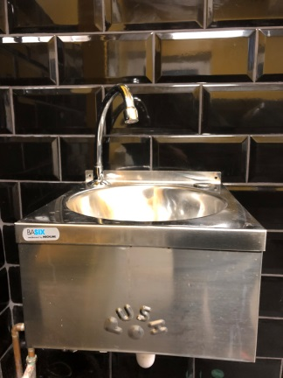
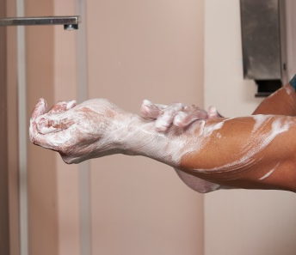
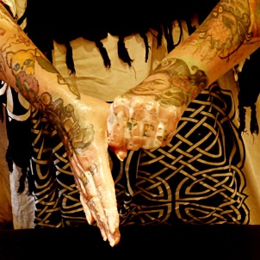
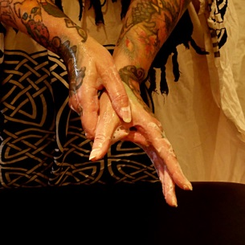
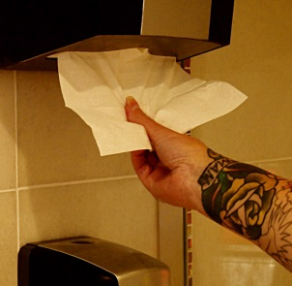

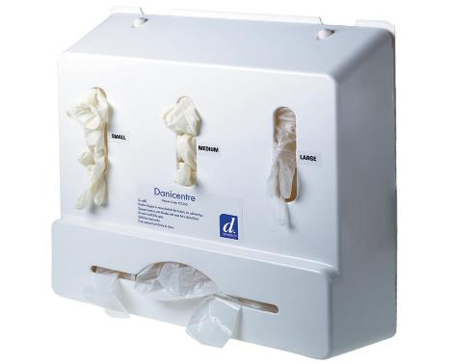
Some practical examples of how SICPs can control the spread of infection
Correct Hand Hygiene
Wearing disposable gloves Correct disposal of sharps

Slide 16





Infectious Agent
Susceptible host
Reservoir
Applying SCIPs to the Chain of Infection
Portal of Entry
Portal of Exit
Mode of transmission

Slide 17
Summary
The Chain of Infection comprises of 6 links which are:
  Infectious Agent, Reservoir, Portal of Exit, Mode of Transmission, Portal of Entry and Susceptible Host.
The Chain of Infection shows how infection can spread and how it can be prevented/controlled
Standard Infection Control Precautions (SICPs) break the ‘Chain of Infection’ and prevent the spread of infection
SICPs are good hygiene practices e.g. hand hygiene, cleaning and disinfection, safe disposal of contaminated waste

Slide 18
Quiz – True or False
Question | True or False
A diabetic client is an example of a ‘susceptible host’
‘Mode of transmission’ is an example of a Standard Infection Control Precaution’ (SCIP)
The ‘Chain of Infection’ is a model used to show how infection spreads
Using an autoclave correctly is an example of a SICP
Bacteria are an examples of a ‘reservoir’
Pseudomonas is an example of an ‘infectious agent’
A healthy 20 year old male is an example of a ‘susceptible host’
A reusable blood contaminated needle is an example of a ‘Mode of transmission’
There are 6 links in the ‘Chain of Infection’

Slide 19
Quiz – True or False answers
Question | True or False
A diabetic client is an example of a ‘susceptible host’ | True
‘Mode of transmission’ is an example of a Standard Infection Control Precaution’ (SCIP) | False
The ‘Chain of Infection’ is a model used to show how infection spreads | True
Using an autoclave correctly is an example of a SICP | True
Bacteria are an examples of a ‘reservoir’ | False
Pseudomonas is an example of an ‘infectious agent’ | True
A healthy 20 year old male is an example of a ‘susceptible host’ | False
A reusable blood contaminated needle is an example of a ‘Mode of transmission’ | True
There are 6 links in the ‘Chain of Infection’ | True

Slide 20
Group Work
Using the special procedure you perform, give an example of each of the stages in the chain of infection
Infectious Agent
Mode of Transmission
Reservoirs
Portal of Entry
Portal of Exit
Susceptible host

Slide 21
Group Work - Example
Using the special procedure you perform, give an example of each of the stages in the chain of infection
Infectious Agent
Pseudomonas
Reservoir
Water
(water based products)
Portal of Exit
Dispenser spray
Mode of Transmission
Contaminated aftercare spray
Portal of Entry
Recent ear piercing
Susceptible host
Young person using spray

Slide 22
Group work:
Identify 6 ways the chain of infection can be broken (one for each link)
Infectious
agent
Portal of exit
Mode of transmission
Portal of entry
Susceptible
host
Reservoir

