Slide 1


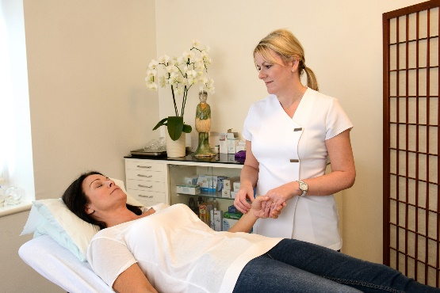
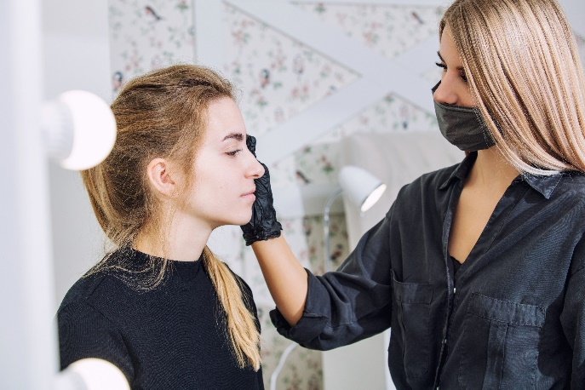
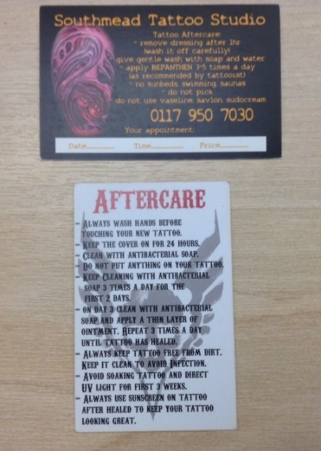
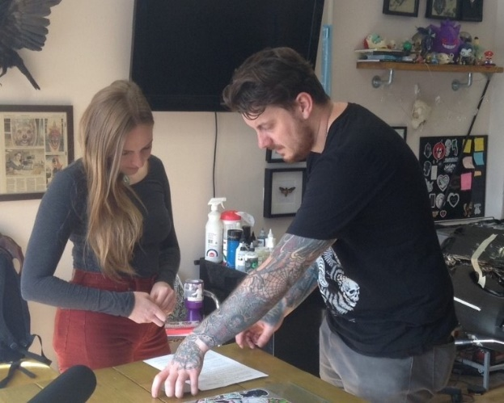
Section 7:
Client Consultation and Aftercare

Slide 2
Why is client consultation and aftercare important?
Raise awareness of the risks associated with the Special Procedures (often referred to as a ‘warn and inform’)
Identifies contraindications
Protect clients from preventable adverse health effects
Legal requirement
  ‘Section 63 (2)(c) Public Health (Wales) Act 2017 ‘consultation to be carried out before and after a special procedure is performed’
  Licence conditions
Business reputation

Slide 3
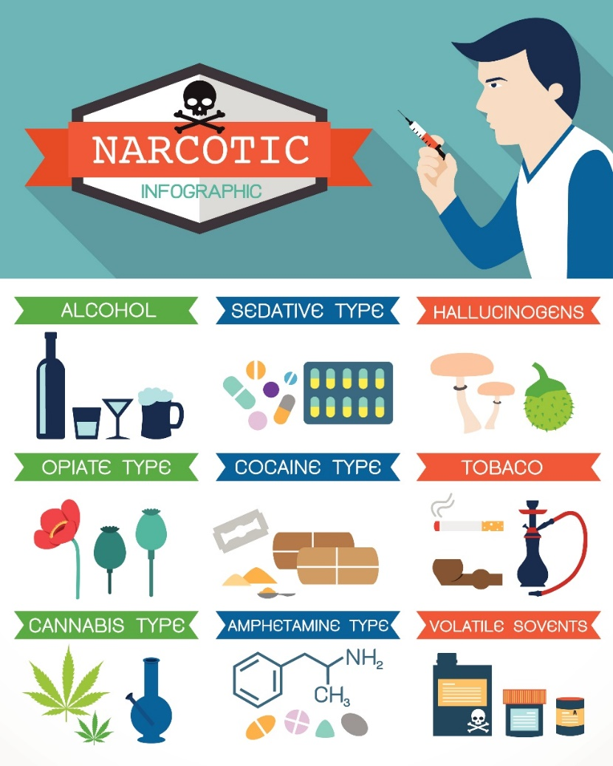
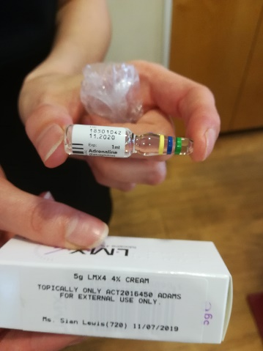
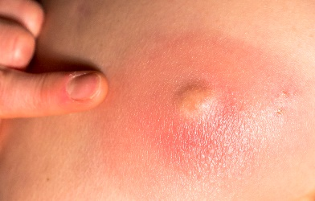
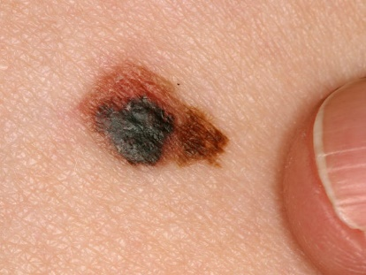
Contraindications
In Special Procedures a contraindication is where a procedure should not be undertaken on a client because it may be harmful to that person.

Slide 4
Goal - To undertake a special procedure safely and hygienically
Group Work
Discuss:
What should be included in the client consultation
The most effective way of undertaking this process
Responses to contraindications
Issues you have experienced in your business

Slide 5
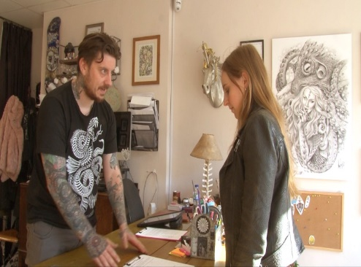
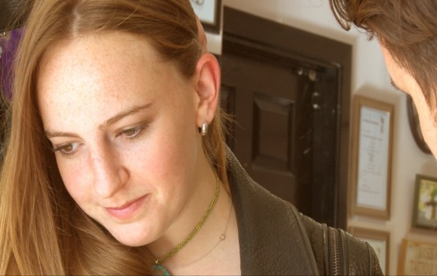
Good client consultations should include:
Clear explanations of the special procedure, the risks associated with that procedure and the contra-indications to the special procedure
Confirm the client listens, reads, understands the information provided
Ensure the client signs and dates the pre consultation form

Slide 6
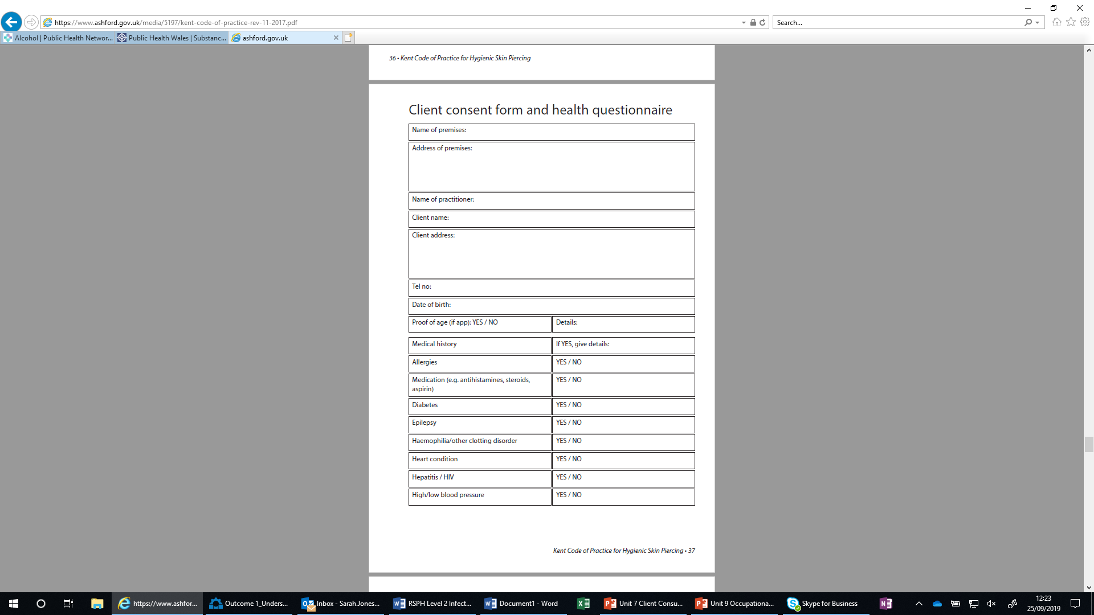
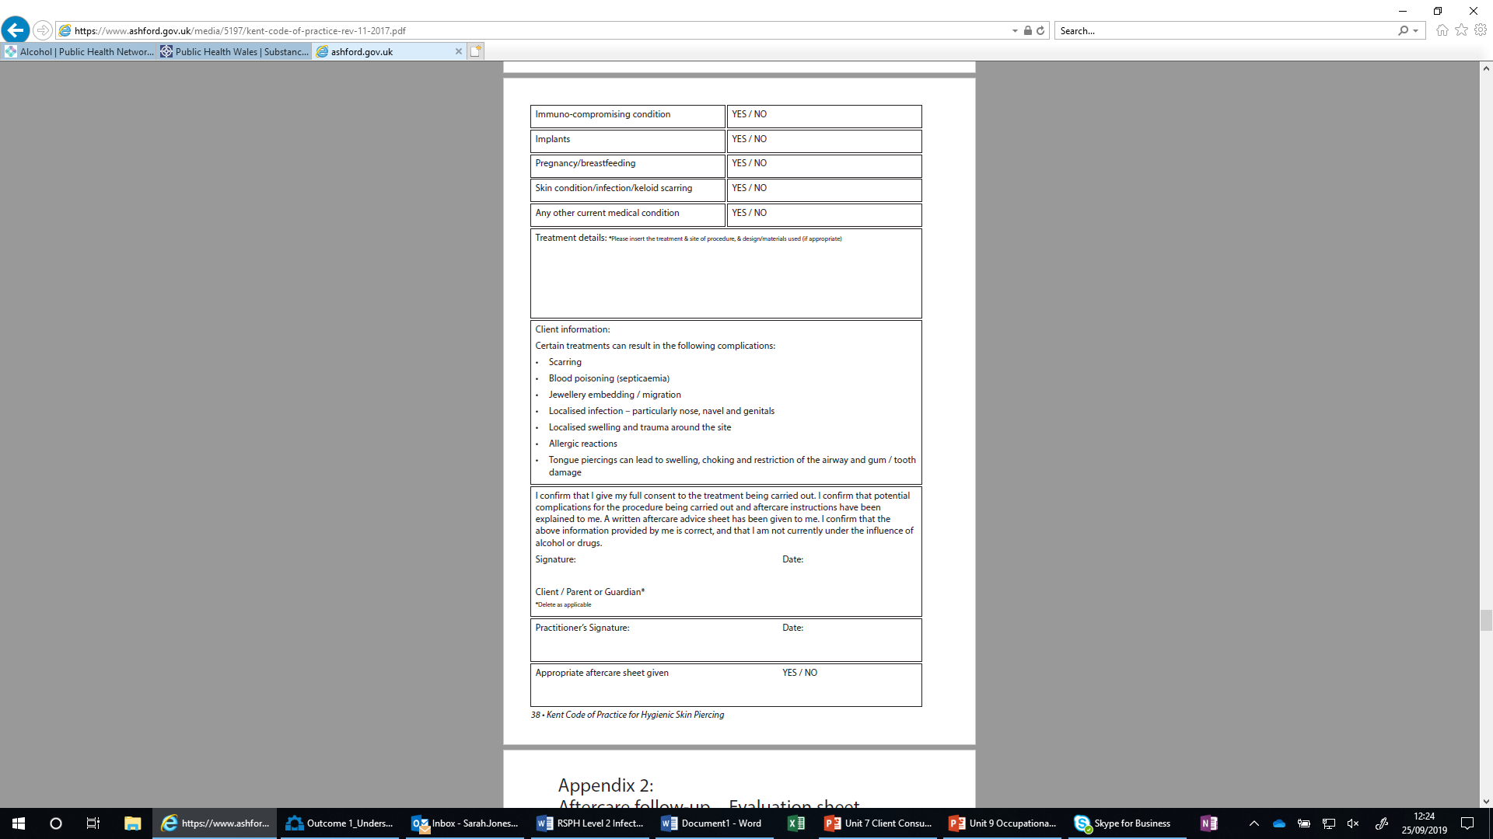
Kent code of practice for hygienic skin piercing

Slide 7
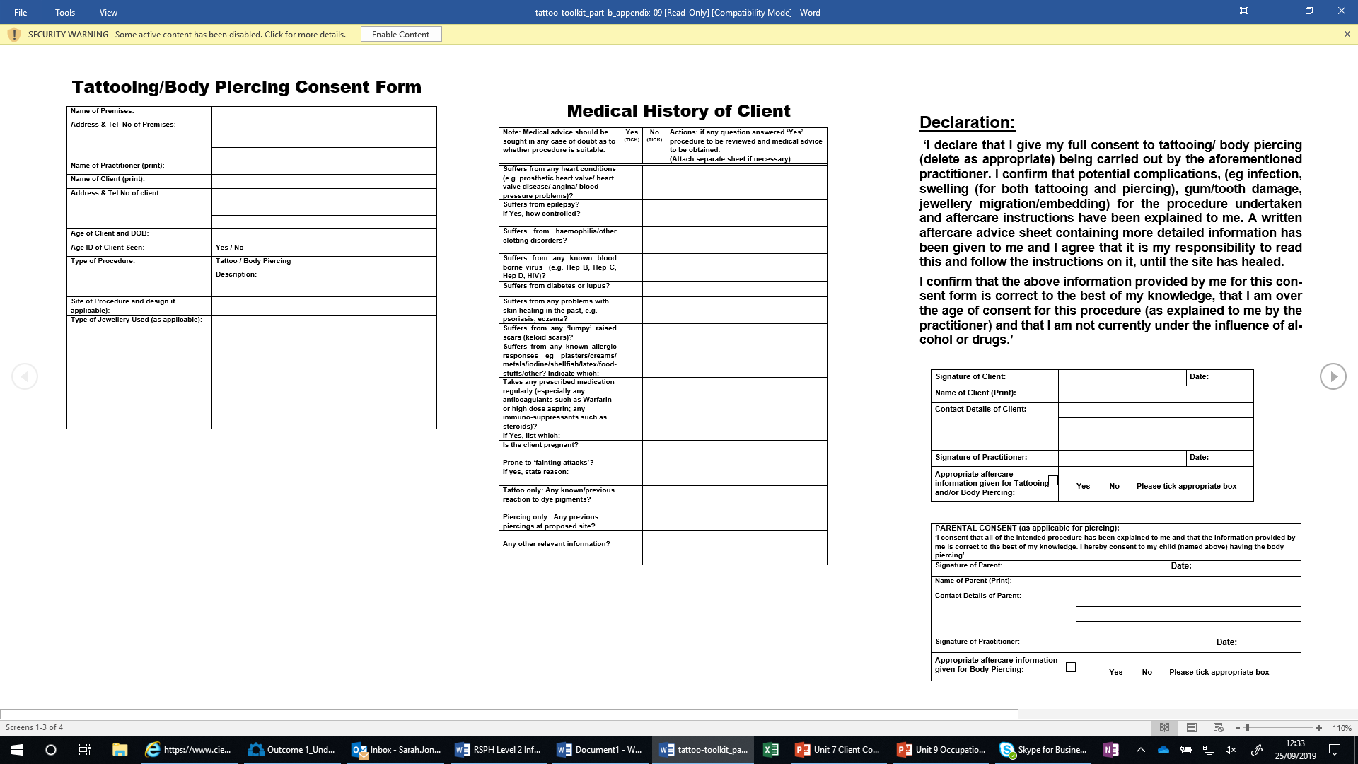
CIEH Toolkit 2013

Slide 8
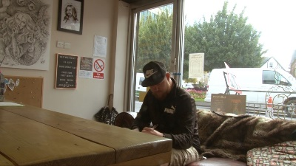
Client consultation challenges
Illiteracy
Dyslexia
Emotional or development needs
Cultural issues
Physical disabilities
Client recall
Dishonesty!
Remember
  Over the counter and prescribed medications
  Illicit and licit drugs

Slide 9
How can the age of a client be validated?

Slide 10
Client consultation case- studies
A client comes in for a pre arranged special procedure and you notice a strong smell of alcohol on her breath. What action do you take?
A 19 year old man comes in with his father requesting a tongue piercing. What action do you take?
A returning client who is a diabetic comes in for a prearranged special procedure. What action do you take? Would this action differ if this client was new? If so how?
An epileptic 20 year old lady comes in an acupuncture treatment for migraines. What action do you take?
A 30 year old man comes to your studio requesting a tattoo on his neck. What action do you take? You notice he has two moles in the area he wishes to have the tattoo how would you manage this?
A 23 year old lady has booked and appointment to have her eye brows micro bladed and you notice her eczema had flared on her face and hands. What action would you take?

Slide 11
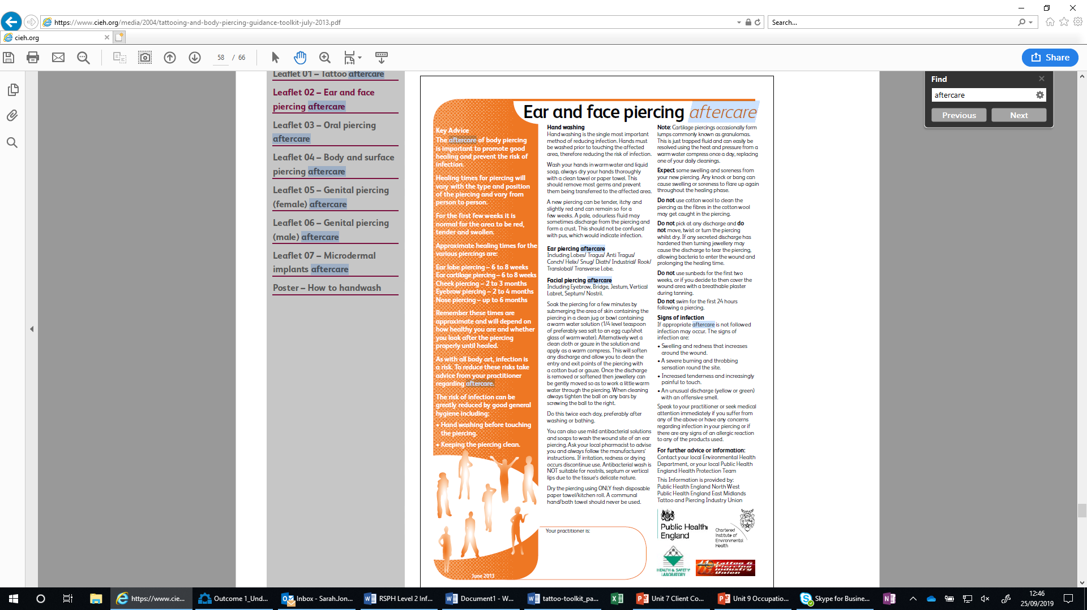
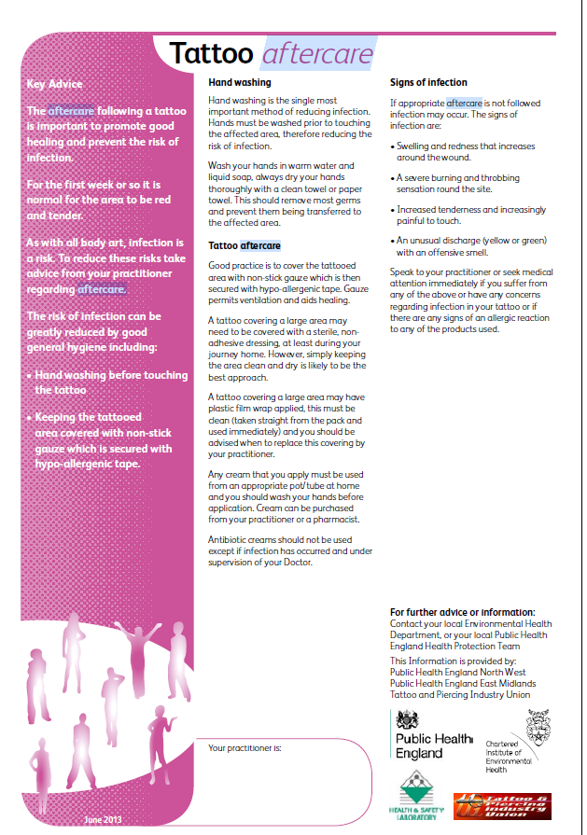
Aftercare advice and post client consultation

Slide 12
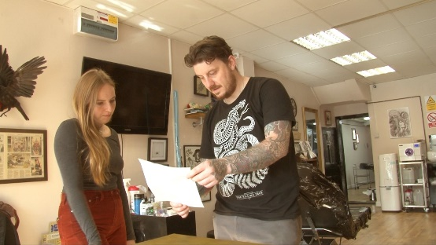
Client Aftercare
Know the difference between - The natural process of wound healing AND signs and symptoms of allergy or infection.
Simply and clear aftercare advice that
promotes good healing and reduces the risk of infection
Good communication

Slide 13

Aftercare - Promote good healing and reduce the risk of infection
Remember – the special procedure has compromised the integrity of the skin
Avoid cross infection
  Clean hands, avoid touching site of procedure, no high infection risk activities
Wound – moist or dry?
Apply appropriate cleaning solutions

Slide 14
Aftercare advice
Clear and concise advice must be given to the client.
In an easy to understand format
This should be given verbally and in written form (include the practitioner’s contact details).
Practitioners must satisfy themselves that the client has understood the aftercare advice
What are the challenges for Practitioners?

Slide 15
Admin and client records
Evidence
Good and retrievable record keeping
Assured security – client confidentiality
Age verification
Audit trail

Slide 16
Client Records
Maintain records for 3 years after the final procedure was performed
Name, address and contact details of the client
Date of birth (where required under the conditions of the licence)
Relevant medical history
Procedure undertaken, including position on the body
Name and licence number of the practitioner who carried out the procedure
Date and time when the procedure/s was undertaken
Details of any reported problems associated with the procedure
Copies of signed consent, client consultation and aftercare advice given

Slide 17
Summary
Circumstances when a client should not receive a special procedure
Correct action to be taken when a pre consultation form identifies a contradiction
Aftercare advice
Examples when a client should seek urgent medical attention
Client records
  Confidential
  Safe and secure
  Information on contraindications and special procedure details
  Age verification

Slide 18
True or False Quiz
Question | True or False
A practitioner refuses to undertake a special procedure on a new diabetic client until they have received a note from their GP. Is this response appropriate?
Client records must be maintained by the practitioner for marketing purposes
It’s only necessary to give verbal aftercare advice to a client following a special procedure
A client should not have a special procedure if the practitioner suspects they are under the influence of alcohol
Following a special procedure a client should seek urgent medical attention if the site of the procedure is slightly red and swollen
Special Procedure Practitioners should confirm a new clients age by checking and recording suitable identification documents
A client should not have a special procedure if they have Hepatitis B

Slide 19
True or False Quiz - Answers
Question | True or False
A practitioner refuses to undertake a special procedure on a new diabetic client until they have received a note from their GP. Is this response appropriate? | True
Client records must be maintained by the practitioner for marketing purposes | False
It’s only necessary to give verbal aftercare advice to a client following a special procedure | False
A client should not have a special procedure if the practitioner suspects they are under the influence of alcohol | True
Following a special procedure a client should seek urgent medical attention if the site of the procedure is slightly red and swollen | False
Special Procedure Practitioners should confirm a new clients age by checking and recording suitable identification documents | True
A client should not have a special procedure if they have Hepatitis B | False

