Slide 1


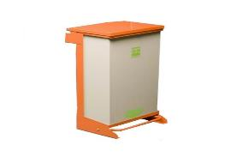
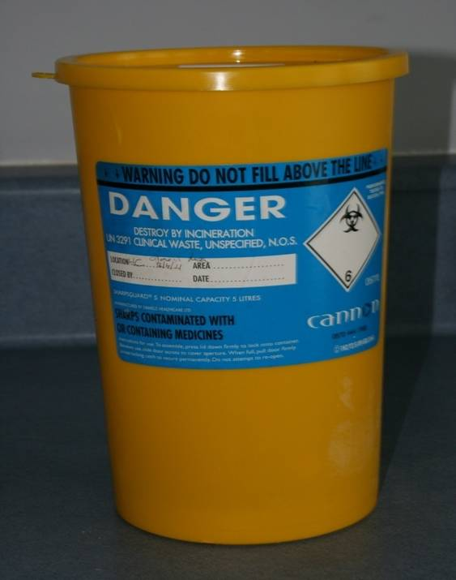
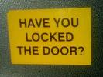
Section 14: Collection and Disposal of Waste
Sharps contaminated commercial
Minimising the risk of infection
location security frequency

Slide 2
Types of waste
Clinical or hazardous waste
  Sharps
Infectious
  Contaminated with body fluids
Offensive
  Contaminated with non-infectious body fluids
Commercial/domestic
  Anything else

Slide 3
Waste Policy
Premises should have a waste policy. This will support good infection prevention and control.
Ensure that contracts are in place for collection and safe disposal of waste from the premises.
Maintain relevant documentation.
Where necessary ensure with the waste management provider that appropriate documentation is generated.
Notes:
Sharps waste – hazardous waste
Infectious waste – contaminated with body fluids. Orange waste bags properly sealed collected by an approved agent
Offensive waste – contaminated with non-infectious body fluids. Yellow and black bags (Tiger bags) If less than 7kgs can be put into commercial/domestic black bag system. Otherwise approved waste collector

Slide 4
Instructions for Safe Disposal of Sharps
Dispose of sharps in purpose designed, yellow stream waste containers
Keep the waste container as close to the work area as possible to enable disposal at point of use.
Do not re-sheath needles before disposal.
Do not fill yellow stream waste containers beyond the fill line or exceed 4 kg in weight.
Once sealed, label the container to identify the source of the waste.

Slide 5
Sharps Containers
Notes:
Are they Labelled
Correct Assembly
Store out of clients reach

Slide 6
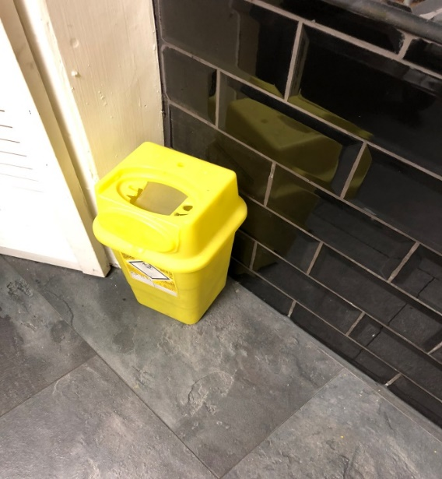
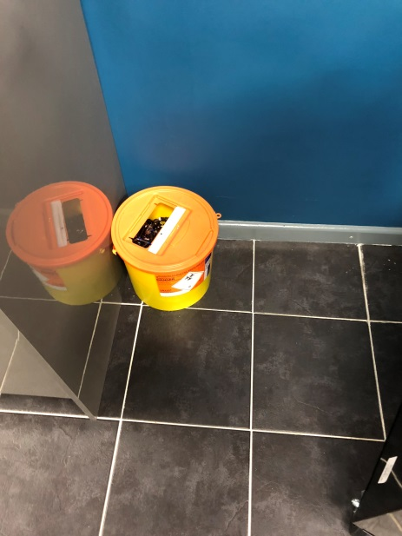
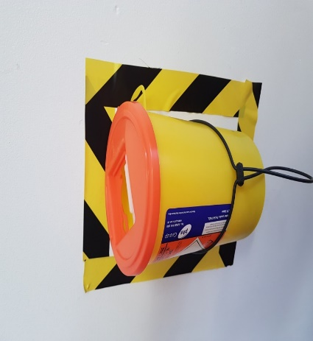
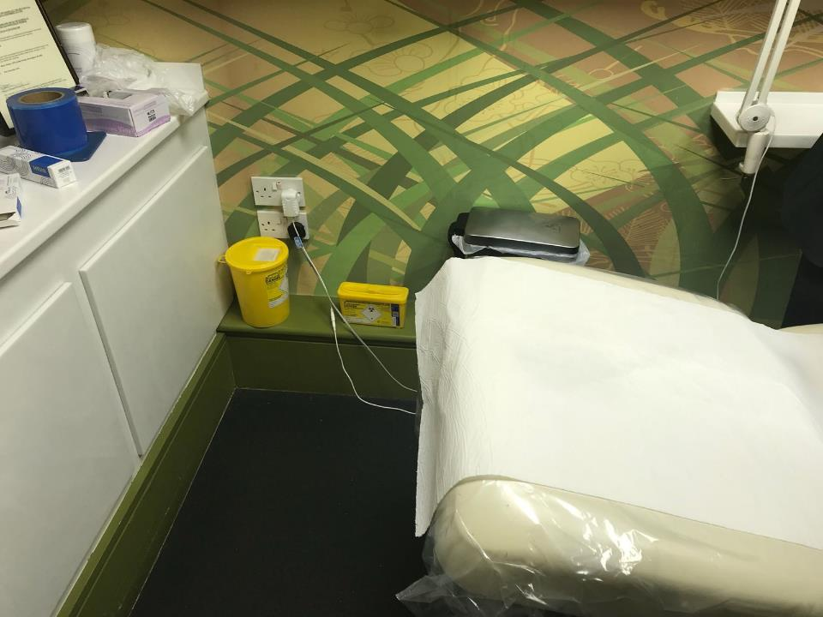
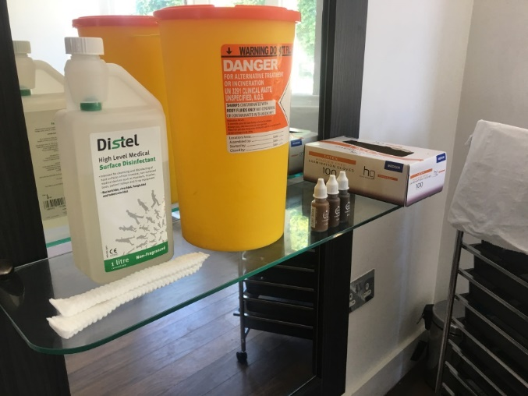
Sharp box locations

Slide 7
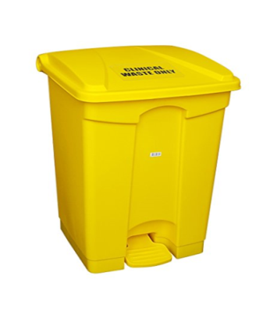
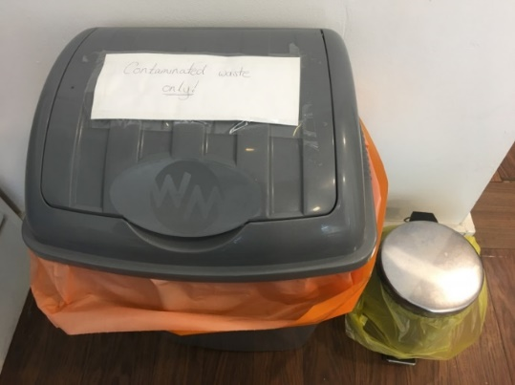
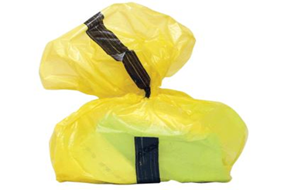
Managing waste – minimise the risk of contamination
Who’s responsible?
Sufficient number of bins
Location easily accessible and close to point of origin
Designated and secure storage
Bins - non hand operated, easily cleaned regularly emptied
Emptied when ¾ full
Double bagging
Notes:
Used gloves and aprons, swabs, small dressings, and cotton wool contaminated with body fluids would be considered as offensive/hygiene waste. This should be placed into a yellow/black bag (“tiger bag”) for disposal.

Slide 8
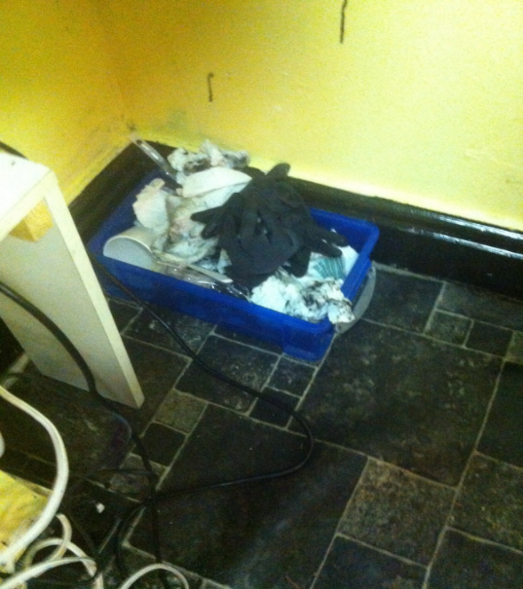
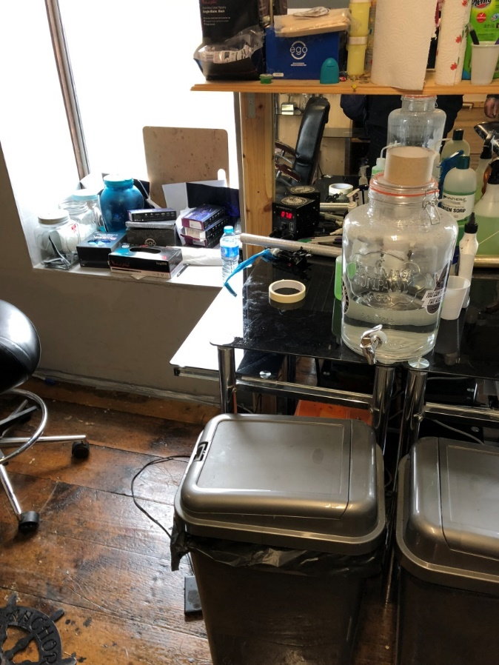
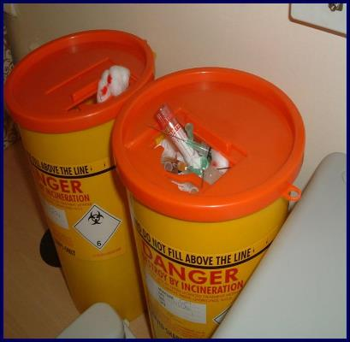
Poor practices

Slide 9
Summary
Non sharp waste
Clinical waste
Sharps box, location and safe of disposal of sharps waste
Double bagging where contaminated
Remove waste from treatment area regularly
Colour bags
Location of waste bins
Cleaning of waste bins

Slide 10
True or False Quiz
Question | True/False
A sharps box should be located on the floor in the treatment room
Waste should be removed from the treatment area on a regular basis
A good waste policy will increase the risk of infection in a special procedure business
Contaminated gloves are an example of clinical waste
Old consent form and receipts should be included as offensive waste
Hazardous waste should be stored in a secure location

Slide 11
True or False Quiz - answers
Question | True/False
A sharps box should be located on the floor in the treatment room | False
Waste should be removed from the treatment area on a regular basis | True
A good waste policy will increase the risk of infection in a special procedure business | False
Contaminated gloves are an example of clinical waste | True
Old consent form and receipts should be included as offensive waste | False
Hazardous waste should be stored in a secure location | True

