Slide 1
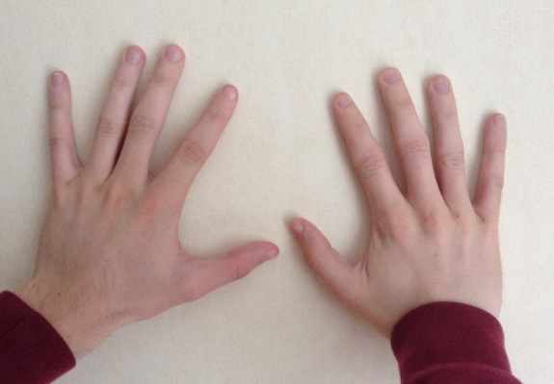
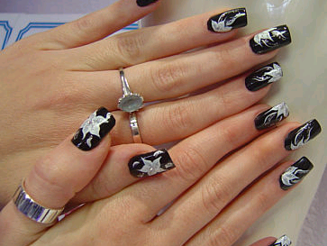
Section 8: Hand Hygiene Hands are the most important route for spreading infection
Hand Hygiene include methods that remove or destroy micro organisms
(hand washing and the appropriate use of alcohol based rubs)

Slide 2
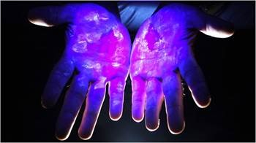
Hand Hygiene is important because it protects the client and practitioner from infections.
Resident and transient micro-organisms on the skin
Resident micro-organisms form part of your normal defence
Transient micro-organisms responsible for most infections associated with Special Procedures.
Transient micro-organisms are easily removed by good hand washing

Slide 3
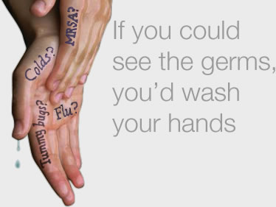
Food
Toilet
Mouth
Clients
Instruments
Fixtures and fittings
Clothes
Equipment
Taps
Work surfaces
Waste

Slide 4
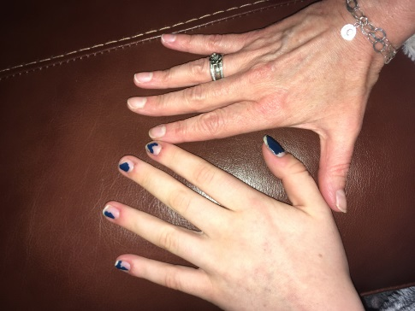
What increases the risk of hands transmitting infection?
Poor or infrequent hand washing
Long nails/artificial nails/varnished nails
Jewellery
Nail biting
Wounds that are not covered with a waterproof dressing

Slide 5
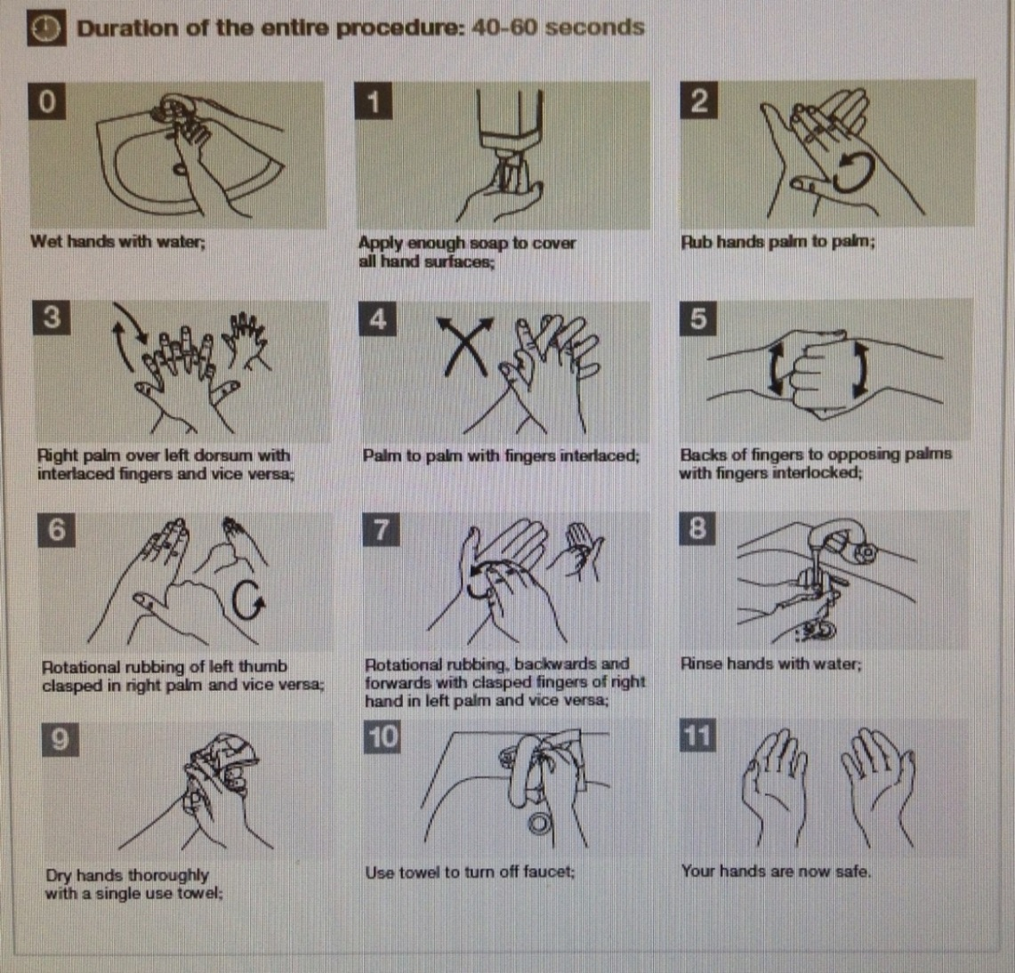
How to wash hands correctly
Wash hand basin
Hot and cold/warm water
Liquid/foam soap
Means of drying the hands (disposable paper towels preferable)

Slide 6
Don’t forget your forearms!!

Slide 7
Parts of the hand frequently missed during hand washing

Slide 8
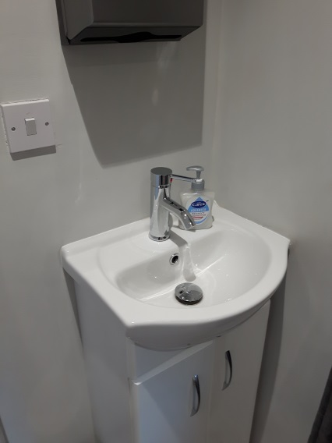
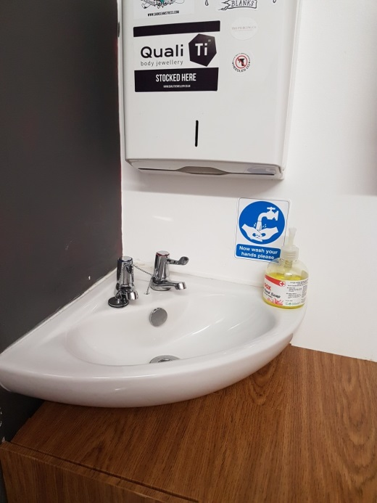
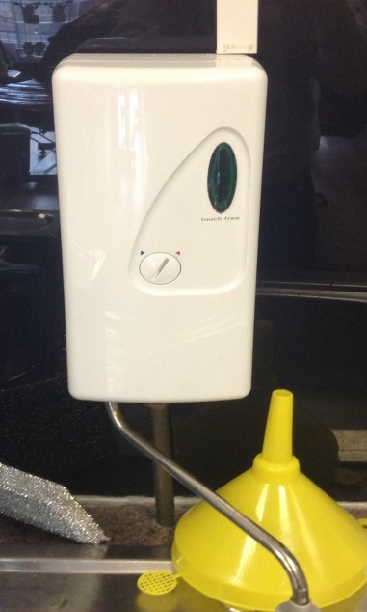
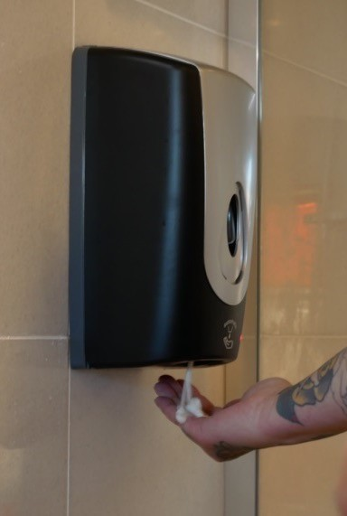
Examples of hand wash facilities
Any comments?

Slide 9
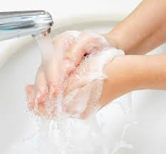
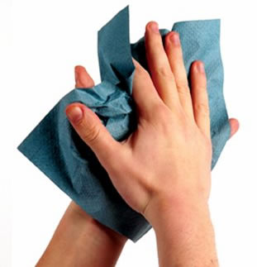
When to wash hands
Before putting gloves on at the start of a special procedure
Before and after eating and drinking
Before and after direct contact with a client
Before commencing work
After
Removing gloves and apron at the end of a procedure
Using the toilet
Handling contaminated items including waste
Smoking
Contact with blood or body fluids

Slide 10
5 Moments for Hand Hygiene
There are 5 moments (indications) when it is essential to perform hand hygiene

Slide 11
Time is a major obstacle for hand hygiene Make time!
Adequate hand washing with water and liquid soap: 40-60 seconds
(Average time adopted by health-care workers: <10 seconds)

Slide 12
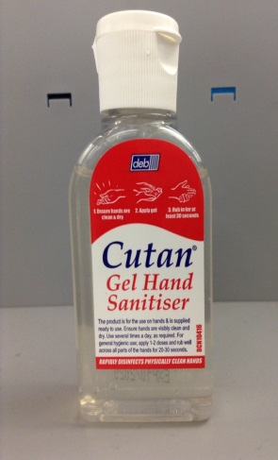
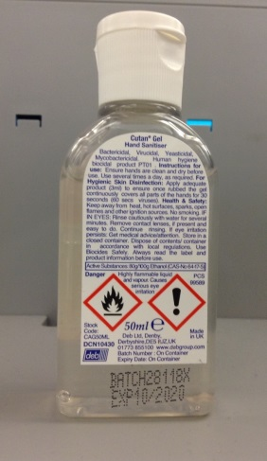
Use of alcohol hand rubs
Alcohol hand rubs make the hands hygienically clean by killing micro-organisms
In special procedures should be used as an addition to hand washing
BUT
They are not effective on dirty hands
They should never substitute hand washing
Alcohol rub must cover the whole hand using the same technique and hands rubbed until the alcohol has evaporated

Slide 13
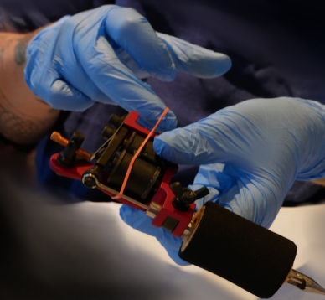
Hand hygiene and glove use
The use of gloves does not replace the need for cleaning your hands!
You should remove gloves to perform hand hygiene when the integrity of the gloves has been compromised
You should wear gloves only when indicated – otherwise they become a major risk for micro-organism transmission

Slide 14
What’s the purpose of gloves?
Practitioner and Client protection
Protects the hands of the practitioner from becoming contaminated with dirt and micro-organisms
This barrier protects the client from any micro-organisms harboured on the practitioner’s hands
By changing gloves, prevents transfer of micro-organisms from one client to another

Slide 15
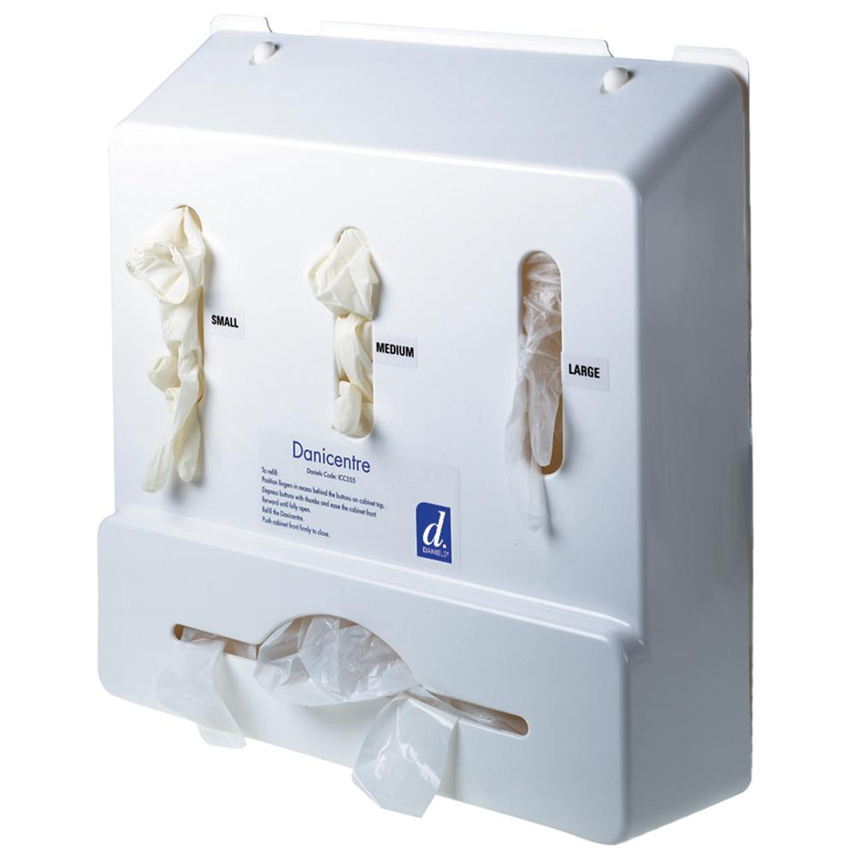
Gloves
Single use
Latex free
Powder free
Nitrile
Allergies
Don’t make gloves a vehicle of transmission in your business

Slide 16
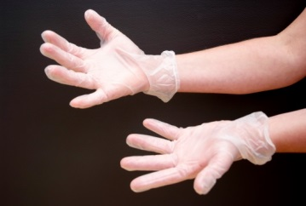
Glove Rules
Must be CE-marked for use with ‘biological agents’
Must be regarded as ‘single use’
Should be discarded as hazardous (clinical) waste after use
Put on immediately before client contact or procedure
Remove as soon as procedure is completed, or when leaving the client for any reason.
Change between different procedural activities for same client
Remove/replace if they become torn.
Should not be regarded as a substitute for good hand washing
Should be fit for purpose.

Slide 17
How to Don and Doff Gloves
http://www.hse.gov.uk/skin/videos/gloves/removegloves.htm
Removing single-use gloves without contaminating your hands [WMV 22.7MB

Slide 18
Summary
Hands are the most important route for spreading infection
Hand washing is one of the most important and effective infection control practices.
‘Washing hands’ includes wrists and forearms
Hand hygiene includes hand washing and using alcohol-based hand rubs
Hand wash basins require: non hand operated taps, liquid/foam soap, hot and cold water, disposable paper towels
Gloves must not be a substitute for good hand hygiene.
The use of hand rubs must not replace hand washing
Fingertips, in between fingers, thumbs and backs of hands are often missed when washing hands
THINK – when should I wash my hands/use hand rub? When should I use gloves?

Slide 19
True or False Quiz
Question | True or False
Hand washing removes micro-organisms from hands.
Alcohol based hand rubs work effectively on visually dirty hands
It is acceptable for practitioners to have long nails if they wear gloves.
Gloves should be CE marked for the use of ‘biological agents’
Alcohol based hand rubs are an effective substitute for hand washing
Gloves are an example of a ‘single use’ item
Correct hand washing takes between 10 – 15 seconds

Slide 20
True or False Quiz - answers
Question | True or False
Hand washing removes micro-organisms from hands. | True
Alcohol based hand rubs work effectively on visually dirty hands | False
It is acceptable for practitioners to have long nails if they wear gloves. | False
Gloves should be CE marked for the use of ‘biological agents’ | True
Alcohol based hand rubs are an effective substitute for hand washing | False
Gloves are an example of a ‘single use’ item | True
Correct hand washing takes between 10 – 15 seconds | False

Slide 21
Exercise Parts of hands frequently missed during hand washing

Slide 22
Parts of the hand frequently missed during hand washing

