Slide 1
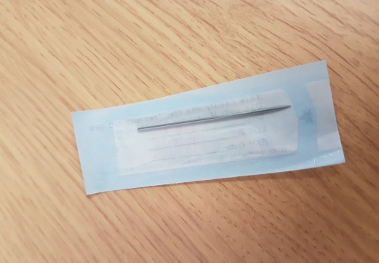
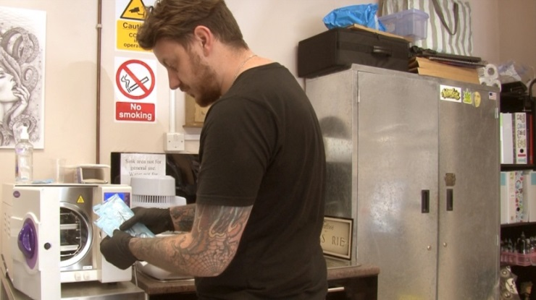
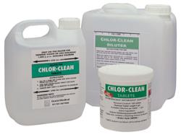
Section 11: Cleaning, Disinfection and Sterilisation

Slide 2
Key Definitions
Cleaning
‘removes dirt, grease, organic matter and micro organisms from a surface or item’
Disinfection
‘reduces/destroys micro organisms to a safe level’ - reduces the number of micro organisms
Sterilisation
‘Destroys all their micro organisms and spores’ – renders a surface/item free from all living organisms.
Without prior cleaning, disinfection and sterilisation will NOT be effective - Why?
Notes:
Removes microorganisms and organic matter that maybe protect micro organisms or in the case of disinfection deactivate the disinfectant.

Slide 3
Associated definitions
Detergent: A product that dissolves and removes dirt and grease
Sanitiser: A product that removes dirt and grease and reduces microorganisms to a safe level
Disinfectant: A product that reduces microorganisms to a safe level
Antiseptic: A substance that kills pathogenic microorganisms
Sterile: Free from microorganisms and their spores
Sterilant: A product that destroys all microorganisms and their spores
Aseptic: A procedure used to avoid the introduction of pathogenic organisms into the body site or onto an invasive device

Slide 4
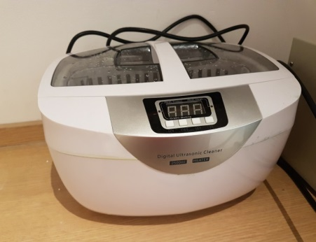
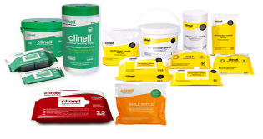
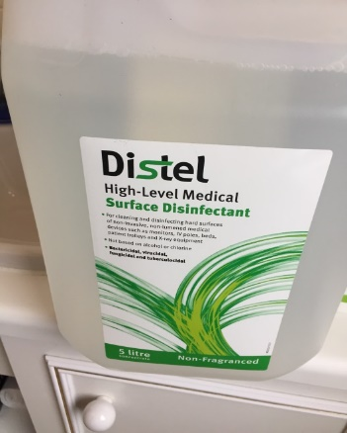
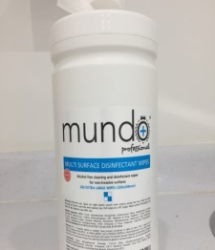
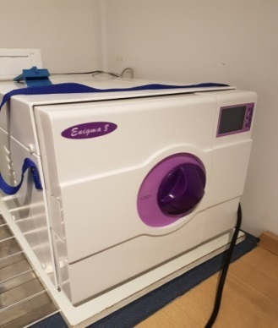
How do we achieve these processes in Special Procedures?
Cleaning
Physical action
Detergents/degreasers
Ultrasonic cleaners
Disinfection
Chemical
Heat/thermal
Sterilisation
Steam under pressure (autoclave)
Cold sterilisation?
Notes:
Colour coded equipment
Detergent and water
Detergent wipes
Drying
No sweeping brushes
Damp dust
Cleaning schedules

Slide 5
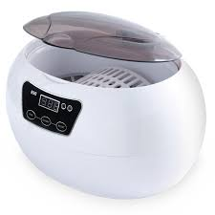
Ultrasonic cleaning
Operate using a process called cavitation – bubbles are generated that vibrate within the liquid bath, attacking every surface including recessed and hollow areas
Items must be submerged in the detergent, then rinsed and dried using a clean, disposable towel.
Periodic testing of the machine is required
Machine should be used in accordance with manufacturers instructions
This is an efficient method of cleaning instruments and small pieces of equipment.

Slide 6
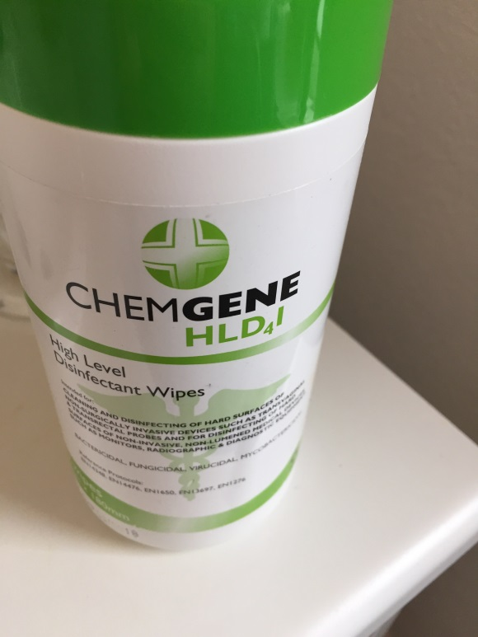
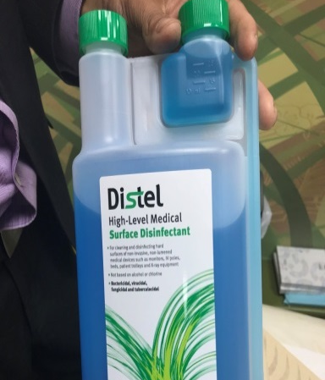
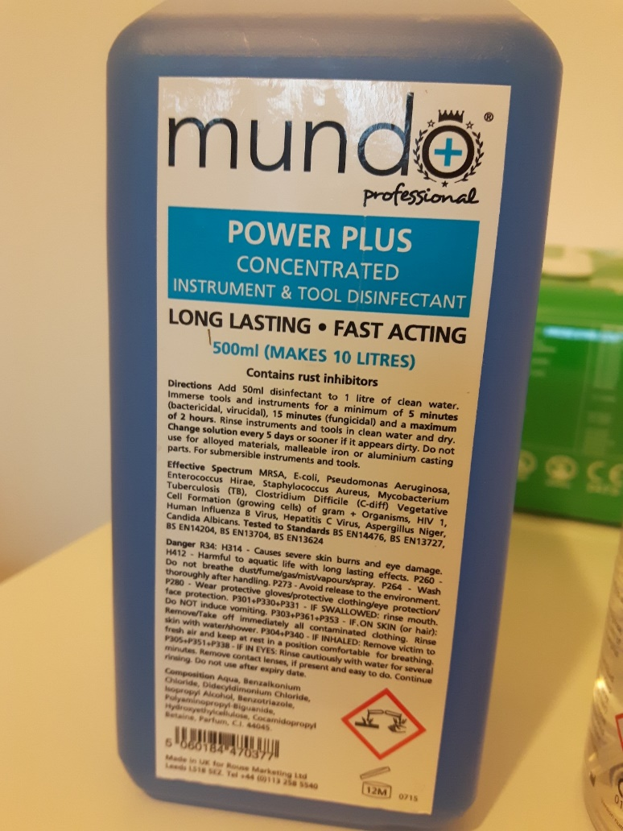
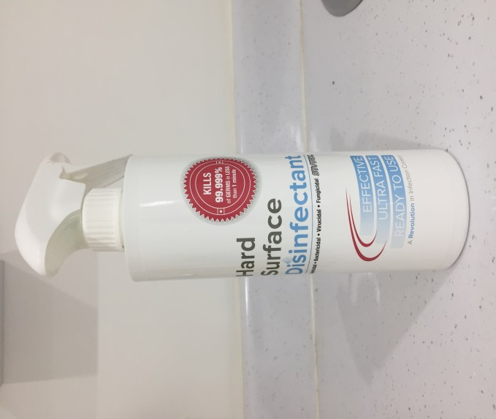
Disinfectants - Examples

Slide 7
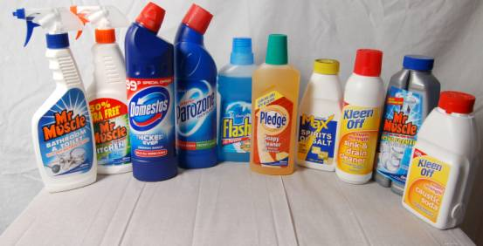
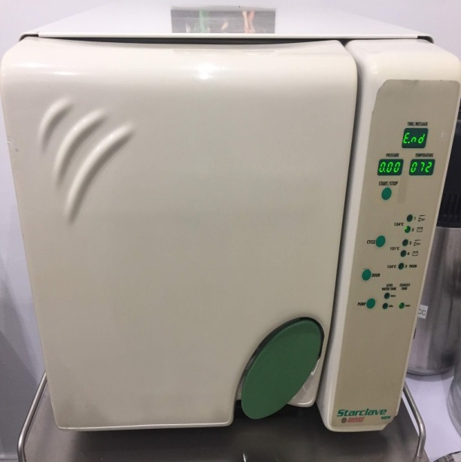
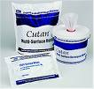
The decision to clean, disinfect or sterilise is based on the risk of infection
Discuss which surfaces, equipment and instruments in a special procedures environment should be routinely:
Cleaned
Disinfected
Sterilised

Slide 8
When would you disinfect a floor or walls?
Clean, disinfect or sterilise?
Clean | Disinfect | Sterilise
Floors | Client chair/couch | Invasive equipment
Walls | Work station surfaces | Needles
Bins | Hand contact surfaces | Jewellery
Ceilings | Non invasive equipment | Ink/pigment

Slide 9
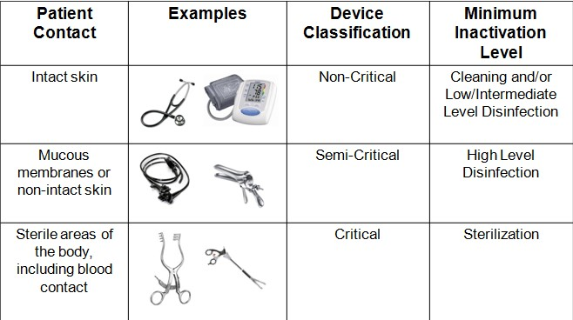
Risks of infection determine whether cleaning, disinfection and/or sterilisation is required
HIGH
Anything that enters a normally sterile body area or is in contact with a break in the skin or mucous membrane
MEDIUM
Anything in contact with intact mucous membrane
LOW
Anything in contact with intact skin
MINIMAL
Items not in close contact with people or their immediate surroundings

Slide 10
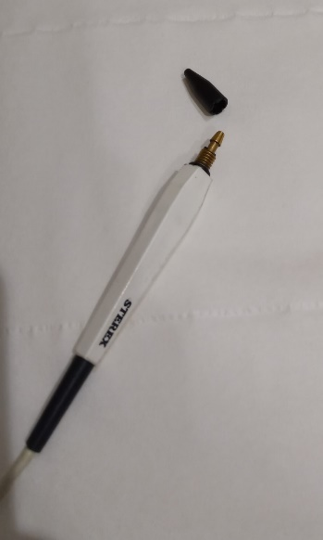
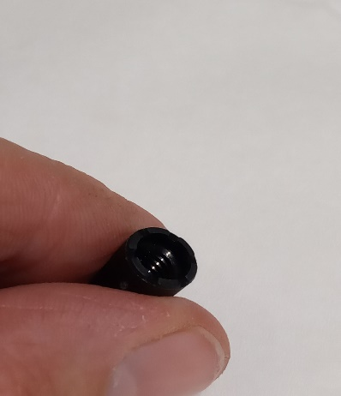
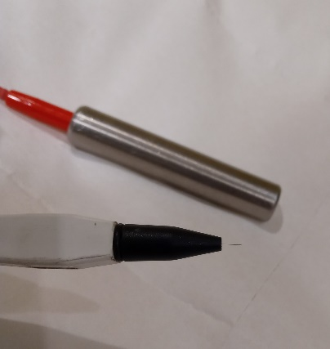
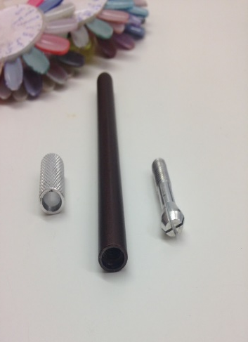
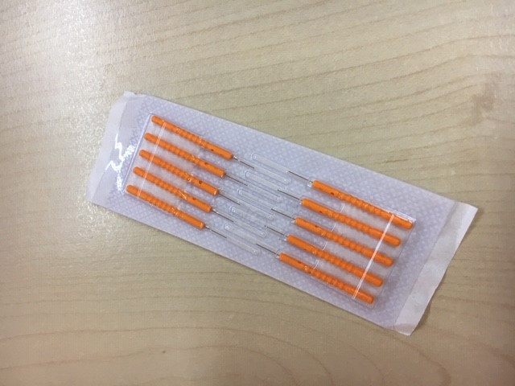
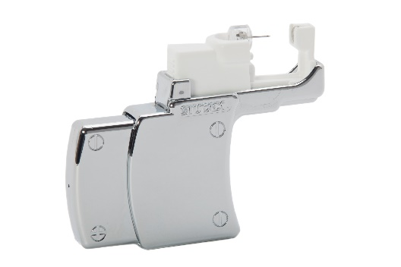
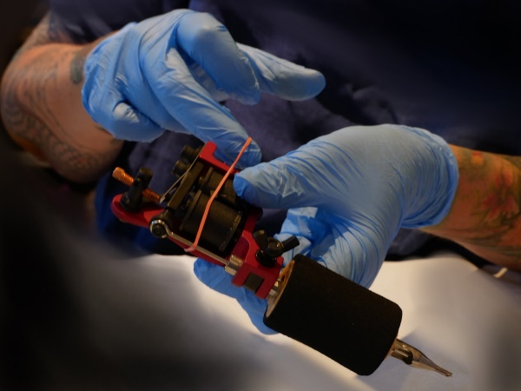
Equipment: Disinfection, sterilisation or single use

Slide 11
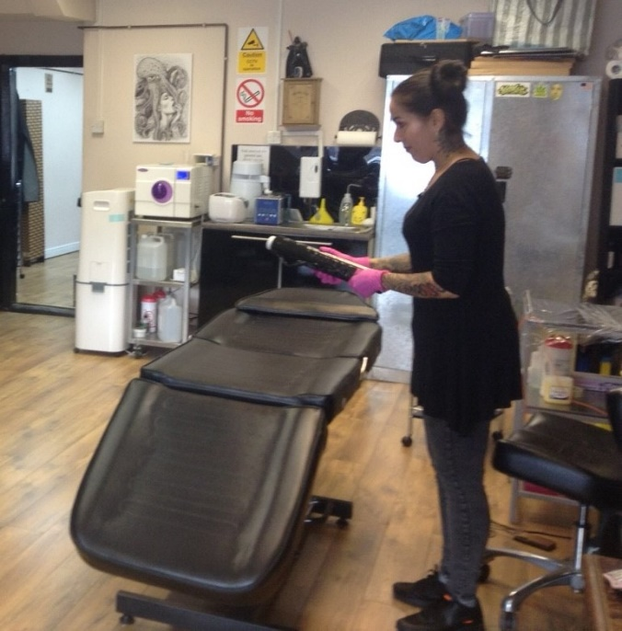
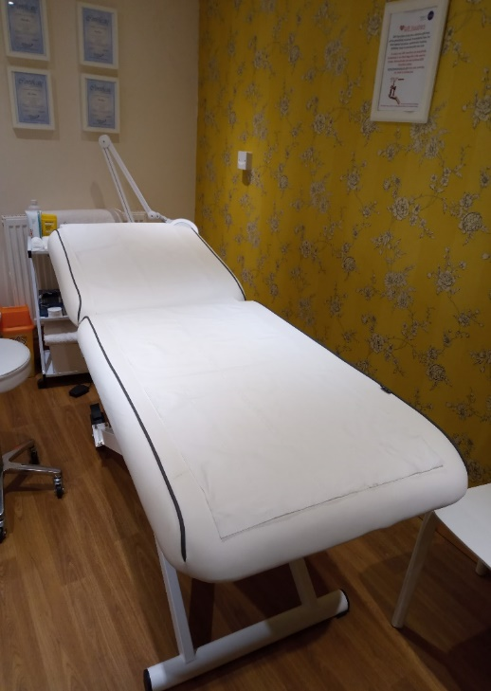
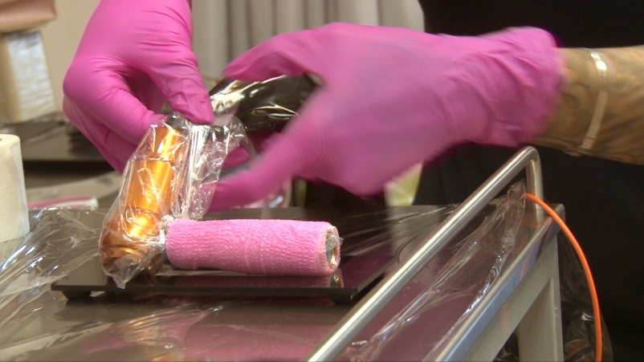
Barrier precautions – in addition to cleaning and disinfection
Notes:
Covering a client chair with cling film – does this create another infection risk?
Possibly creates an ideal environment for microbial growth? Warmth/food/moisture/time

Slide 12
Sterilisation intended for re-useable items used to pierce a person’s skin/come in contact with broken skin
Items include – clamps, forceps, jewellery, grips, tubes
Non-vacuum autoclaves – solid unwrapped instruments
Sterilised items remain sterile for 3 hours or until the door is opened
Vacuum autoclaves – hollow or wrapped items
Items are sterilized in a vacuum steam steriliser (with a drying cycle) Type S or N
sterilised items that are wrapped will remain sterile as long as the wrapping remains in tact and dry

Slide 13
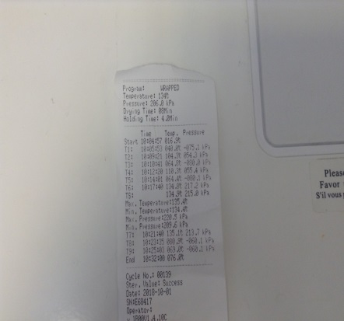
Autoclaves
Vacuum autoclaves
Use in accordance with manufacturers instructions
Install, commission, validate and maintain in accordance with manufacturers instructions
134°C for 3 minutes
Use distilled or sterile water
Daily checks and weekly testing required

Slide 14
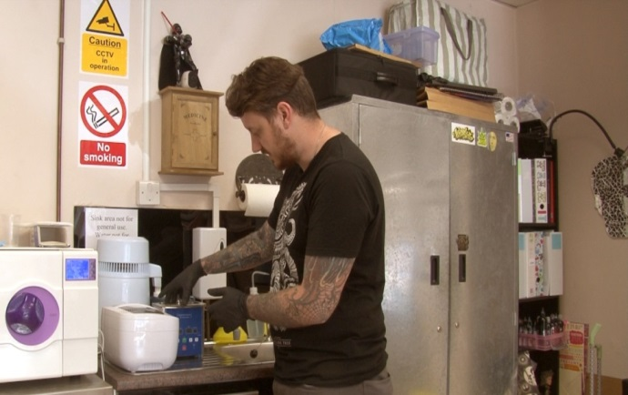
Sterilisation and autoclave use
Notes:
What about ‘cold sterilisation’? And of course ‘single use sterile’ instruments –needles are a solution to using autoclaves

Slide 15
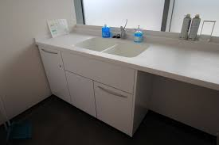
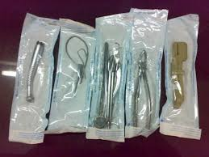
Decontamination
& Sterilisation of re-useable equipment
Designated equipment sink
Ultra-sonic water bath
Verification strips
Sterilized equipment
Vacuum autoclave

Slide 16
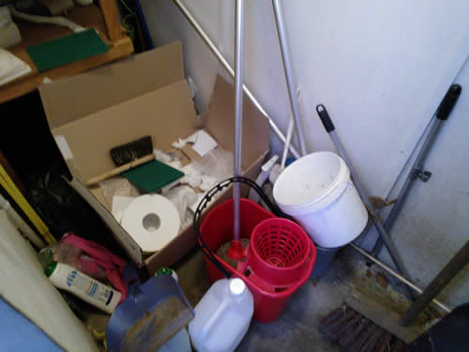
Common problems/compromises
Dilution rates and contact times
Incorrect application e.g. an aerosolised spray used to clean/disinfect a work surface
Manufacturers instructions not followed
Poor maintenance of equipment
Post contamination/cross infection
Needs to be a clear flow from ‘dirty’ to ‘clean’
Designated storage area
Cleaning equipment cleaned and disinfected

Slide 17
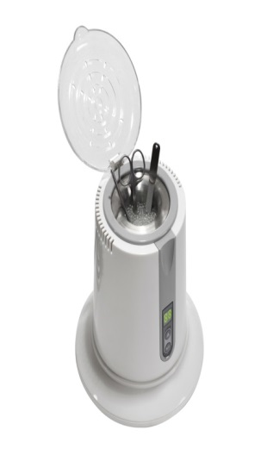
Poor practices associated with re useable equipment/instruments
Rinsing with boiling water
Antibacterial wipes
UV Boxes
Glass bead sterilisers and dry heat sterilizers
Barbicide soaking
General lack of awareness on decontamination & sterilisation stages

Slide 18
Cleaning Schedules National Colour Coding Scheme
Scheduled cleaning
‘Clean as you go’
2 stage cleaning

Slide 19
Cleaning schedule
Should include the following:
Who?
What?
Where?
When?
How?
Usage | Dilution of stock solution | Example dilution | Available Chlorine
 |  |  | % | Parts per Million (PPM)
Blood Spillages | 1 in 10 | One part hypochlorite to 10 parts water, e.g. 10 ml hypochlorite in 100ml water | 1.0 | 10,000
Environmental Disinfection | 1 in 100 | One part hypochlorite to 100 parts water, e.g. 10 ml hypochlorite in 1000ml (1 litre) water | 0.1 | 1,000

Slide 20
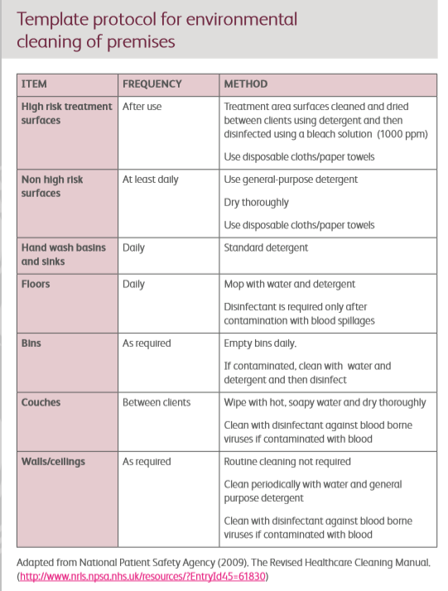

Slide 21
Summary (1)
Cleaning. Disinfection. Sterilisation.
Detergent
Disinfection
Santiser
Sterilant
Autoclaves (vacuum and non vacuum) 134°C for 3 mins
Ultrasonic cleaners
Contact times and dilution rates
2 stage cleaning
Manufacturers instructions!

Slide 22
Match the correct answer to the sentence
Question | Answer
Disinfectant | always follow the manufacturers instructions
Sterilisation | involves cleaning and disinfection
‘contact time’ refers to | clean at regular intervals
The purpose of a cleaning schedule is to | destroys all microorganisms and their spores
How can Practitioners make sure that a detergent is used properly? | the time that a substance should be left of a surface in order to work properly
Two stage cleaning | reduces micro organism to a safe level

Slide 23
Answers
Question | Answer
Disinfectant | reduces micro organisms to a safe level
Sterilisation | destroys all microorganisms and their spores
‘contact time’ refers to | the time that a substance should be left on a surface in order to work properly
The purpose of a cleaning schedule is to | clean at regular intervals
How can Practitioners make sure that a detergent is used properly? | always follow the manufacturers instructions
Two stage cleaning | involves cleaning and disinfection

Slide 24
True or False Quiz
Question | True or False
It is not necessary to clean a surface before applying a disinfectant
An ultra sonic cleaner can be used to clean and sterilise instruments
An autoclave uses steam under pressure to sterilise equipment
Non vacuum autoclaves are only suitable for wrapped or hollow instruments
Using an autoclave effective sterilisation requires equipment to be held at 134°C for 3 minutes
An ultrasonic cleaner uses sound waves to clean equipment
A cleaning schedule should include the frequency of cleaning, the product to be used, the method of cleaning and the person responsible for the task

Slide 25
True or False Quiz - answers
Question | True or False
It is not necessary to clean a surface before applying a disinfectant | False
An ultra sonic cleaner can be used to clean and sterilise instruments | False
An autoclave uses steam under pressure to sterilise equipment | True
Non vacuum autoclaves are only suitable for wrapped or hollow instruments | False
Using an autoclave effective sterilisation requires equipment to be held at 134°C for 3 minutes | True
An ultrasonic cleaner uses sound waves to clean equipment | True
A cleaning schedule should include the frequency of cleaning, the product to be used, the method of cleaning and the person responsible for the task | True

