Slide 1


Section 4:
Common non-infectious hazards and their sources
‘Hazards which cannot be spread from one person to another and are caused by genetics, lifestyle and environmental exposures’

Slide 2
Non infectious hazards
Allergic reactions
  ‘An allergy is a condition caused by over reaction of the immune systems to a normally harmless substance’
Keloid and hypertrophic scarring
Physical injuries
Contra indications
  ‘Specific situations in which a procedure should not be undertaken because it may be harmful to the client’.

Slide 3
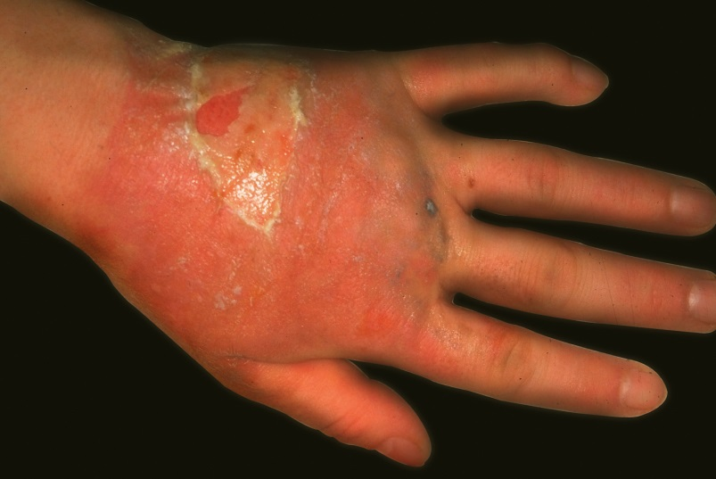
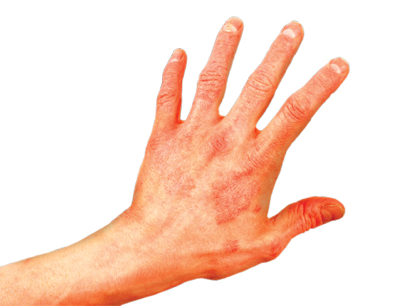
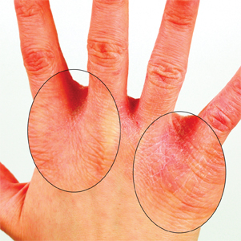
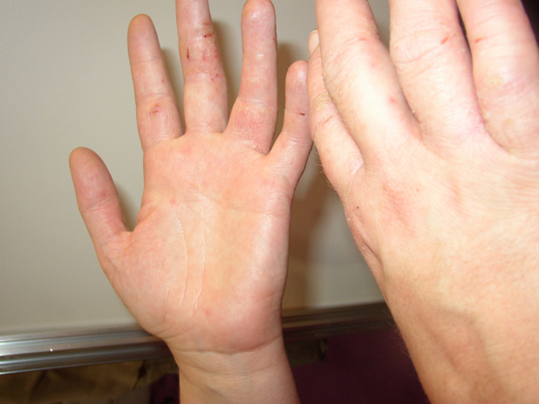
Allergic reactions
Red and itchy, swollen and blistered, dry and bumpy. Generally confined to site of contact
‘Contains public sector information published by the Health and Safety Executive and licensed under the Open Government Licence’.

Slide 4
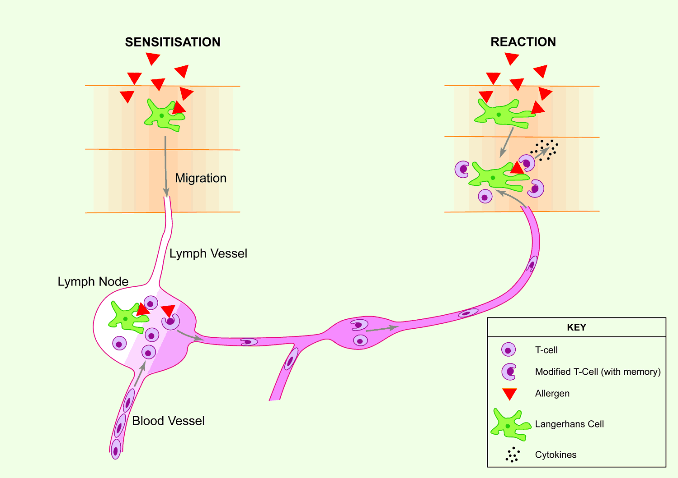
Allergic reaction
‘Contains public sector information published by the Health and Safety Executive and licensed under the Open Government Licence’.

Slide 5
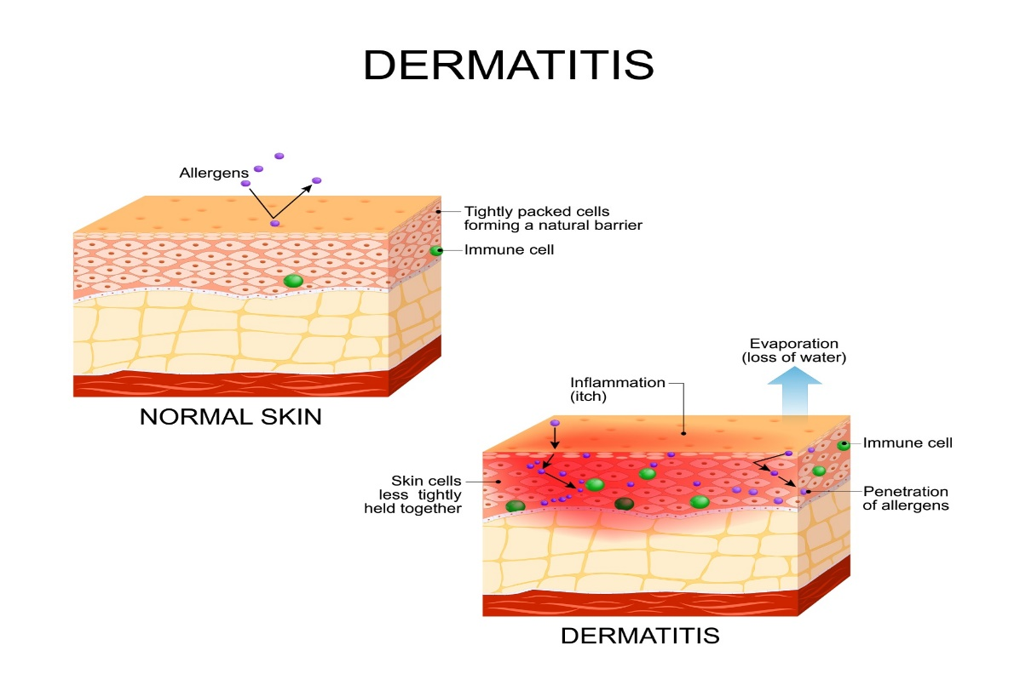
Dermatitis - What is it?
Inflammation of the skin
It can affect all parts of the body, but it is most common to see the hands affected.
Two types
  Irritant - single heavy dose or prolonged exposure
  Allergic - repeated exposure, sensitisation
Notes:
Nearly 90 % of dermatitis cases in cleaners is of the irritant type (as reported to EPIDERM by dermatologists 2002-2004).

Slide 6
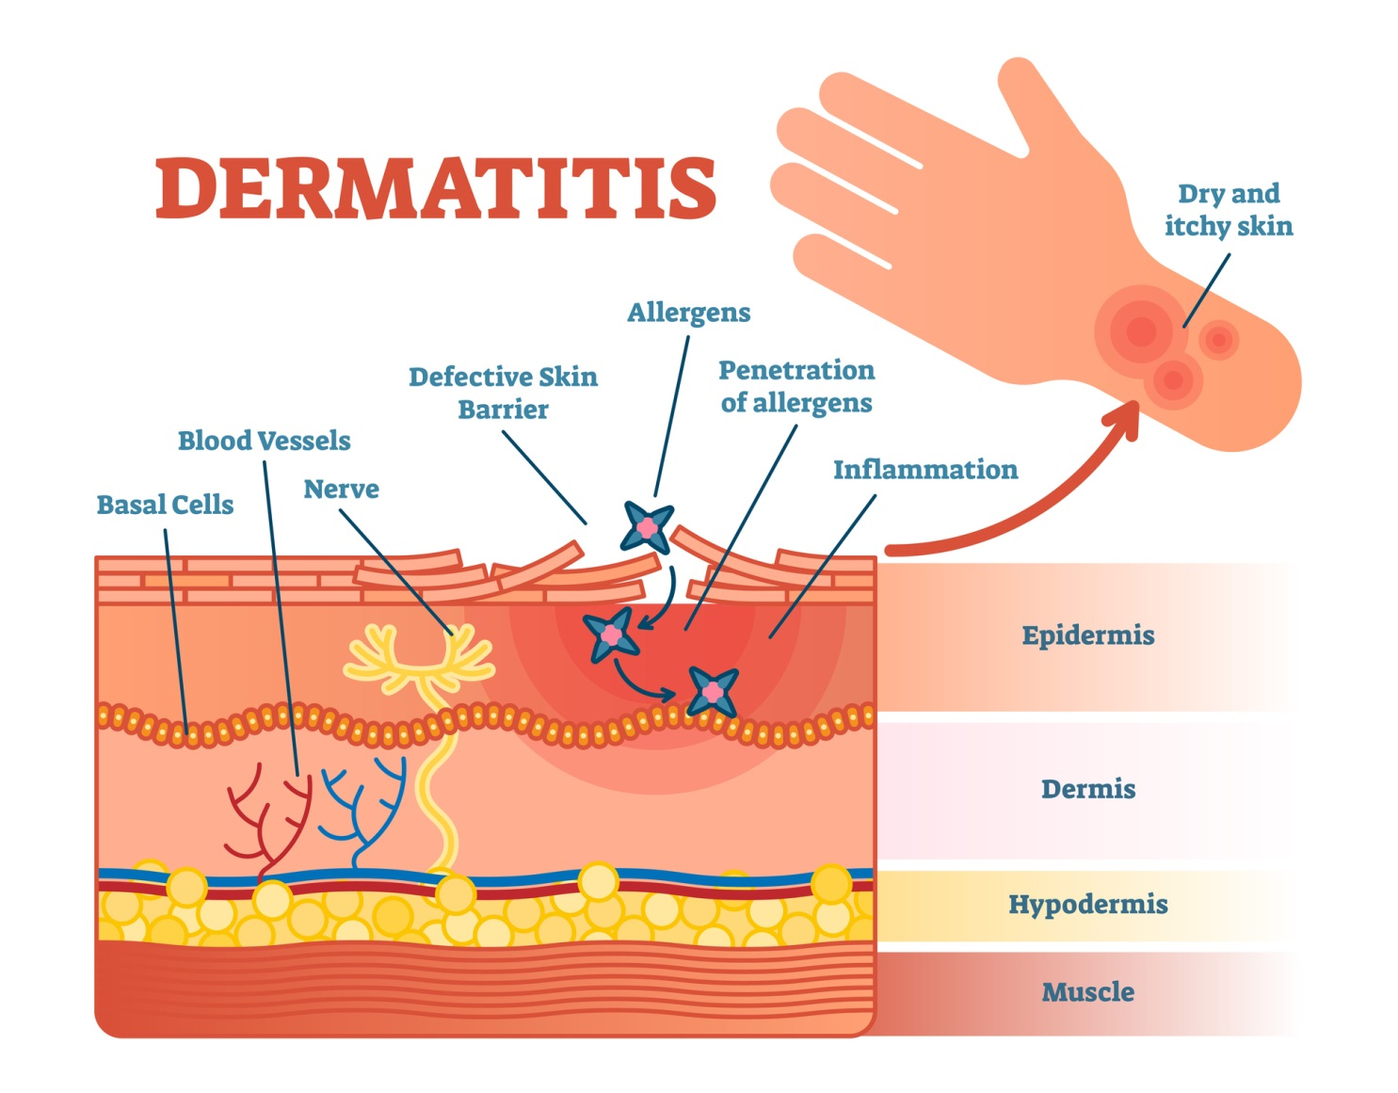

Slide 7
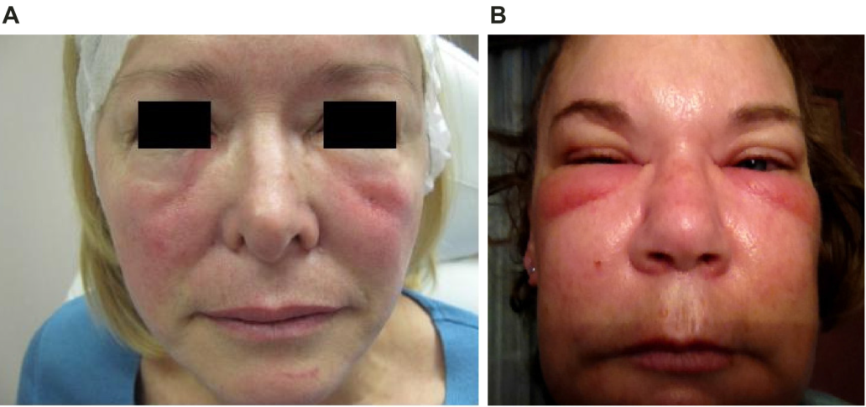
Angioedema
Angioedema is a skin reaction most often characterised by an abrupt and short-lived swelling of the skin and mucous membranes. All parts of the body may be affected but swelling most often occurs around the eyes and lips. In severe cases, the internal lining of the upper respiratory tract and intestines may also be affected.
Source: Clinical, Cosmetic and Investigational Dermatology, 2013

Slide 8

Anaphylactic shock is a severe allergic response that maybe triggered in sensitive individuals by a normally harmless substance

Slide 9

https://www.nhs.uk/conditions/anaphylaxis/

Slide 10

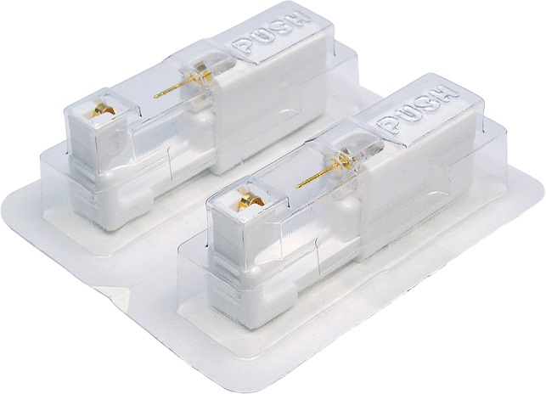
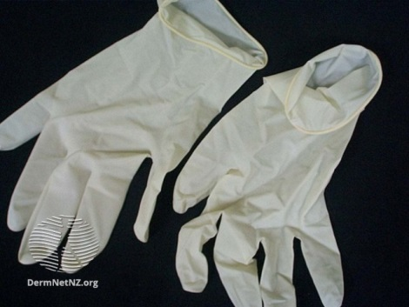
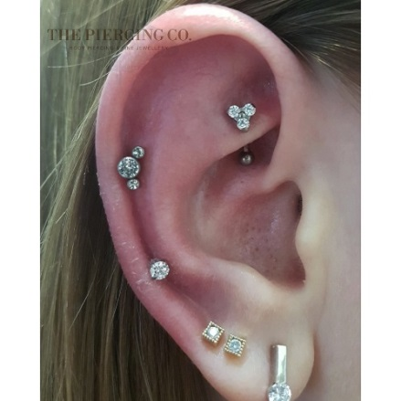
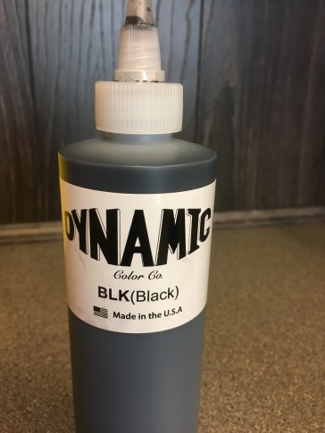
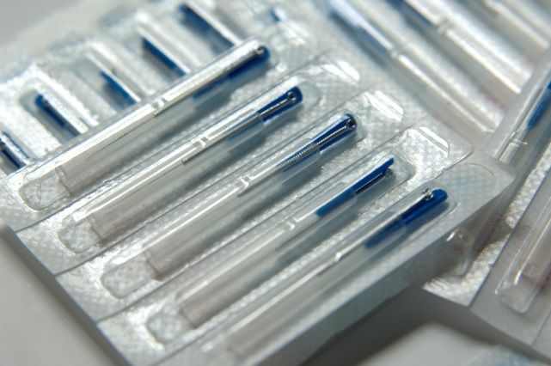
Allergies - sources

Slide 11
Allergens - Routes of contamination
Direct contact (accidental or otherwise)
  washing/shampooing hair with bare hands
Direct handling
  handling equipment soaked in chemicals
Indirect handling
  Contaminated surfaces
  clothing/tools/containers
Splashing
  mixing/handling inks
  Depositing
  aerosols/dust

Slide 12
Allergies: Minimising risks
Thorough pre consultation with client
Awareness and avoidance
PPE
Skin patches
Sourcing products and equipment from reputable suppliers
Good hygiene practices

Slide 13
Case studies
A client thinks they maybe allergic to cobalt
A client says they think they are allergic to condoms
A client advises you that they have an allergy to gold
In each example discuss your thought process and actions?

Slide 14
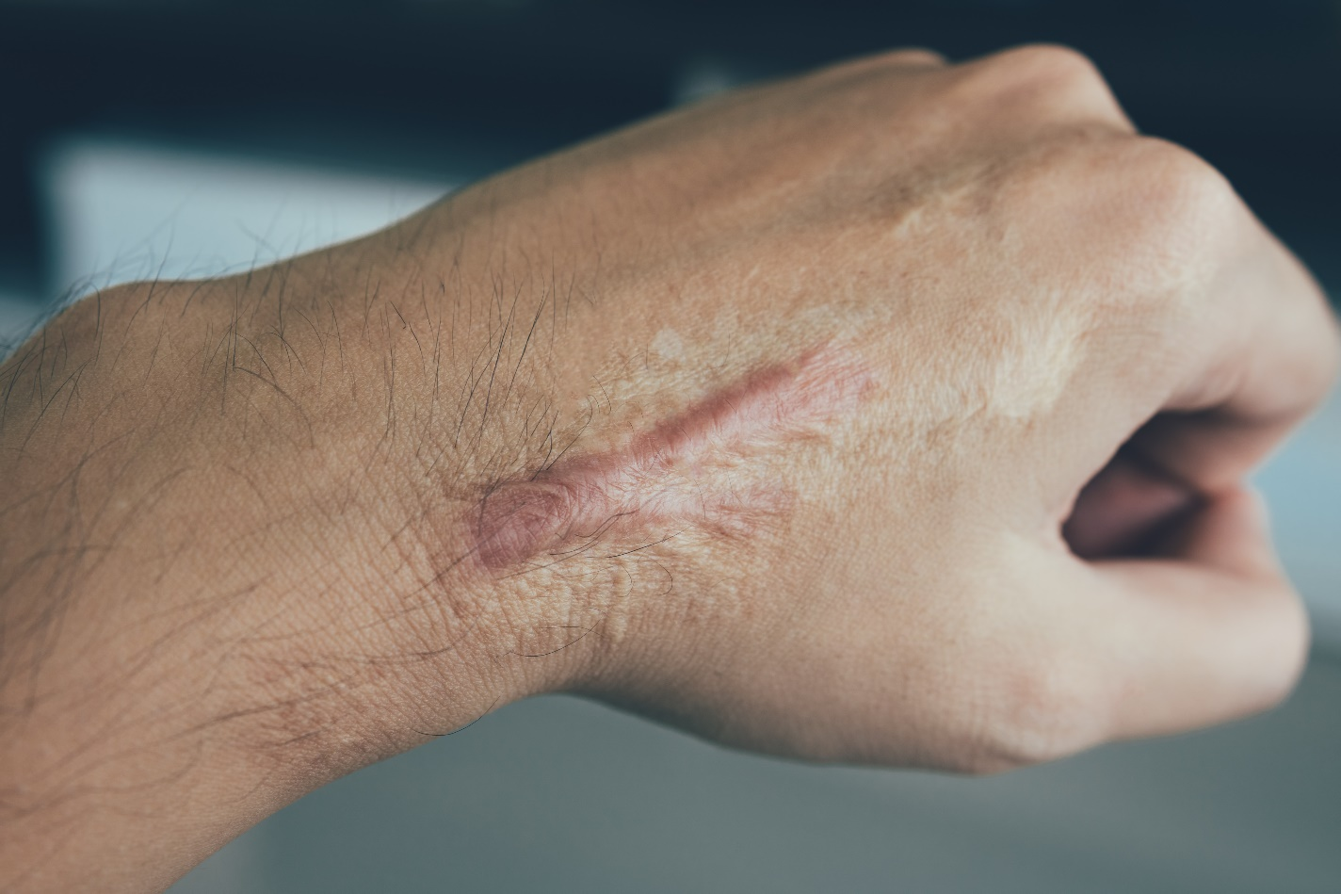
Keloid scarring
A keloid scar is a firm, smooth, hard growth due to spontaneous scar formation. A keloid is harmless to general health and does not change into skin cancer

Slide 15
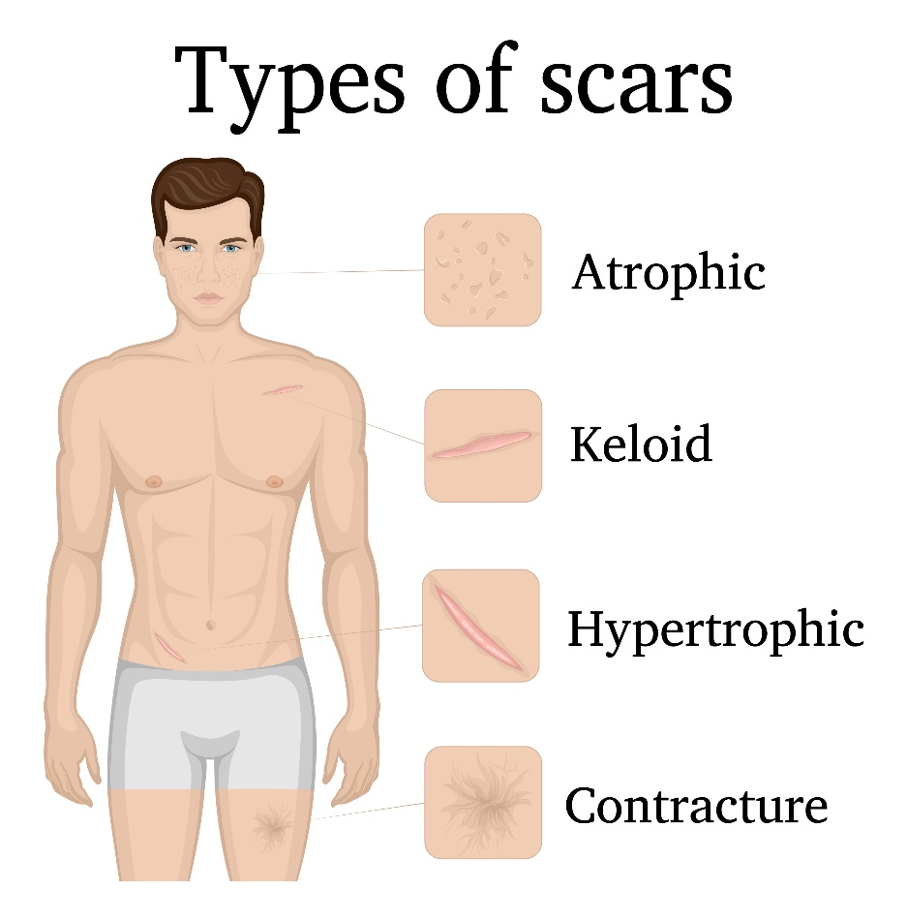
Keloid and Hypertrophic scarring
As wounds heal, scar tissue forms, which at first is often red and somewhat prominent. Over several months, a scar usually becomes flat and pale. If there is a lot of tension on a healing wound, the healing area is rather thicker than usual. This is known as a hypertrophic scar. A hypertrophic scar is limited to the damaged skin.

Slide 16
Physical Injuries
Needle stick injuries
Embedding of jewellery
Bleeding
Swelling
Swallowing

Slide 17


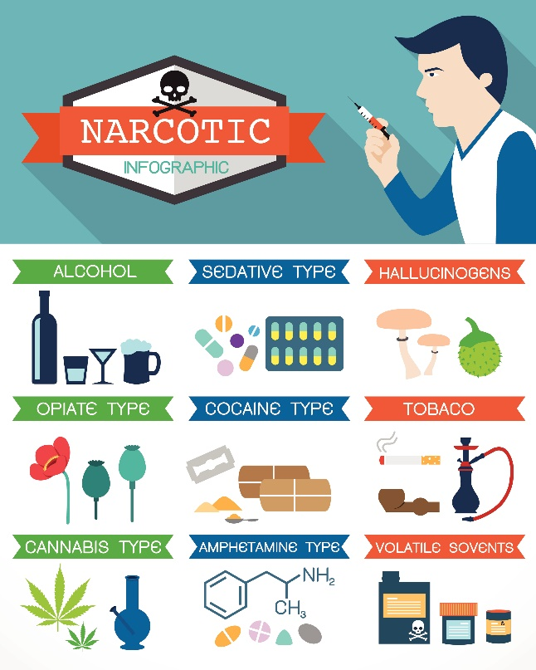
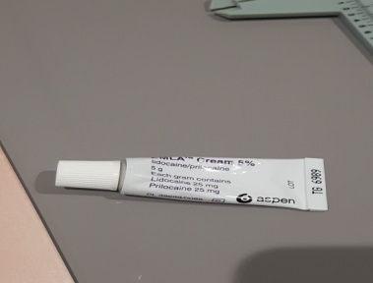
Contraindications
A specific situation in which a procedure should not be undertaken because it may be harmful to the client

Slide 18
Contraindications: Minimising risk
Thorough pre consultation with client
Document/record advice given and actions required by client in ‘client records’.
Update consultation on day of procedure
If in doubt
  postpone special procedure
  refer client to their GP or medical specialist
Contraindications | Likely Actions
1. Consumption of alcohol | A. Check instruments/products before proceeding with procedure
2. Heavy smoker | B. Request note from GP before undertaking procedure
3. Keloid scarring | C. Postpone procedure
4. Nickel allergy | D. Postpone procedure
5. Epileptic | E. Proceed with procedure
6. Fasting | F. Request note from GP before undertaking procedure

Slide 19
Summary (1)
An allergy is a condition caused by over reaction of the immune systems to a normally harmless substance’
Signs of an allergic reaction: Rash
Dermatitis is inflammation of the skin
Anaphylactic shock: An extreme, often life threatening allergic reaction, a severe allergic response to a normally harmless substance
Common allergens associated with Special Procedures:
  Latex, Nickel, Gold, Cobalt, PPD
  Topical medications

Slide 20
Summary (2)
Acrylate – nail cosmetics
Nickel - metals
Cobalt – metals, hair dyes
Latex – gloves, balloons, condoms
PPD – Henna tattoos, hair dye
Topical medications - active drug ingredient or a component of the vehicle or base that caries the drug

Slide 21
Summary (3)
Keloid: A fibrous type of scar tissue which is not harmful to health
Common contraindications:
  Underlying health conditions including some skin conditions
  Prescription and over the counter medication
  Illicit drugs
  Alcohol
Minimising the risk of non infectious hazards
  Thorough pre consultation with client
  Raise awareness
  Avoid and replace

Slide 22
Quiz:
Match each symptom to a likely source/cause?
Non infectious Hazards | Likely Source
1. Needle stick injury | A. Prescription medication
2. Keloid scarring | B. Nickel
3. Extreme bleeding | C. Latex
4. Hand dermatitis | D. Poor practice
5. Pustular and blistering of the skin | E. Pre-disposed client
6. Allergic contact dermatitis | F. Black henna

Slide 23
Quiz:
Match symptom to likely source/cause: Answers
Non infectious Hazards | Likely Source
1. Needle stick injury | D. Poor practice
2. Keloid scarring | E. Pre-disposed client
3. Extreme bleeding | A. Prescription medication
4. Hand dermatitis | B. Nickel
5. Pustular and blistering of the skin | F. Black henna
6. Allergic contact dermatitis | C. Latex

Slide 24
‘True or False’ Quiz
Question | True or False
Dermatitis and angioedema are examples of the body’s reaction to an allergen
Practitioners should not perform a special procedure on a client if they have been drinking
Keloid scarring can be treated successfully with antibiotics
Cobalt and nickel are commonly found in metals
An allergy is a condition caused by over reaction of the immune systems to a harmful substance
A contraindication is a situation in which a special procedure can be performed as it is harmless to the client
Dermatitis is a bacterial infection of the skin
Anaphylactic shock is a severe allergic response that maybe triggered in sensitive individuals by a normally harmless substance

Slide 25
‘True or False’ Quiz - Answers
Question | True or False
Dermatitis and angioedema are examples of the body’s reaction to an allergen | True
Practitioners should not perform a special procedure on a client if they have been drinking | True
Keloid scarring can be treated successfully with antibiotics | False
Cobalt and nickel are commonly found in metals | True
An allergy is a condition caused by over reaction of the immune systems to a harmful substance | False
A contraindication is a situation in which a special procedure can be performed as it is harmless to the client | False
Dermatitis is a bacterial infection of the skin | False
Anaphylactic shock is a severe allergic response that maybe triggered in sensitive individuals by a normally harmless substance | True

