Slide 1
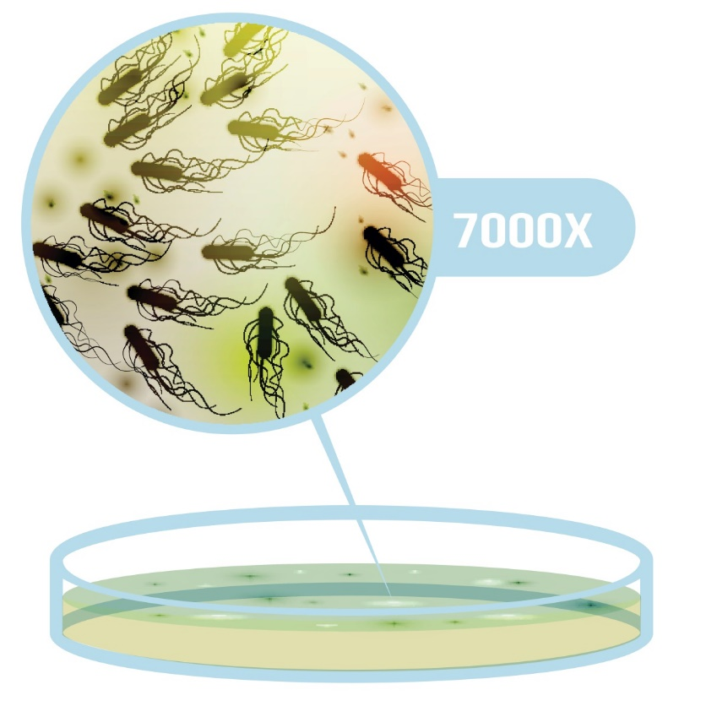
Section 2: The role of micro organisms in infection and the sources of infectious hazards

Slide 2
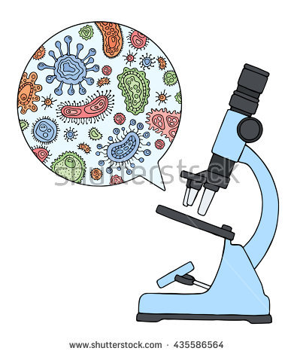
What are micro organisms?
‘micro’ means tiny and ‘organism’ means a living creature.
They cannot be seen by the naked eye.
The majority of micro-organisms that live in our body, on our skin and surround us in our environment are usually harmless however, some micro-organisms when given the right opportunity can cause infections, and these are known as pathogens

Slide 3
Pathogens and non pathogens
Pathogen – micro organism that can cause disease
Examples include?
Non pathogen – micro organism that doesn’t cause disease, harm or death
Examples include?
https://www.youtube.com/watch?v=1xuEowtB7qg

Slide 4
Pathogenic micro organisms
Examples?

Slide 5
Growth requirements for bacteria
Food
Warmth
Moisture
Time
In less than 7 hours 1 bacteria can multiply into 1 million

Slide 6
Bacterial growth
https://www.youtube.com/watch?v=BsPKcHShGYw

Slide 7
Bacterial Growth Curve
How can your prevent the growth and multiplication of pathogenic micro organisms in your studio?

Slide 8
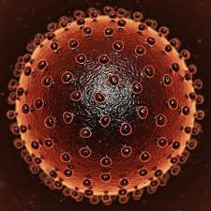
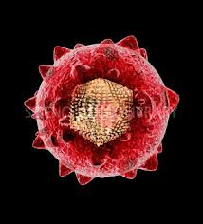
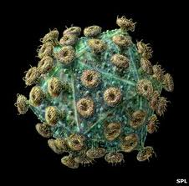
Blood borne viruses (BBVs) Transmitted from person to person through blood
Most common BBVs associated with special procedures are:
Hepatitis B, Hepatitis C and HIV
Routine infection control practices can prevent infection

Slide 9
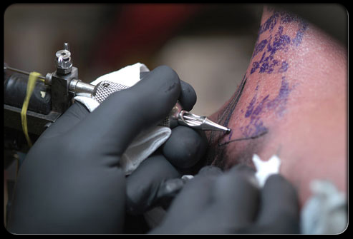
Hepatitis B (HBV)
Humans are the only reservoir. Blood is the main source of infection but the virus has also been isolated from semen, vaginal secretions, urine and saliva.
The virus can be transmitted by: Acute HBV infected cases, chronic HBV infected cases and asymptomatic carriers.
Routes of transmission:

Slide 10
Chronic Hepatitis B Prevalence

Slide 11
HBV - Vaccination requirement
Full course of Hep B vaccination
An accelerated course consisting of three doses at zero, one and two months (followed by a fourth dose at twelve months after the first dose for those at continued risk of exposure)
Blood test to check antibody titres (blood levels) one to four months after the completion of the primary course of vaccine.
Keep copies of vaccination history/antibody levels
There is no vaccine against Hep C & HIV

Slide 12
Hepatitis (HCV)
Hepatitis C (HCV) can cause both acute and chronic hepatitis infection, ranging in severity from a mild illness lasting a few weeks to a serious, lifelong illness.
Similar routes of transmission
Sharing or use of contaminated equipment during injecting drug use
Needle stick or other sharps injuries
Tattooing and body piercing
Sexual contact
Vertical transmission
Household non-sexual contacts e.g. sharing toothbrush or razors
(Receipt of infectious blood or blood products)

Slide 13
Human Immunodeficiency Virus (HIV)
Humans are the reservoir
Routes of transmission similar to those of HBV
Only sexual exposures and exposure to blood and tissues carries a risk
No risk of transmission from social or community contact with an HIV infected person
AIDS is the late clinical stage of this infection
There is no cure (life can be lengthened by treatment)

Slide 14
How long do these viruses last outside the body?
HIV
Does not survive for long outside the body, this varies from minutes to hours depending on conditions
HBV
Can survive outside the body for at least 7 days.
HCV
Is the most robust and can survive outside the body at room temperature, on environmental surfaces, for up to 3 weeks.

Slide 15
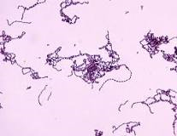
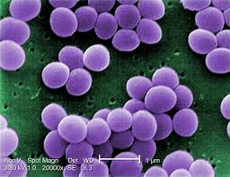
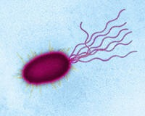
Bacterial Infections Transmitted by direct contact with infected person/carrier or contaminated objects/instruments/products
Streptococcus Staphylococcus Pseudomonas
These 3 bacteria cause the most common skin infections associated with special procedures
More robust than BBVs outside the body
Antibiotic resistance can be an issue in the treatment of these infections.
Routine infection control practices can prevent infection

Slide 16
Staphylococcal and Streptococcal Infections
Streptococcus (pyogenes)
Staphylococcus (aureus)
Infections
Impetigo
Cellulitis
Necrotising fasciitis
Secondary infections
Treatment - antibiotics
Infections
Boils
Impetigo
Abscesses
Secondary infections
Treatment – antibiotics (resistant strains)

Slide 17
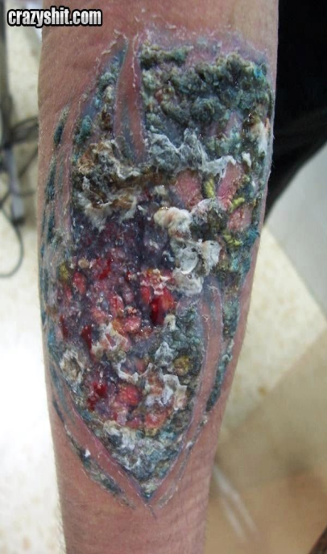
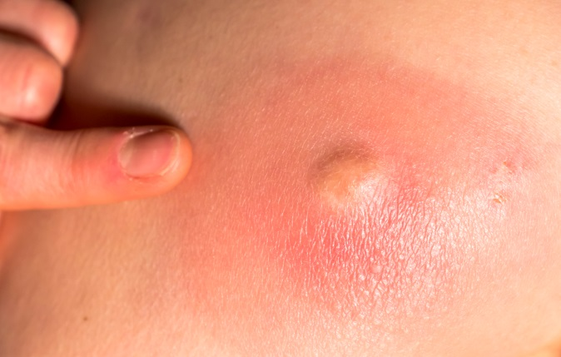
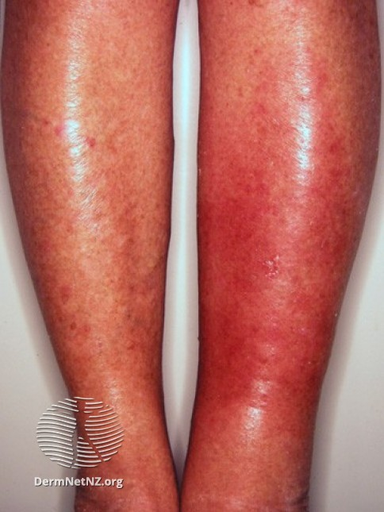
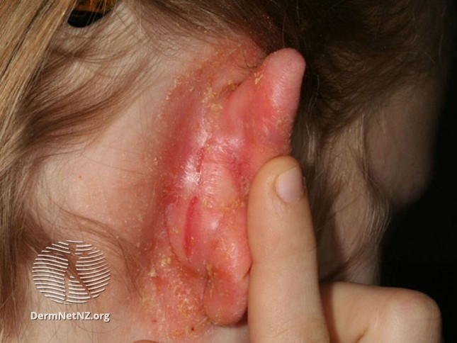
Illustrations of infections caused by Staphylococci and Streptococci

Slide 18
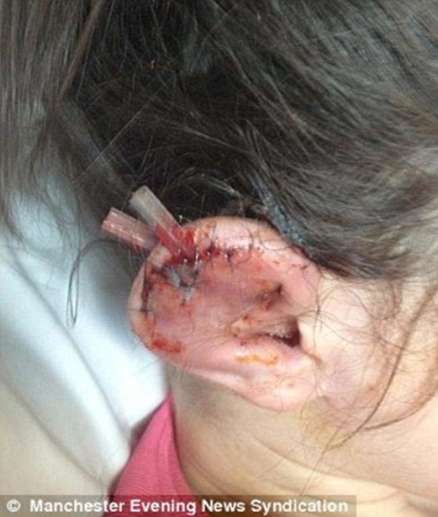
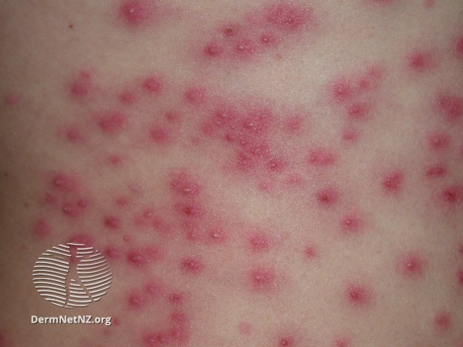
Infections associated with
Pseudomonas aeruginosa
An opportunistic pathogen causing a range of infections
Found widely in the environment and likes moist conditions including water. It can be spread via the hands of those undertaking piercing/tattooing and via piercing/tattooing equipment

Slide 19
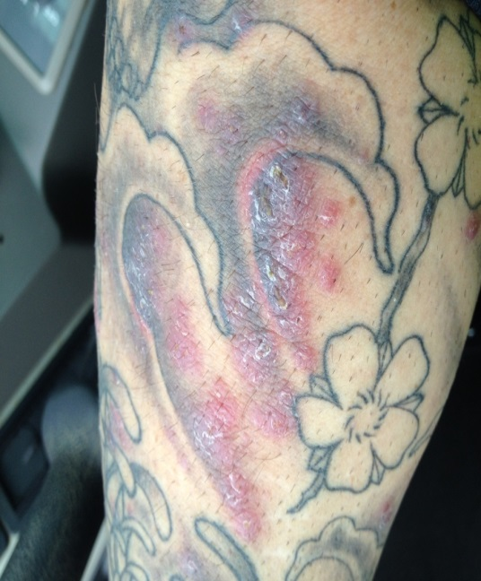
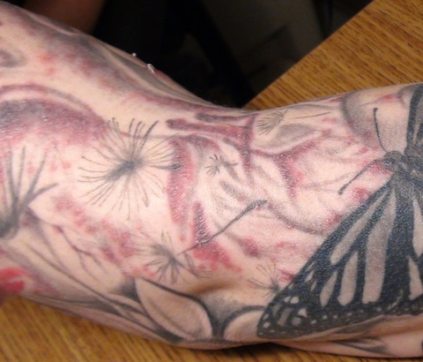
Infections associated with Mycobacterium chelonae (NTM) Another opportunistic pathogen causing a range of infections, robust in the environment and is resistant to some antibiotics

Slide 20
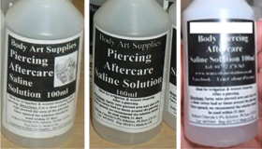
Examples of outbreaks associated with cosmetic piercing and tattooing
Piercing studios associated with a Pseudomonas outbreak - 26 cases linked aftercare saline spray
6 cases of M. chelonae associated with a tattooist in South Wales.
Risk factor thought to be diluting ink with unsterile water

Slide 21
Routes (mode) of transmission How a micro organism gets from its source to a person
Blood borne
Directly by person to person
Indirectly via contaminated needles/equipment etc
Person to person
Directly
Indirectly
Environmental
Directly
Indirectly
(Food borne and air borne)

Slide 22
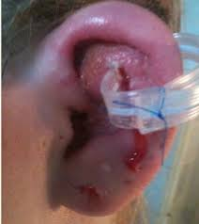
Seren Incident (1)
Cluster of Pseudomonas infection
9 hospital admissions in total
All needed incision and drainage
4 under GA, 5 under LA
Some needed reconstructive surgery
Minimum of 3 nights in hospital
3 cases were in hospital more than 10 nights

Slide 23
Seren Incident (2)
Premises: infection control, history incl. 2 for 1 offer, many bugs cause infections
Clients: false ages, many u16, ability to understand the risks??
Cost: NHS, LAs - £240,159
Enforcement: prosecution of owners but no civil claim

Slide 24
Summary of Section 2
Micro organisms can’t be seen by the naked eye and can be found virtually anywhere.
Difference between pathogens and non pathogens
Pathogenic micro organisms (pathogens) cause disease, examples include:
Viruses: HBV, HCV, HIV
Bacteria: Staphylococcus, Streptococcus, Pseudomonas, Non Tuberculosis Mycobacterium (NTM)
Blood borne infections and skin Infections

Slide 25
Summary of Section 2 (continued)
Conditions needed to grow and multiply:
Nutrients (food); Warmth (temperature); Moisture (water); Time

Slide 26
Quiz 1
Can you match each organism to a likely source?
Organism | Likely Source
1. Pseudomonas aeruginosa | A. Humans (blood)
2. Hepatitis B | B. Humans (boils)
3. Staphylococcus aureus | C. Rinse water
4. HIV | D. Humans (nose)
5. Streptococcus pyogenes | E. Water based products
6. NTM (M. Chelonae) | F. Humans (blood)

Slide 27
Quiz 1 - Answers
Organism | Likely Source
1. Pseudomonas aeruginosa | E. Water based products
2. Hepatitis B | F. Humans (blood)
3. Staphylococcus aureus | D. Humans (nose)
4. HIV | A. Humans (blood)
5. Streptococcus pyogenes | B. Humans (boils)
6. NTM (M. Chelonae) | C. Rinse water

Slide 28
Quiz 2
Organism | Bacteria or Virus?
1. Pseudomonas aeruginosa
2. Hepatitis B
3. Staphylococcus aureus
4. HIV
5. Streptococcus pyogenes
6. NTM (M. Chelonae)
7. Hepatitis C

Slide 29
Quiz 2 Answers
Bacteria
Virus
Bacteria
Virus
Bacteria
Bacteria
Virus

Slide 30
Quiz 3 True or False
Pseudomonas bacteria can be associated with skin infections Micro organisms are found in sterile environments Staphylococcal skin infections are commonly caused by poor personal hygiene HIV is an example of a blood borne virus Pathogens need nutrients, moisture, air and time to grow and multiply HCV is a non pathogenic micro organism Most pathogenic micro organisms multiply quickly between 20°C and 50°C There are 4 phases in the growth and multiplication of pathogenic micro organisms

Slide 31
Quiz 3 - True/False Answers
True
False
True
True
False
False
True
True

