Slide 1
Section 10: Management of Body Fluids
A body fluid is:
“any fluid found in, produced by, or excreted from the human body……”
(Peate, 2008)

Slide 2
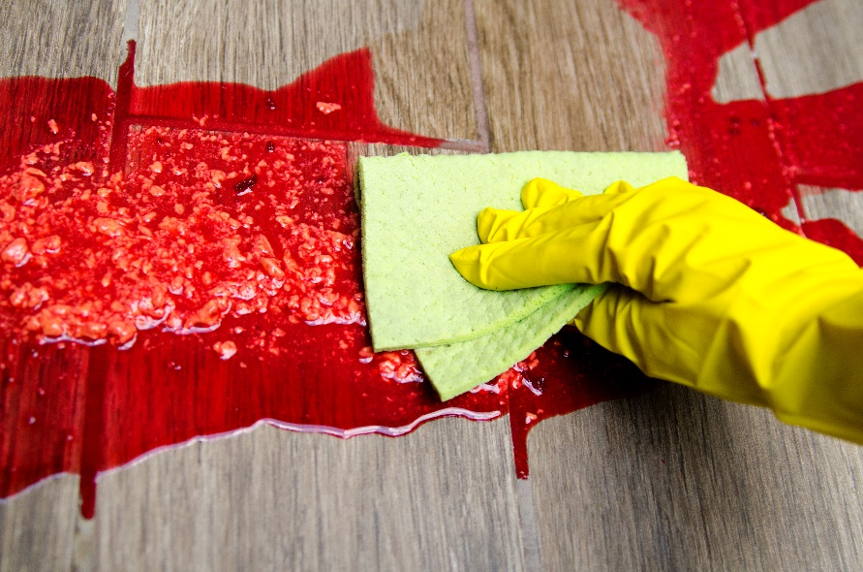
Encounters with body fluids in special procedures
Blood
Saliva
Urine
Faeces
Others?
Blood and other body fluids are considered hazardous and should be dealt with immediately and safely
To ensure protection of the person undertaking the cleaning and all others that may be affected by the spillage.

Slide 3
Examples of body fluid exposure in special procedures
Spills:
Vomit: following fainting or as the result of gastro intestinal infection
Urine/faeces: If a person fits.
Blood: needle stick injury/accident
Exposure (through contact either direct or indirect):
Blood: during any procedure,
Saliva: during oral procedures
Vaginal fluid: during genital piercing

Slide 4
Infection Risks
Blood, vaginal secretions and any body fluid which is blood stained may contain BBVs.
Vomit (if the result of infection may contain pathogens most likely Norovirus)
Diarrhoea (if the result of infection may contain pathogens)
Assume any body fluid is infected

Slide 5
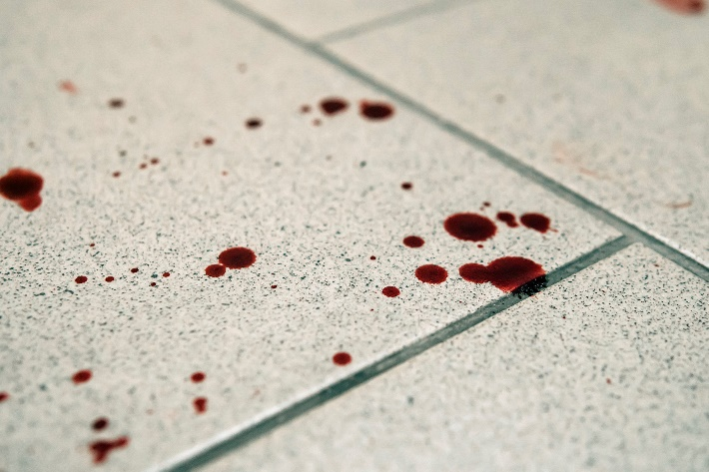
Managing body fluid spills – general points
The technique required for dealing with a spillage of blood differs according to the amount of blood spilt and the method of decontamination
Appropriate personal protective equipment (e.g. gloves, apron) should be worn when dealing with blood and other body fluid spillages
Don’t
treat urine spills with a chlorine based agent
add hot water or anionic detergents to a chlorine based agent
chlorine gas can be produced
If items contaminated with blood or body fluids are incapable of being adequately decontaminated then they should be disposed of.

Slide 6
Action for hard/impervious surfaces
Small spills e.g. drops of blood
are dealt with by wiping with a disposable towel soaked in disinfectant (containing 10,000ppm av.cl.), followed by detergent.
Larger spills of blood
Apply chlorine releasing granules, leave to solidify, remove,
After removal clean with detergent and apply disinfectant (2 stage clean) or steam clean
Alternatively cover with paper towels and gently soak in disinfectant then apply (b)
Larger spills of body fluids
Apply body fluid granules, leave to solidify, remove,
After removal clean with detergent and apply disinfectant (2 stage clean or steam clean)
Alternatively cover with paper towels and gently soak in disinfectant then apply (b)
A concentration of 1,000ppm av.cl. Sodium hypochlorite
Urine spills
Body fluid granules (that do not contain chlorine) or paper towels that absorb the fluid.
Wash the area with detergent and a disinfectant (2 stage clean)

Slide 7
Action for soft furnishings (carpets, rugs, sofas) (can’t tolerate chemical disinfection)
Apply body fluid granules to solidify the fluid
Remove, bag, seal and dispose
Apply a detergent and steam clean to the contaminated area
OR
If the item can be placed in the washing machine – set to: a pre wash and a hot wash - 60°C
OR
If it is not possible to use either of these methods consider disposing of the contaminated soft furnishings

Slide 8
Dilution rates for hypochlorite solutions
Hypochlorite solutions are the most cost effective disinfectant
Usage | Dilution of stock dilution | Example Dilution | Available Chlorine
 |  |  | % | ppm
Blood Spills | 1 in 10 | One part hypochlorite to 10 parts water, e.g. 10 ml hypochlorite in 100ml water | 1.0% | 10,000
Environmental disinfection & other body fluid spills | 1 in 100 | One part hypochlorite to 100 parts water, e.g. 10 ml hypochlorite in 1000ml (1 litre) water | 0.1% | 1,000

Slide 9
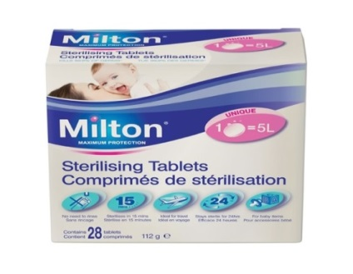
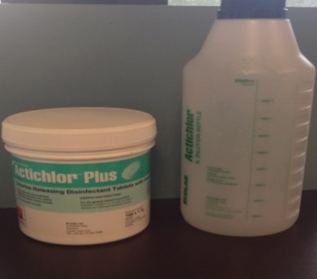
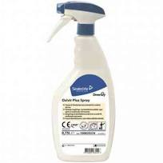
Dilution rates/Contact time - practical tips
1 Milton tablet to 500ml water to create a 1000ppm with a 4 minute
contact time.
http://www.milton-tm.com/en/consumer/products/sterilising-tablets
For Ecolab Actichlor tablets product needs to be in contact with surface for a minimum of 5 minutes.
https://www.youtube.com/watch?v=qstlXdV2Wck
Oxivar is an example of a virucide, attention should be paid to contact times.
.

Slide 10
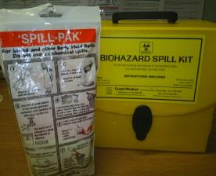
Body Fluid Kits - practical tips The purpose is to solidify the fluid and minimise aerosols

Slide 11
Summary(1)
Body fluids – greatest risk for SPP
Purpose of body fluid kits, how and when they should be used
When using body fluid kits follow manufacturer instructions
Always follow the application of a body fluid kit with 2 stage clean
Washing machine temperature/steam cleaners - effectiveness

Slide 12
Summary (2)
Correct dilution rates and contact times are critical
Use of disposable body fluid kits for larger spills
Remember disposable PPE
If a body fluid is blood stained or suspected to be contaminated with HIV or HBV then 10,000ppm av.cl. should be used.

Slide 13
Body Fluid Quiz – match questions to correct answers
Question | Answer
This piece of equipment should not be used to remove body fluids | 60°C
The safest way to remove a large body fluid spill is to use a | Blood
What should be applied to a hard surface after a body fluid spill has been removed and the area cleaned | Carpets and soft furniture
Applying a body fluid kit reduces the risk of infection by | Body fluids
Vomit, saliva, blood and urine are examples of | A disinfectant
Which floor surface should steam cleaners be applied to | Vacuum cleaner
Clothing contaminated with body fluids should be washed in a washing machine at | Body fluid kit
Which body fluid presents the greatest risk of infection to a practitioner | solidifying the fluid and minimising aerosols

Slide 14
Body Fluid Quiz
Question | Answer
This piece of equipment should not be used to remove body fluids | Vacuum cleaner
The safest way to remove a large body fluid spill is to use a | Body fluid kit
What should be applied to a hard surface after a body fluid spill has been removed and the area cleaned | A disinfectant
Applying a body fluid kit reduces the risk of infection by | solidifying the fluid and minimising aerosols
Vomit, saliva, blood and urine are examples of | Body fluids
Which floor surface should steam cleaners be applied to | Carpets and soft furniture
Clothing contaminated with body fluids should be washed in a washing machine at | 60°C
Which body fluid presents the greatest risk of infection to a practitioner | Blood

