Slide 1


Section 3
The skin: Its reaction to injury and its role in defence against infection

Slide 2
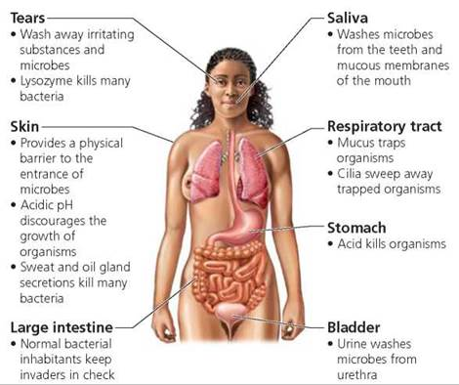
How the body protects itself from infection
Respiratory system
Skin
Immune system
Stomach and
intestines

Slide 3
The skin and its main functions
Acts as a barrier against chemicals and invasion by micro-organisms
Protection against:
  Potential pathogenic organisms
  Chemical damage
  Physical injury
  Ultraviolet radiation from the sun
  Dehydration
Temperature control
Sensory
Immunity
Vitamin D production

Slide 4
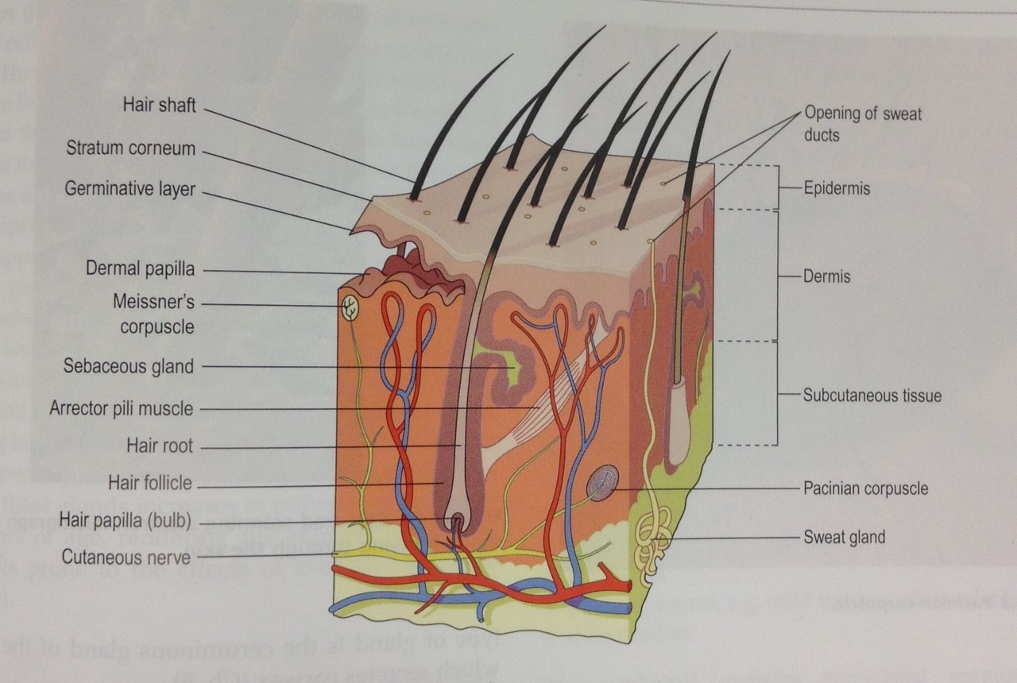
The structure of the skin (1)
‘Anatomy and Physiology in Health and Illness’ 12th Edition, Anne Waugh & Allison Grant, 2014

Slide 5
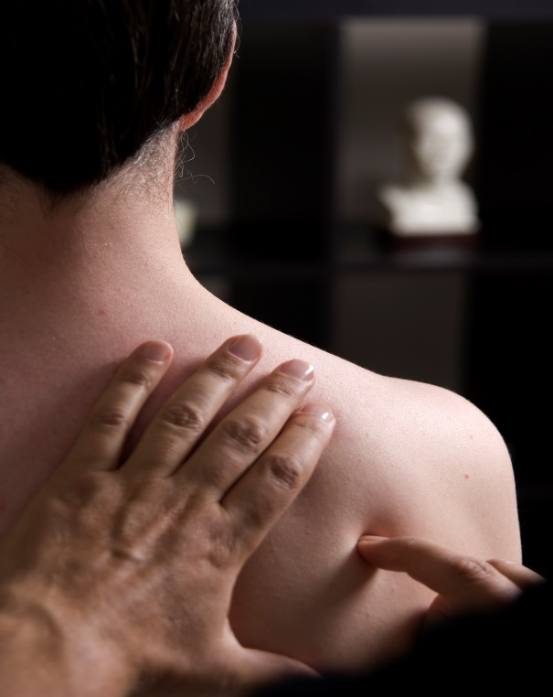
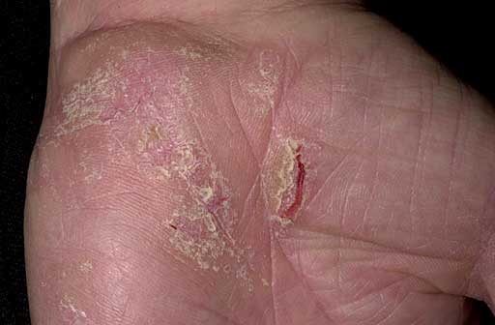
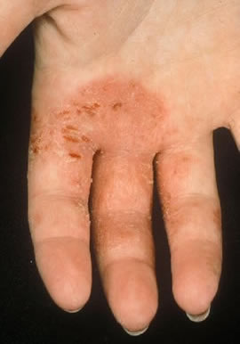
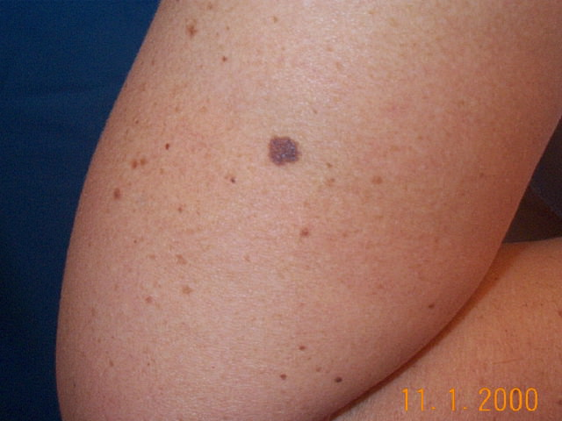
Broken skin and intact skin

Slide 6
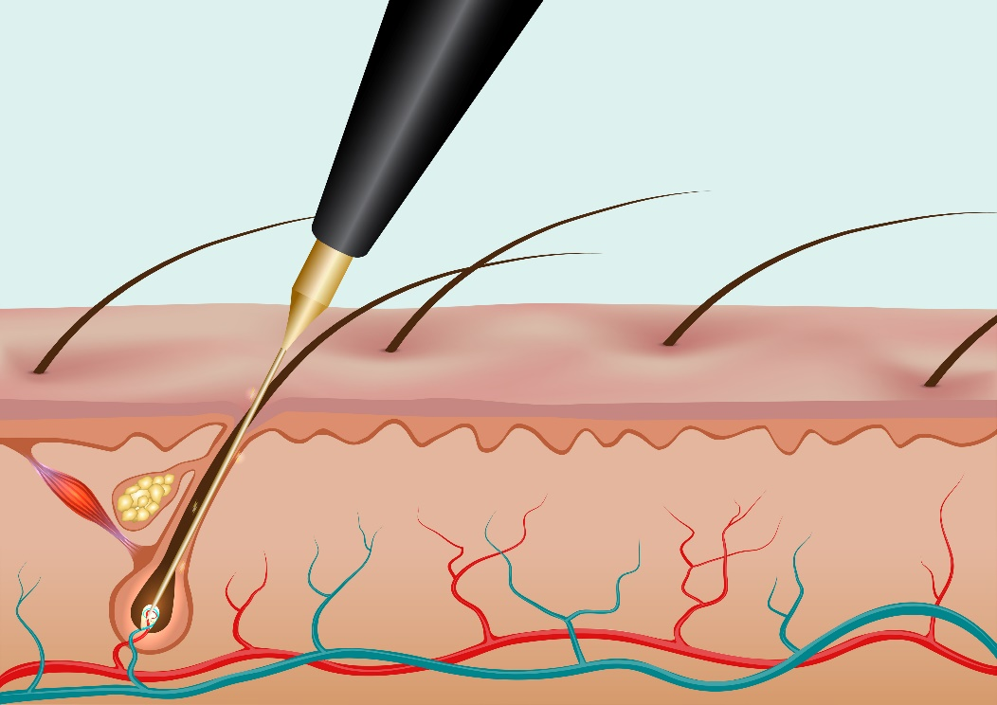
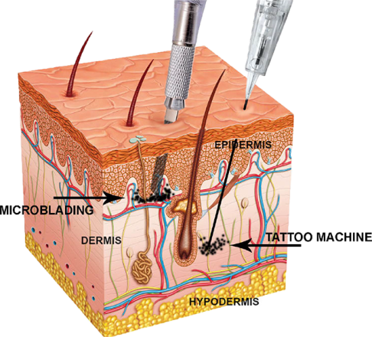
Skin – insertion of instruments

Slide 7
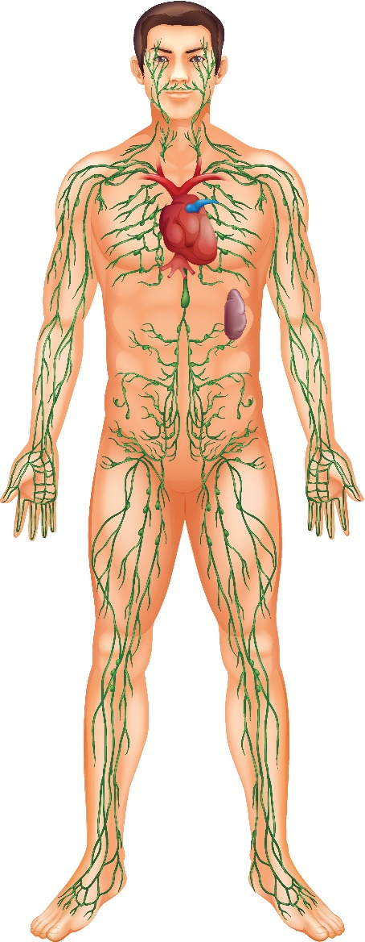
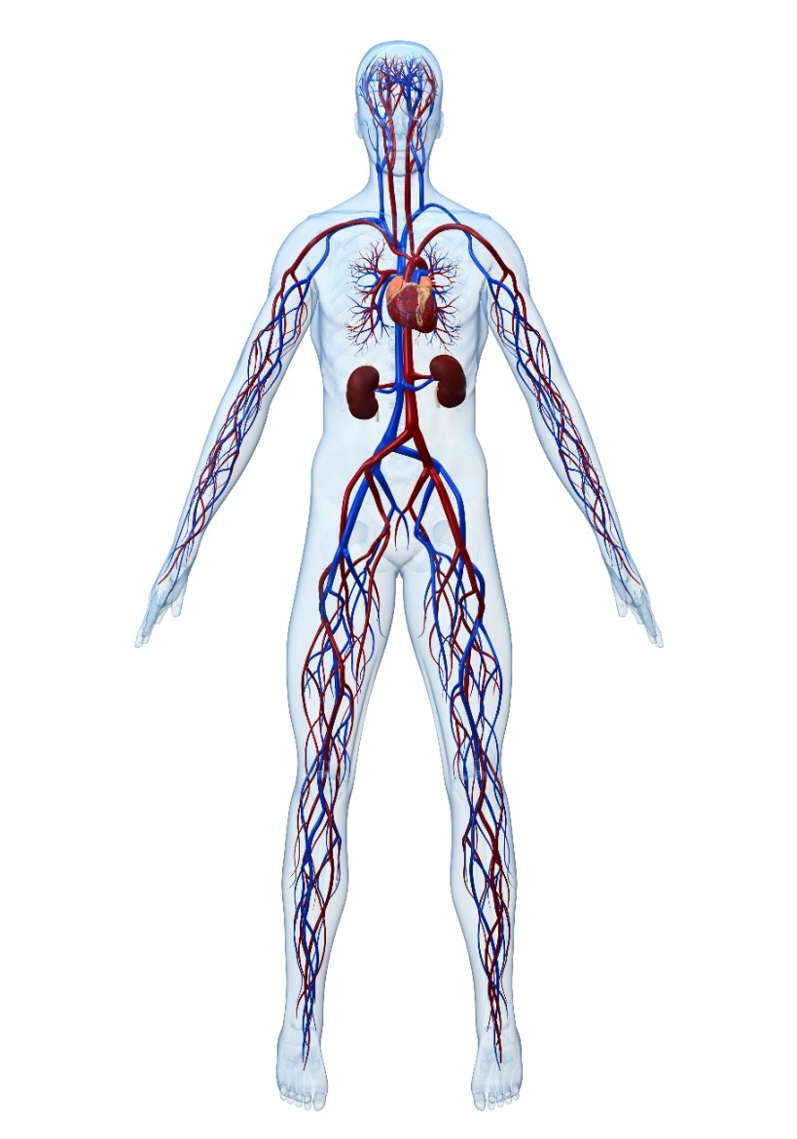
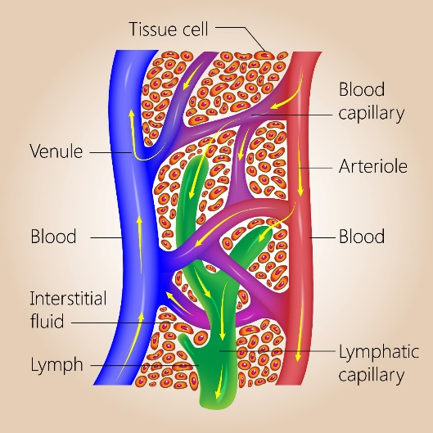
Lymphatic and Circulatory System
Circulatory System
Lymphatic system

Slide 8
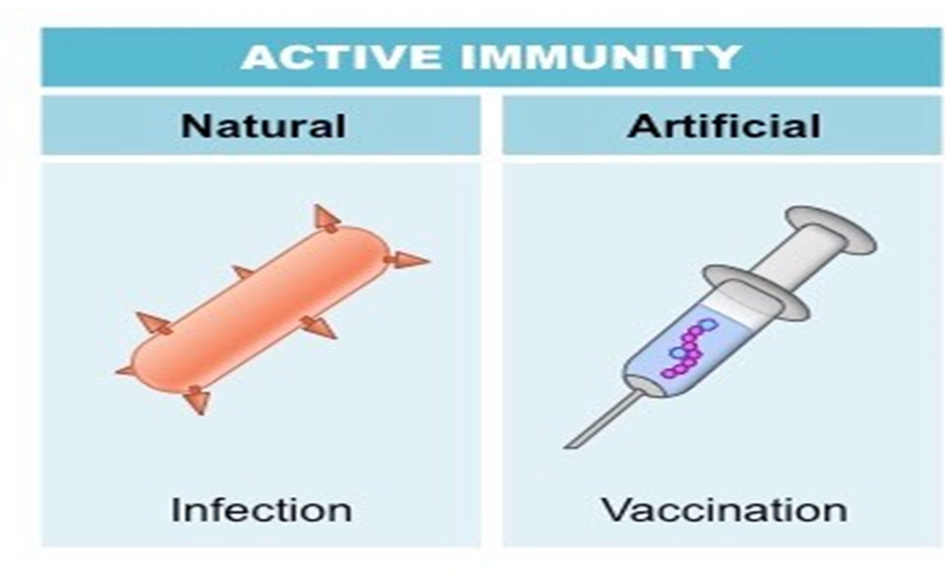
Immunity

Slide 9
What happens to the body following a special procedure?
Acute Inflammation
Redness, heat , swelling , pain
Chronic Inflammation
Local
Systemic
Resolution
With/without
scarring

Slide 10
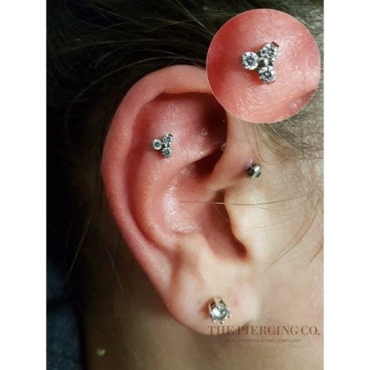
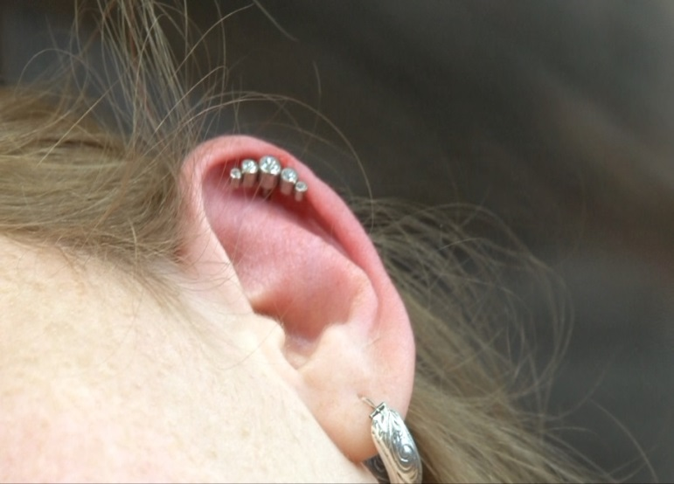
Inflammation
The skin’s response to injury or disease. It is recognised by redness, often accompanied by swelling, heat and pain and/or itch.

Slide 11
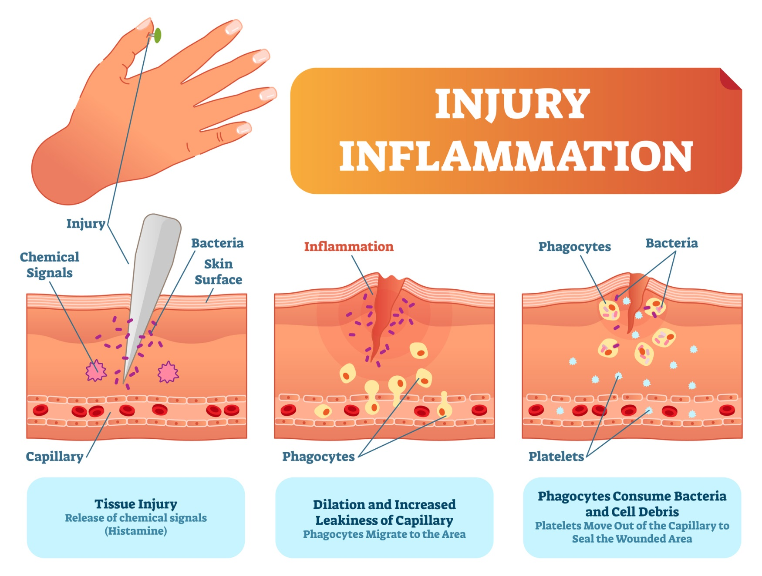
Wound healing (1)

Slide 12
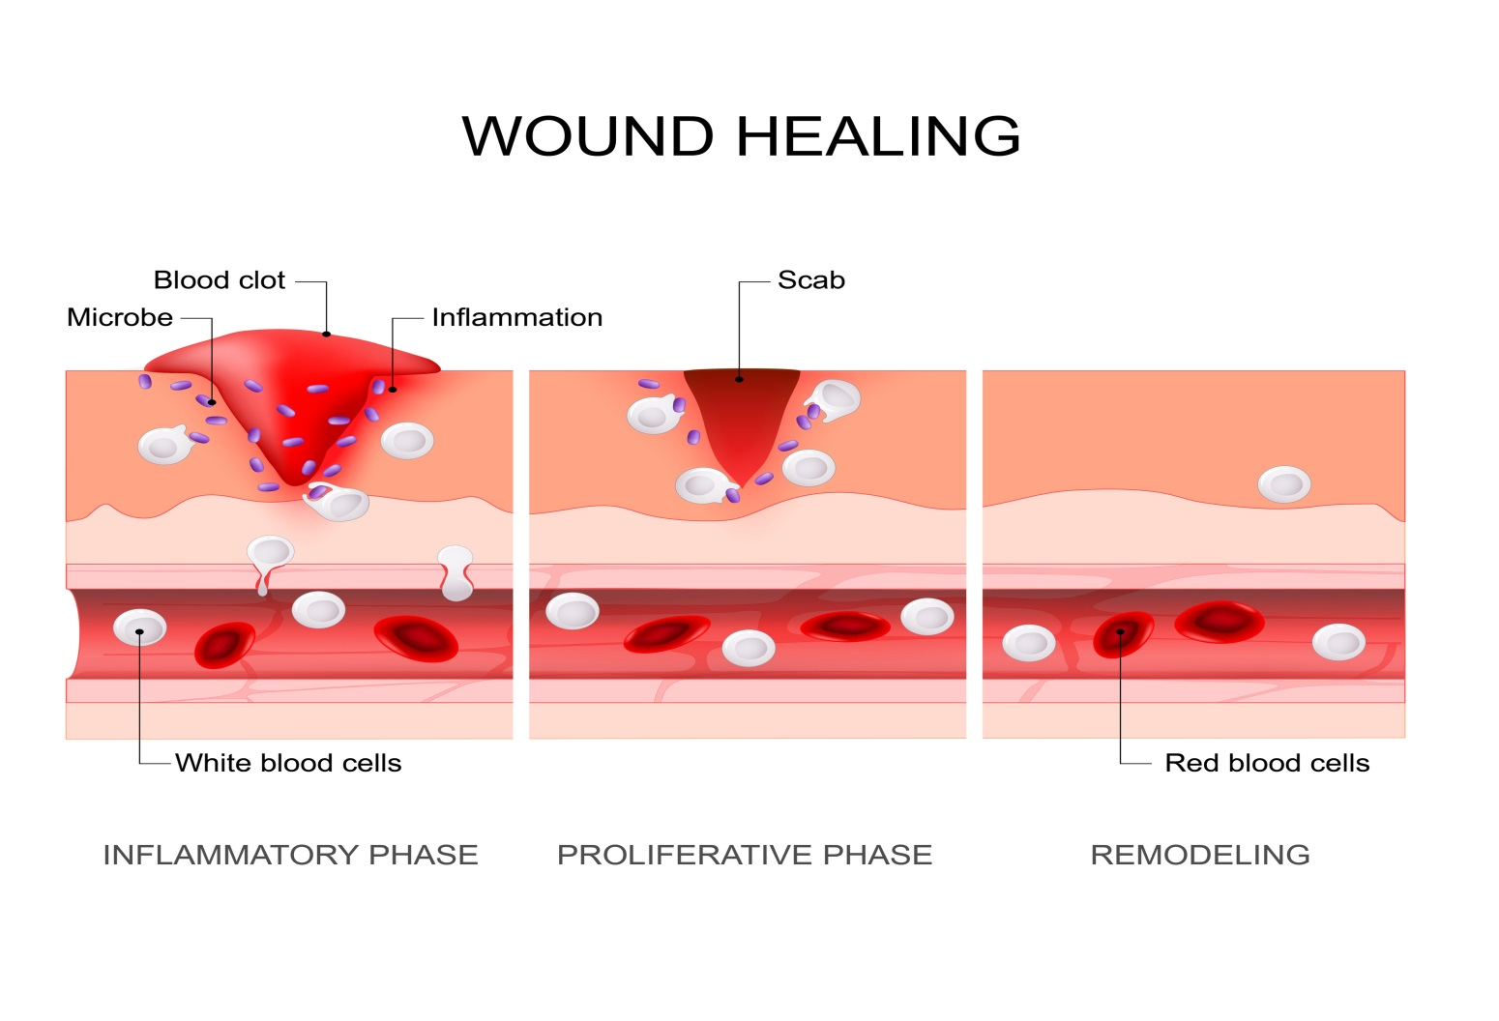
Wound Healing (2)
Primary healing - a repair process
  Inflammation – Proliferation - Maturation

Slide 13
Factors affecting wound healing
Nutritional status
General health
Infection
Weakened/poor immunity
Systemic conditions
  Diabetes
  Cancer
Blood supply
  Good blood supply provides oxygen and nutrients and removes waste products and contaminants
Infection is an important complication of wound healing

Slide 14
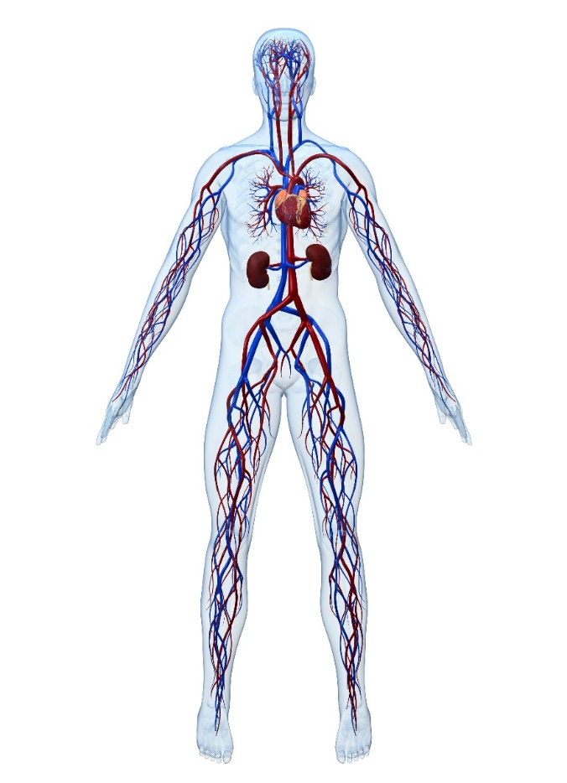
Localised and systematic infections
Skin infections (localised)
Systemic infections
  Bacteraemia
  Bacterial endocarditis
  Sepsis
Usually, your immune system keeps an infection localised, your body produces white blood cells, which travel to the site of the infection to destroy the germs causing infection. IF your immune system is weak or an infection is severe, it can quickly spread through the blood into other parts of the body.

Slide 15
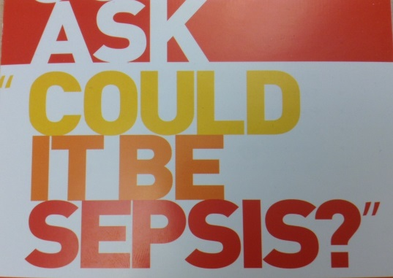
Introduction to sepsis
A reaction to an infection in which the body attacks its own organs and tissues
            Fever, high temperature, rapid breathing
            Body’s response to an infection injures its own tissues and organs
A potentially life threatening condition, triggered by infection
Can lead to multiple organ failure and death
Different to bacteraemia which is presence of bacteria in the blood

Slide 16
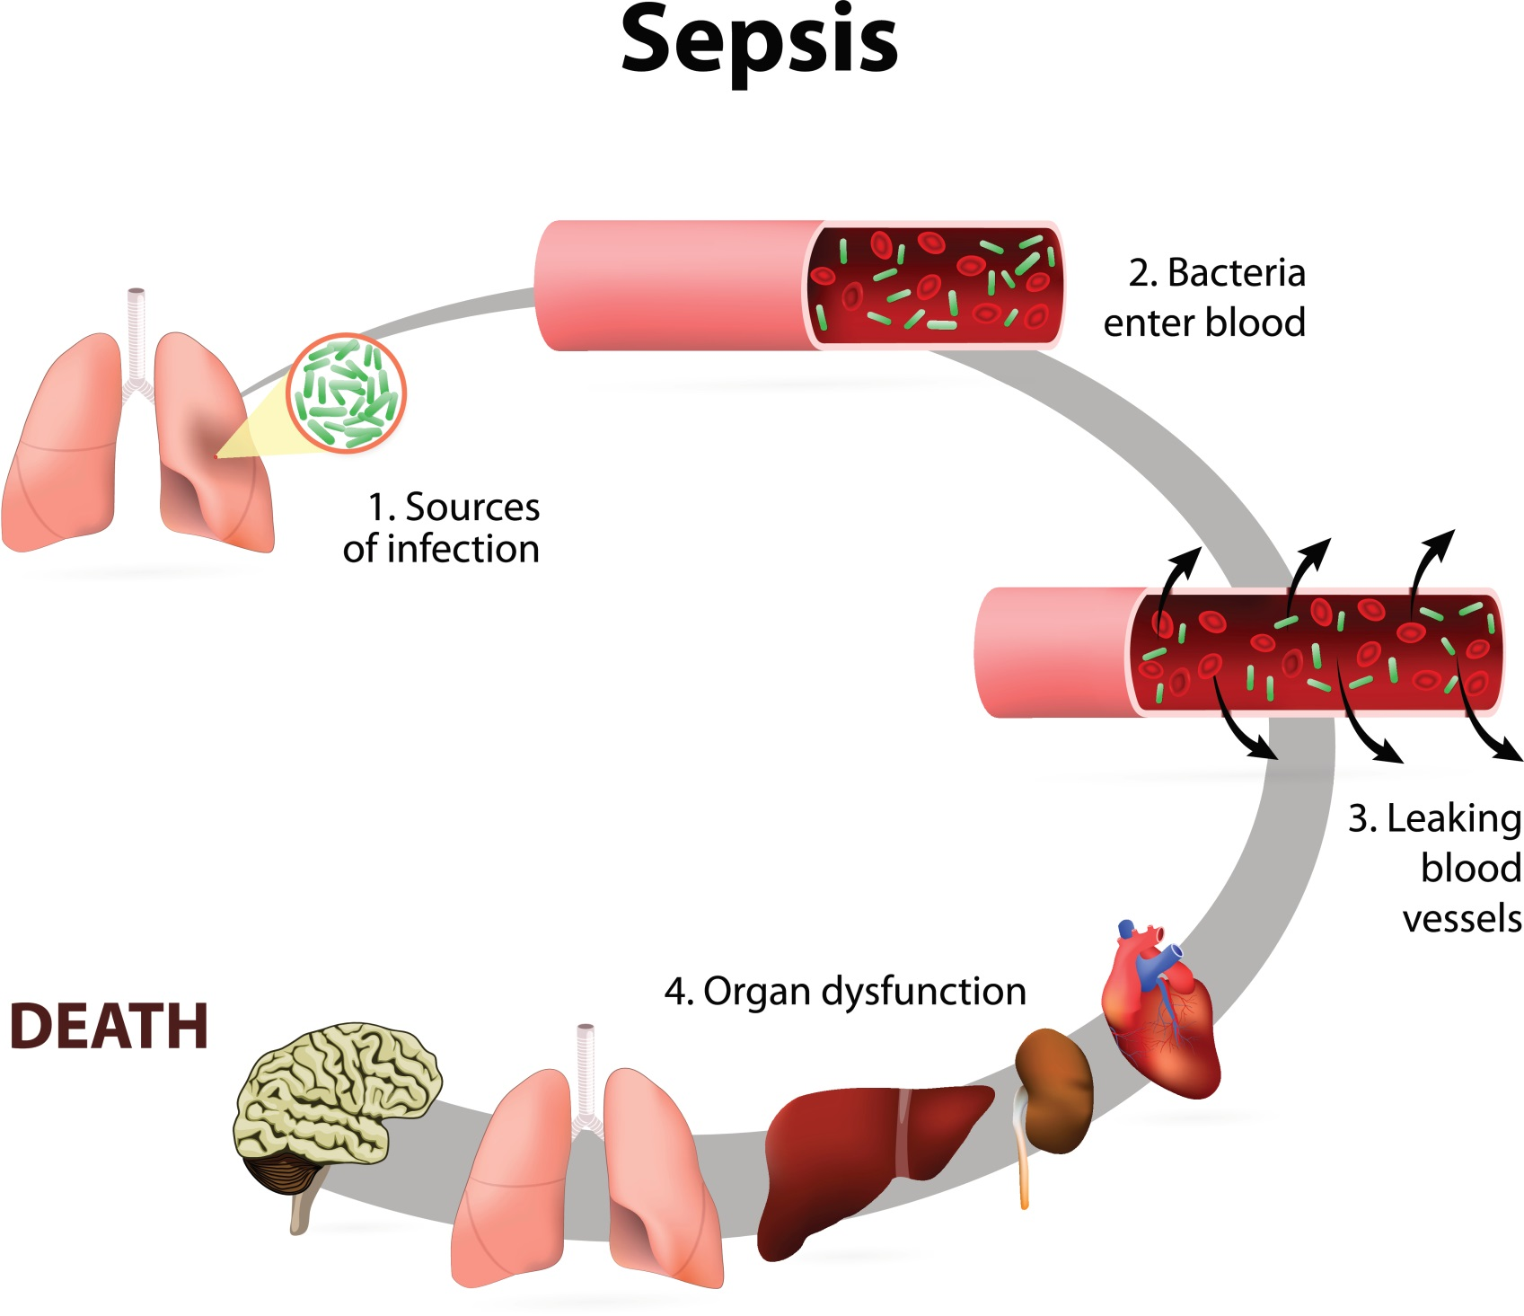

Slide 17
Summary (1)
Skin – external barrier to disease
Skin has 3 layers: Epidermis, Dermis and Subcutaneous Layer
Epidermis – outermost layer of the skin
  No blood supply or nerve endings
  Skin cells are continually shed and then replaced from the base layer. At the surface they make keratin which protects the skin from heat, microbes and helps to make it waterproof
Dermis – tough, elastic layer of the skin under the epidermis and contains
  Blood and lymph vessels
  Sensory nerve endings
  Sweat glands and their ducts
  Hairs and sebaceous glands
Subcutaneous layer (tissue) - Areolar and fat tissue between the skin and underlying structures

Slide 18
Summary (2)
Normal Body temperature - 37°C
Body’s natural response to skin trauma – inflammation – redness, swelling, pain
Healing process – Inflammation – Proliferation – Maturation
Factors which reduce the rate of healing:
  Bacterial contamination/infection
  Poor immune response
  Poor nutritional status
  Poor blood supply
  Under health condition

Slide 19
Summary (3)
Circulatory system – supplies blood to every tissue of the body
Lymphatic system – plays an important role in the defence mechanisms of the body
Bacteraemia – presence of bacteria in the bloodstream
Sepsis – reaction to an infection where the body attacks its own organs and tissues
  Symptoms: fever, high temperature, rapid breathing

Slide 20
Quiz 1
Question | Answer
Inflammation | Acts as a barrier against infection
Circulatory system | Contains blood vessels
Sepsis | Is important in the defence mechanisms of the body
Skin | The skin’s response to infection or injury
Bacteraemia | Reaction to an infection where the body attacks its organs and tissues
Redness, heat and swelling | Supplies blood to every tissue of the body
Dermis | Inflammatory response to a skin trauma
Lymphatic system | Presence of bacteria in the blood stream

Slide 21
Quiz Answers
Question | Answer
Inflammation | The skin’s response to infection or injury
Circulatory system | Supplies blood to every tissue of the body
Sepsis | Reaction to an infection where the body attacks its organs and tissues
Skin | Acts as a barrier against infection
Bacteraemia | Presence of bacteria in the blood stream
Redness, heat and swelling | Inflammatory response to a skin trauma
Dermis | Contains blood vessels
Lymphatic system | Is important in the defence mechanisms of the body

Slide 22
Quiz 2 – True or False
Question | True or False
Pathogens can enter the body through intact skin
Fever, high temperature and rapid breathing are symptoms of sepsis
The healing process can compromised if a client has an underlying health condition
Poor aftercare will not affect the rate of wound healing
A good blood supply, good nutritional status and the absence of bacterial infection increase the rate of wound healing
Bacteraemia and Sepsis are the same thing
Streptococcal infections commonly affect the healing process
The primary healing process is a repair process

Slide 23
Quiz 2 – Answers
Question | True or False
Pathogens can enter the body through intact skin | False
Fever, high temperature and rapid breathing are symptoms of sepsis | True
The healing process can compromised if a client has an underlying health condition | True
Poor aftercare will not affect the rate of wound healing | False
A good blood supply, good nutritional status and the absence of bacterial infection increase the rate of wound healing | True
Bacteraemia and Sepsis are the same thing | False
Streptococcal infections commonly affect the healing process | True
The primary healing process is a repair process | True

