Slide 1


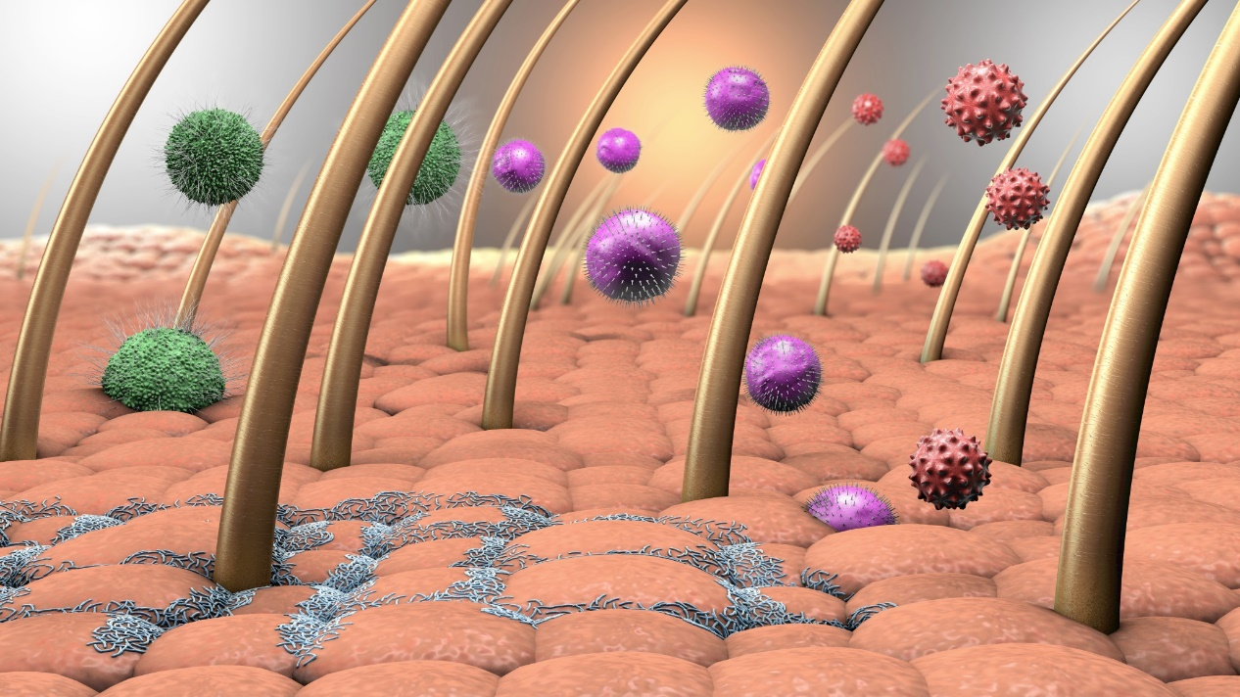
Section 1 Introduction
Level 2 Award in Infection Prevention and
Control for Special Procedures Practitioners

Slide 2
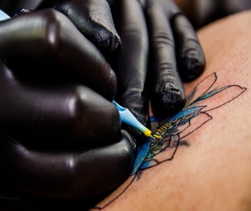
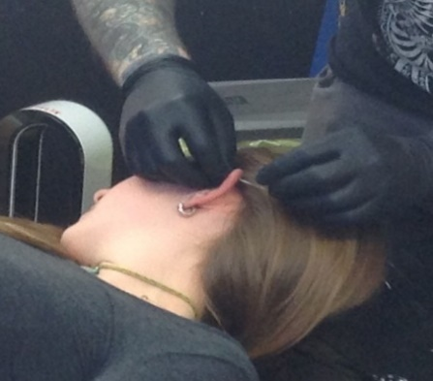
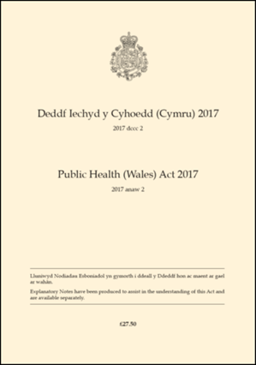
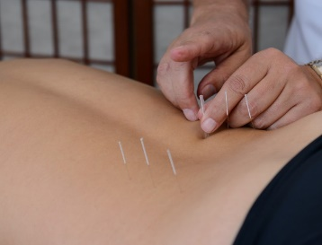
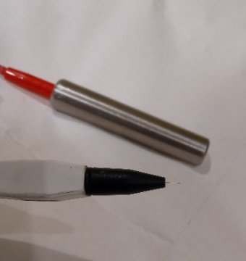

Special Procedures
Designated under Part 4 of the Public Health (Wales )Act 2017

Slide 3
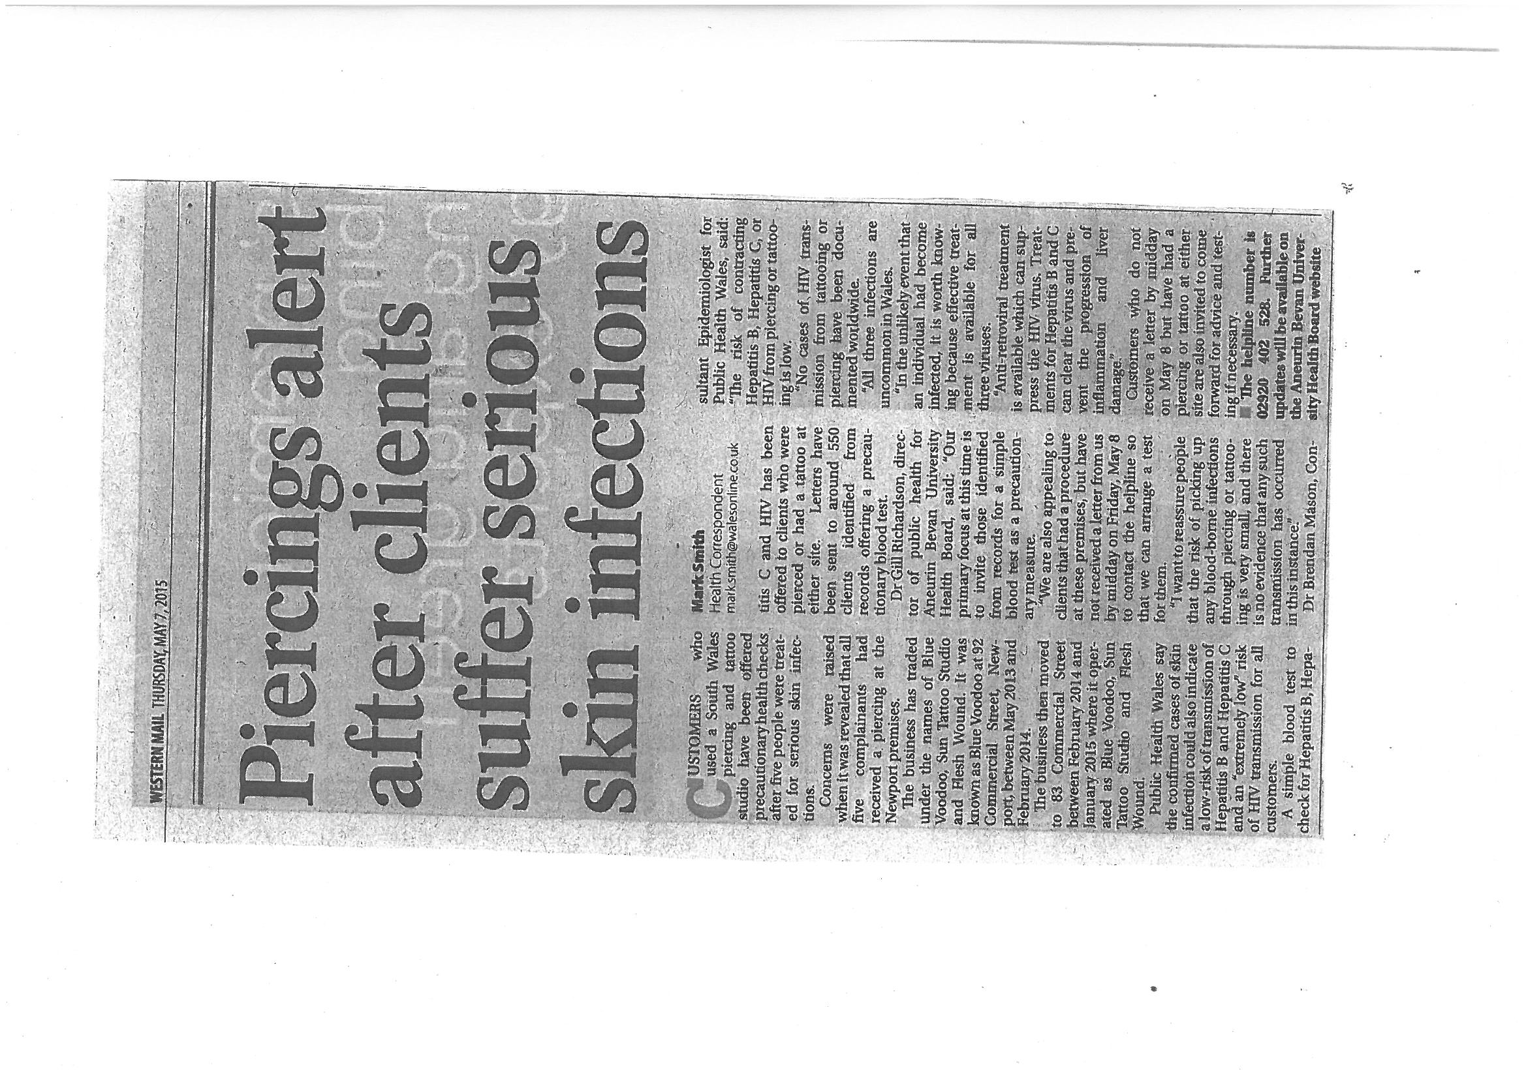
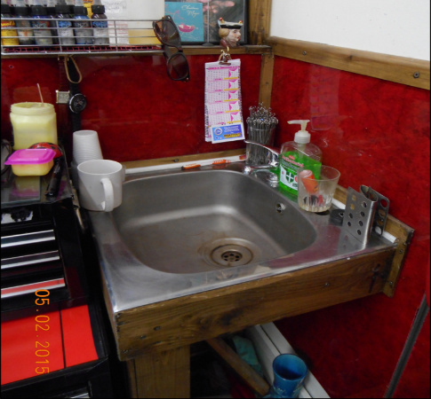
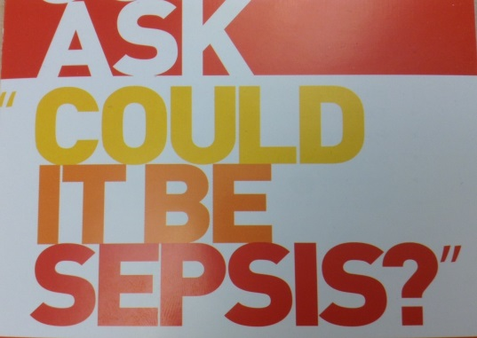
When infection prevention and control doesn’t happen

Slide 4
Objectives and Format
A knowledge and understanding of;
  the importance of infection control and prevention,
  associated infectious and non-infectious hazards,
  good infection practice and controls based upon an awareness of the chain of infection and standard infection control precautions.
Guided Learning Hours 7
Total Qualification Time 8
QiW: C00/3873/0
Ofqual: 603/4597/4

Slide 5
What are the 3 main health risks associated with your business?

