Slide 1


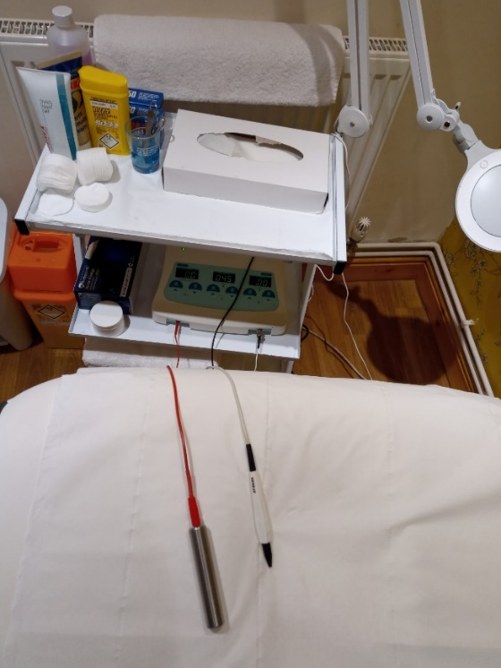
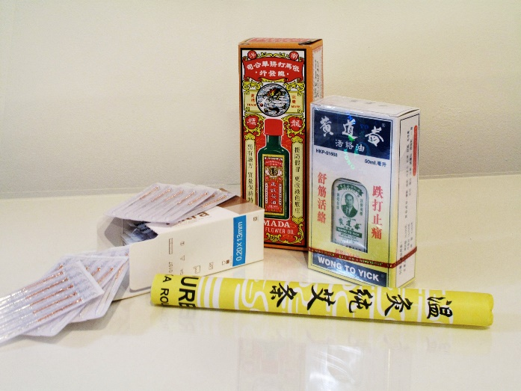
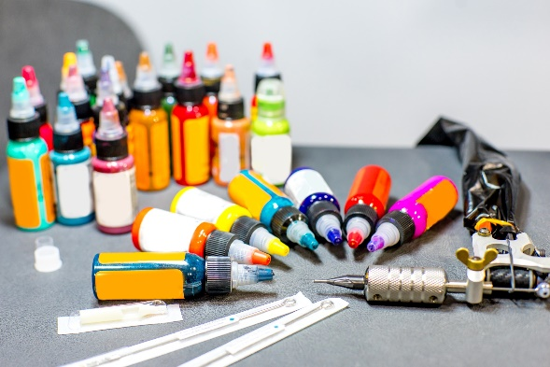
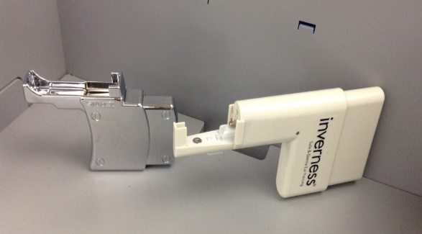
Section 13: Management of Special Procedure Equipment and Products

Slide 2
Special Procedure Equipment
& Products
Equipment/instruments used to perform the special procedure
  Needles, machine, pens
Equipment used to support the performance of the special procedure
  Autoclaves, cleaning/disinfection equipment, chairs
Products used to perform the special procedure
  Inks, pigments, jewellery
Products used to support the performance of the special procedure
  Chemicals, gloves, aprons, rinse water
Specification/material/design should relate to the risk of infection

Slide 3

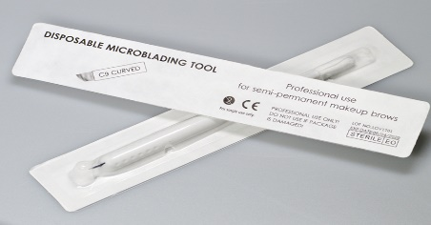
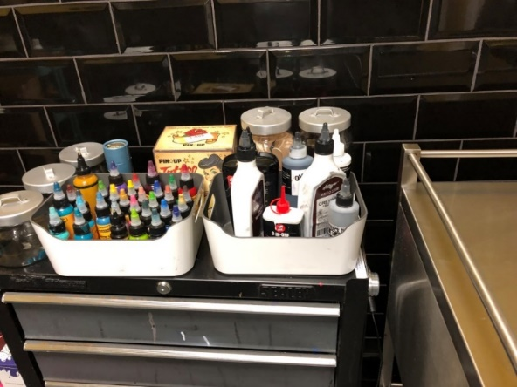
What’s the standard?
‘Standards’ relates to the equipment/product itself and it’s use e.g.:
‘Must be of such material and design that is fit for purpose, capable of being easily cleaned and kept in good order and repair so as to enable effective cleaning and where appropriate disinfection’.
‘use equipment, instruments and products purchased from reputable suppliers and that are fit for purpose’
‘Fixtures, fittings, equipment and products used as part of the special procedure business must not be capable of causing ‘harm to human health’ by design, material, condition or state of repair’.

Slide 4
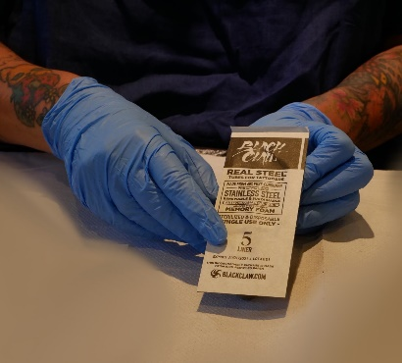
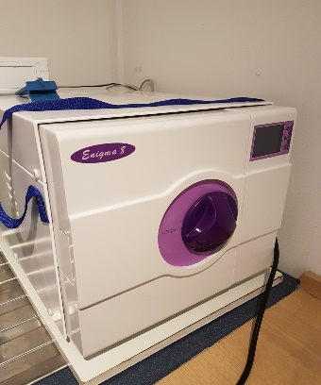
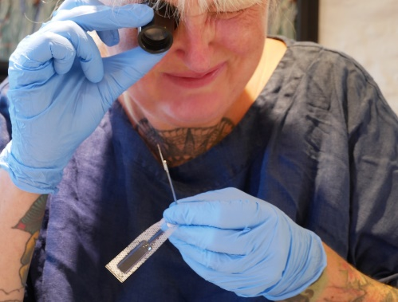
Equipment
Design, material make-up, easy to clean or ‘single use’ and durability – ‘fit for purpose’
Purchase from a reputable supplier
Equipment information
  How to use and store, guidance on maintenance and cleaning
Appropriate storage
Value for money but not a cheap alternative
From an infection control perspective when does equipment become a risk?

Slide 5

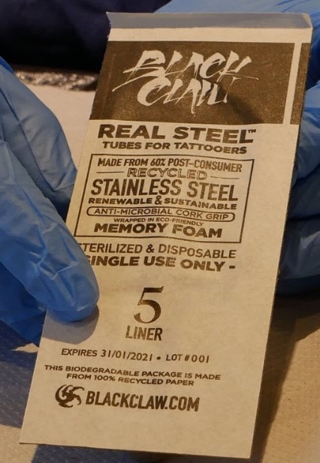
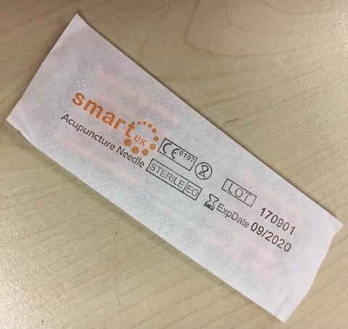
Single Use Symbol
Do not reuse
Examples of single use items
  A needle
  Razors
  Gloves and disposable plastic aprons
  Machine bags, ink pots etc
Are all single use items sterile?
Notes:
Single use even if intended on the same patient

Slide 6
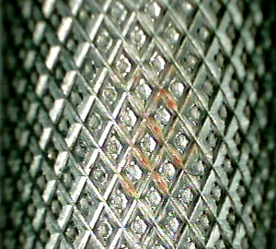
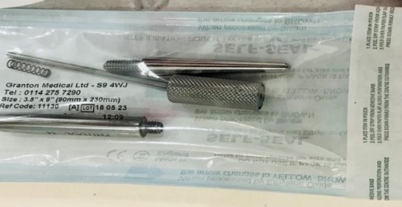
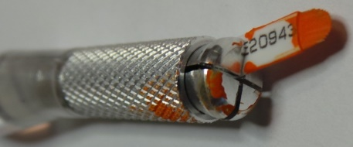
Use of equipment - reducing the risk of infection
Using equipment that can be easily cleaned and maintained
Correct use of equipment
Use of aseptic techniques
  Practice/technique that prevents contamination from pathogenic microorganisms
  Avoiding post contamination
  Standard Infection Control Precautions (SICPs)

Slide 7
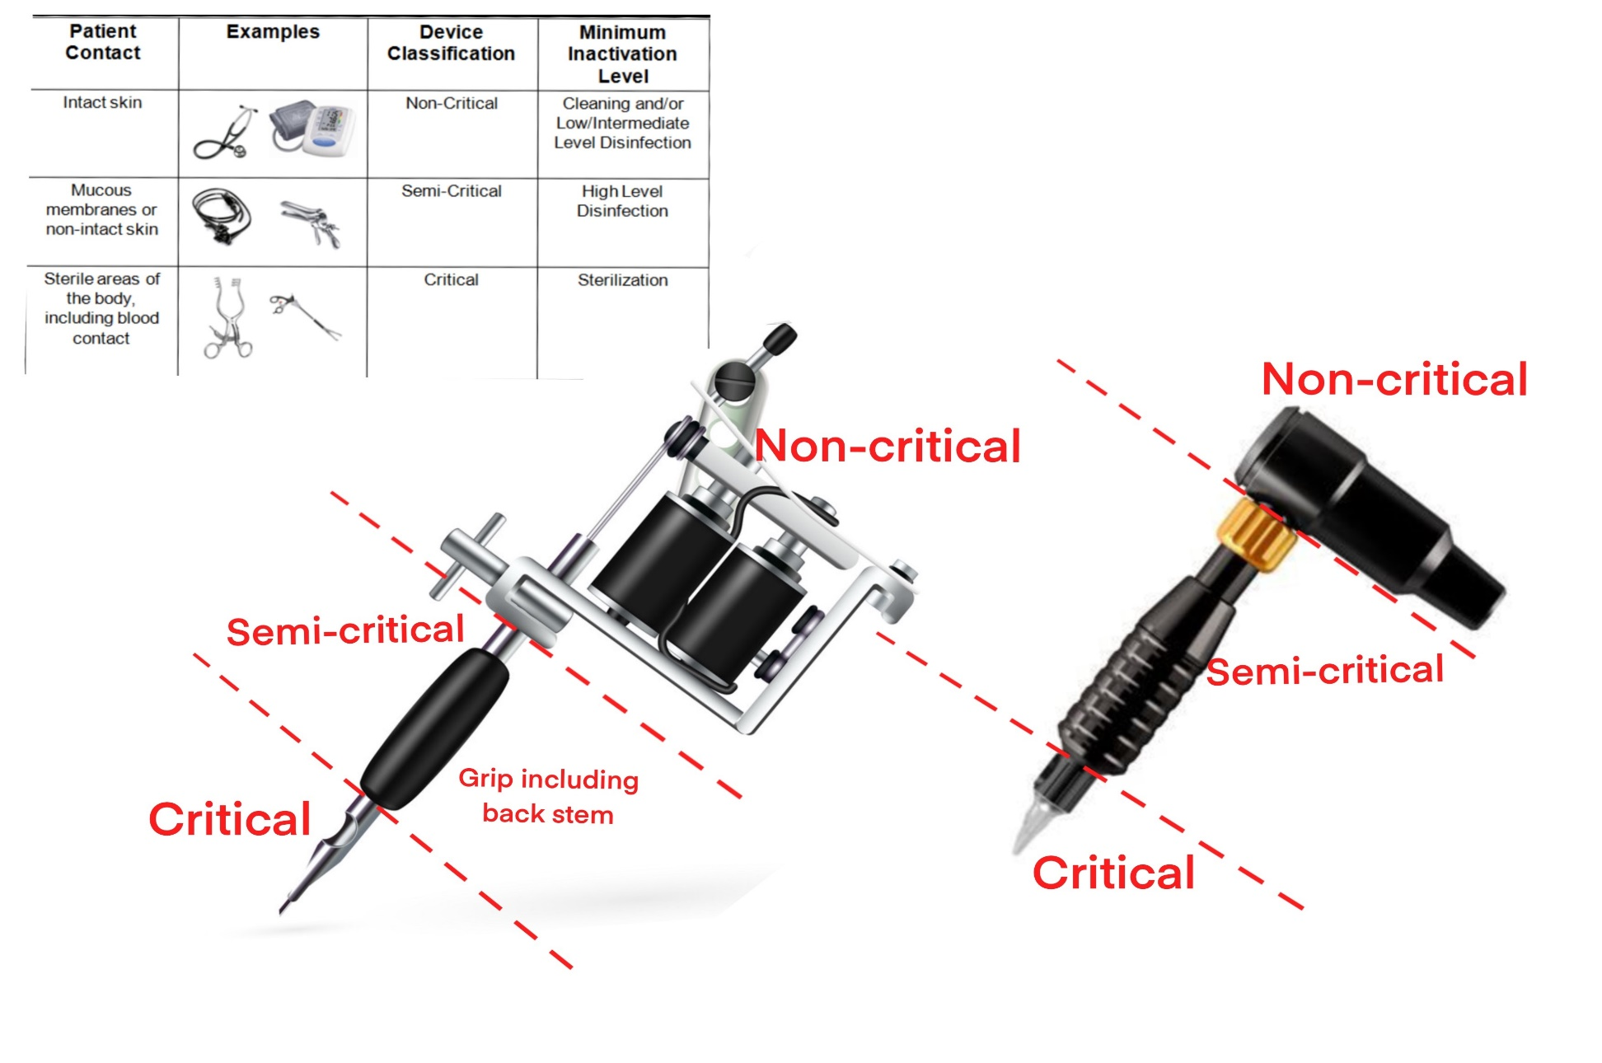
Product/equipment specification and use based on risk of infection

Slide 8
Aseptic Technique
The term ‘asepsis’ means ‘freedom from pathogenic material’ in sufficient quantity to cause infection.
Refers to the procedure used to avoid the introduction of pathogenic organisms into the vulnerable body site or invasive device.
The principle is to protect the client from contamination by pathogenic organisms during a special procedure.
The term sterilized is used to identify products and equipment that have been sterilized. However, once opened to air equipment and products are said to be aseptic.

Slide 9
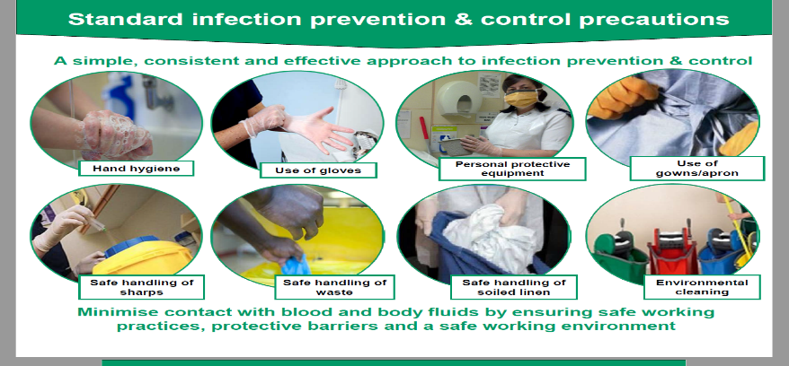
Standard Infection Control
Precautions (SICPs)
Safe Management of blood and body fluid spillages
Safe management of equipment
Safe management of the environment including decontamination
Hand hygiene
Client placement/assessment for infection risk
Personal Protective Equipment (PPE)
Occupational safety:
Prevention and exposure management (including sharps)
Safe disposal of waste (including sharps)

Slide 10
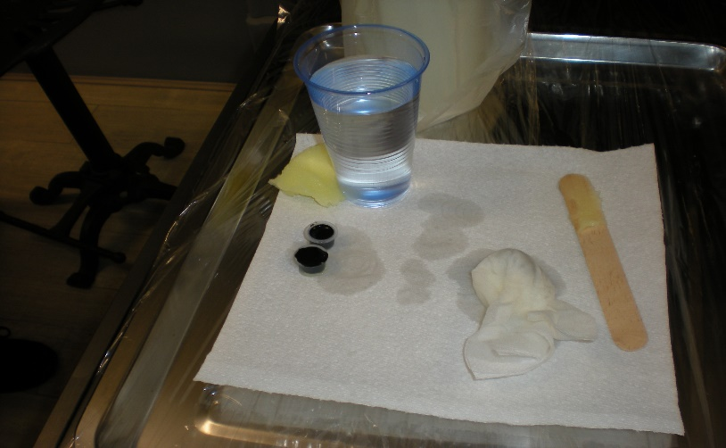
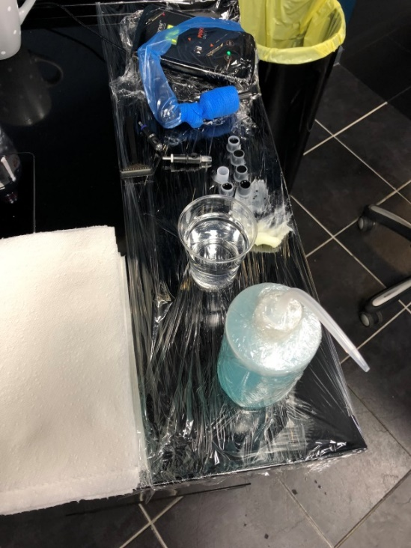
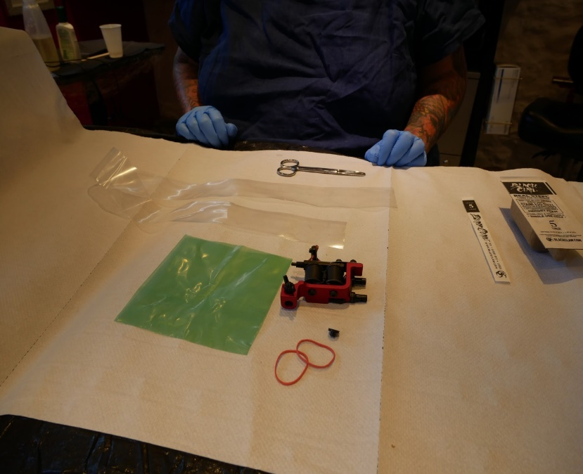
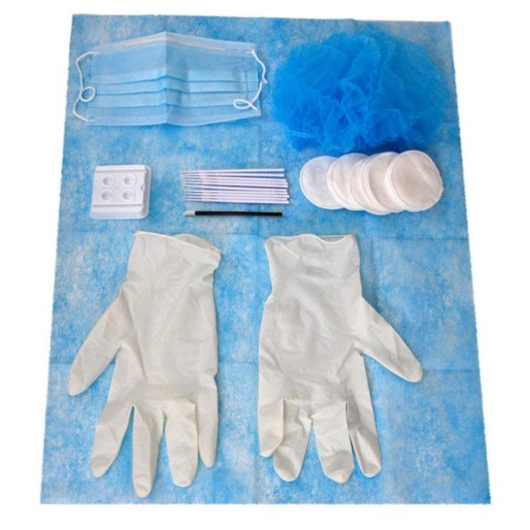
Workstations – aseptic techniques

Slide 11


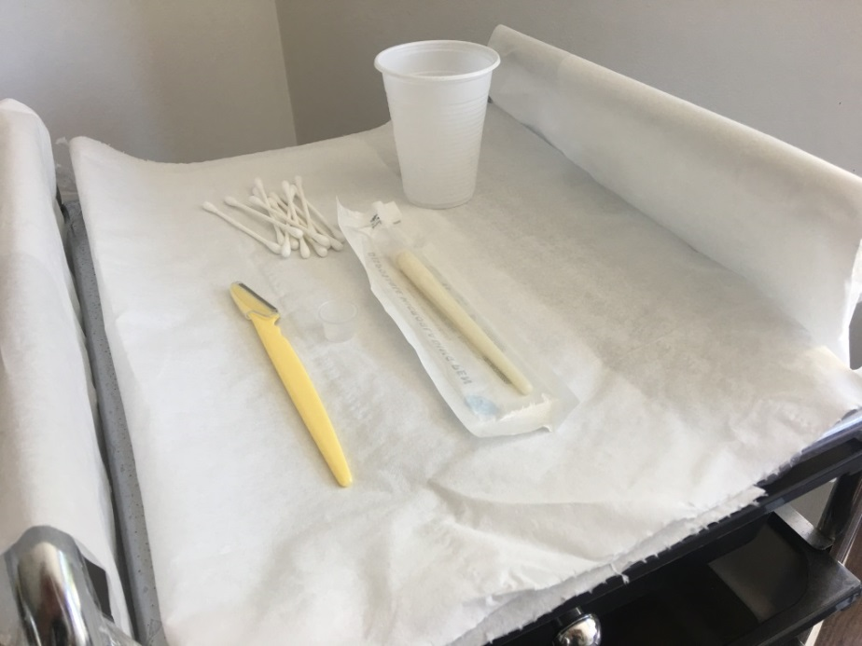
Works stations: Equipment and products

Slide 12
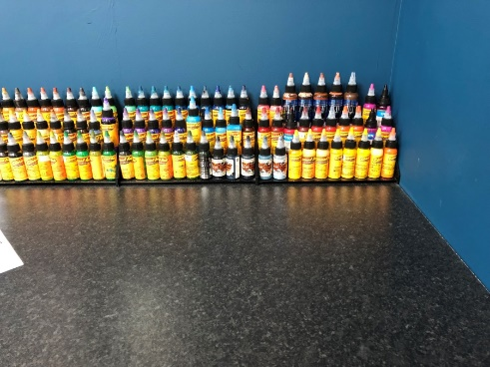
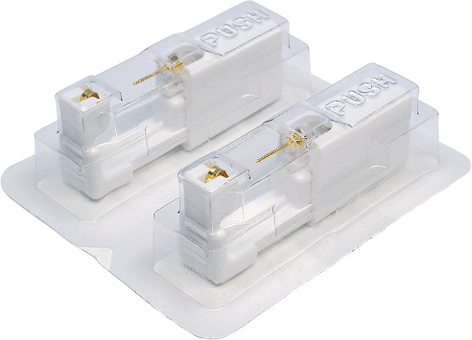
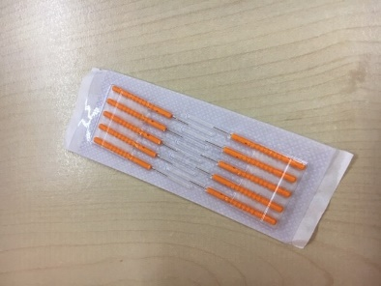
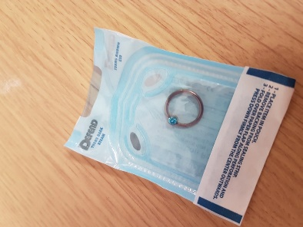
Products
‘Fit for purpose’
Purchase from a reputable supplier
Product information
  Expiry dates, ingredients, contraindications, application, sterility
Good stock rotation (FIFO)
Appropriate storage
Value for money but not a cheap alternative
When does a product become a risk?

Slide 13
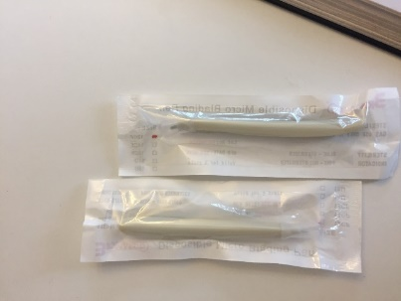

What is a reputable supplier?
Recognised within the industry
Full traceability on the equipment/products they supply.
Equipment/products are compliant and of a consistent quality.
Accessible to their customers

Slide 14
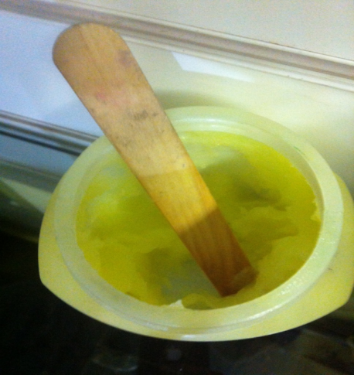
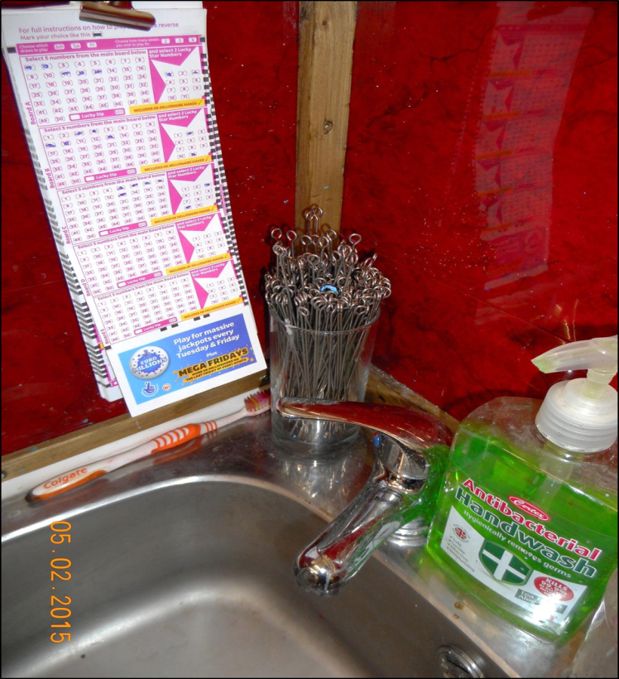
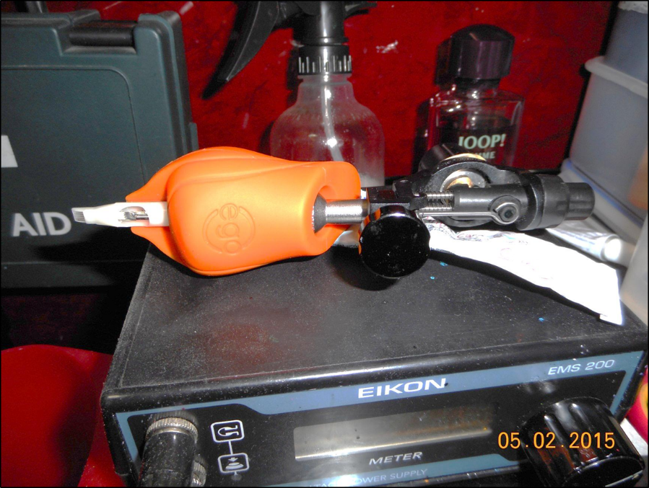
‘What’s the risk of infection?’ (1)

Slide 15

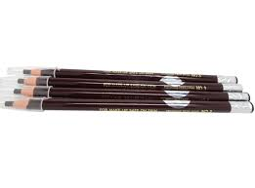
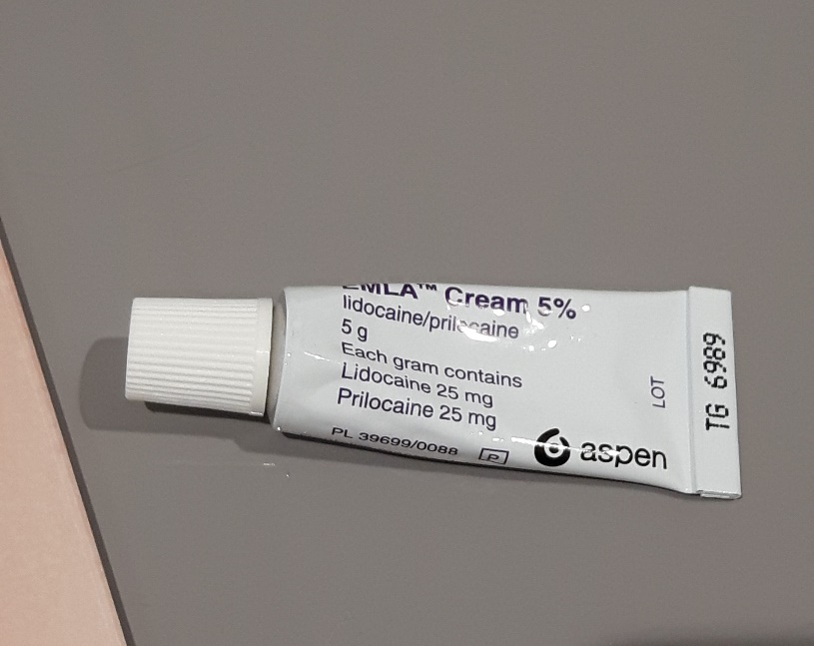
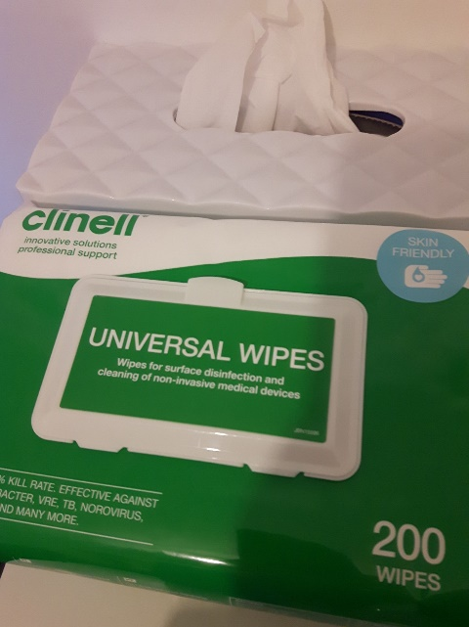
‘What’s the risk of infection?’ (2)

Slide 16
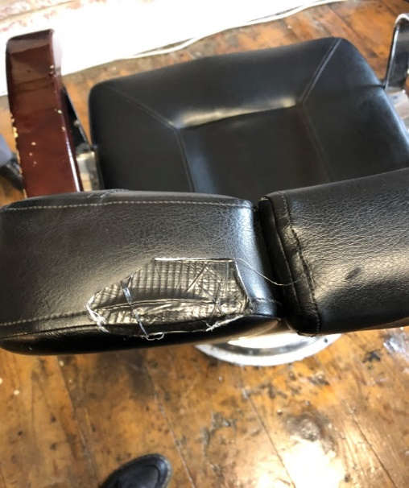
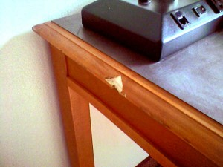
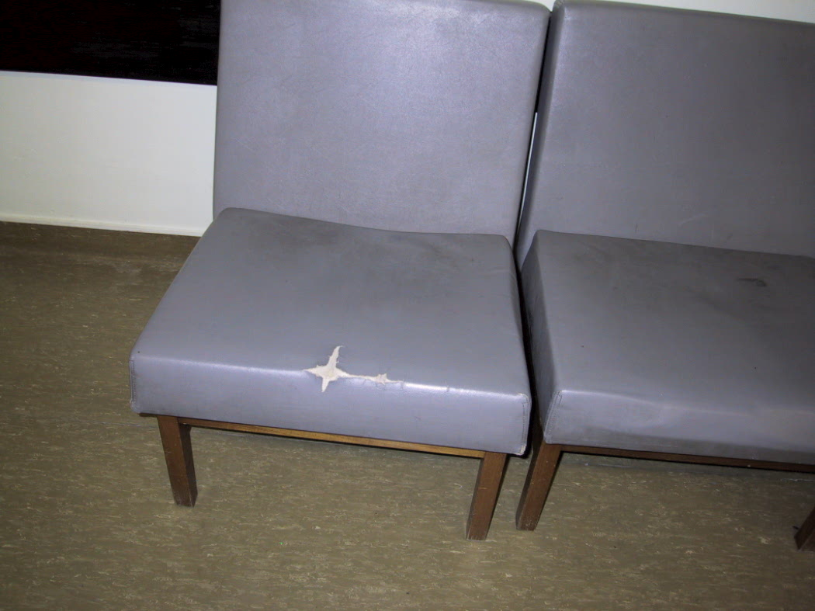
‘What’s the risk of infection?’ (3)

Slide 17
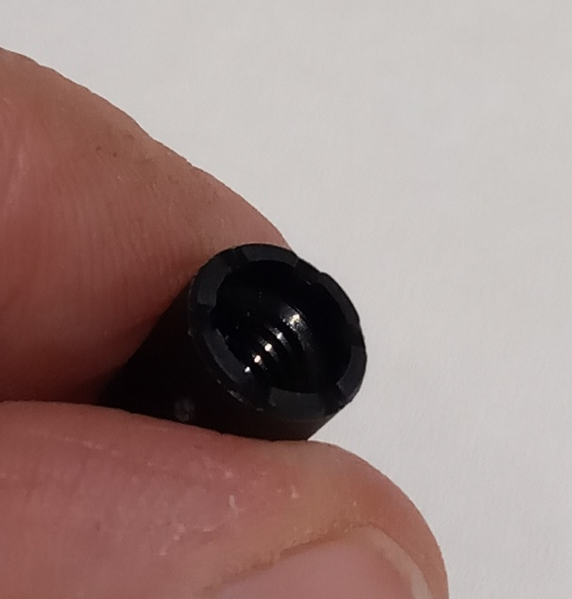
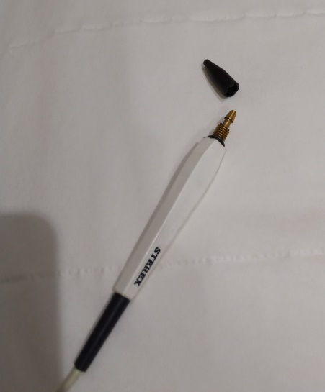
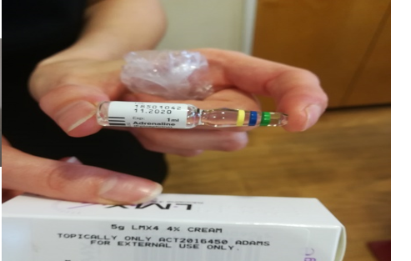
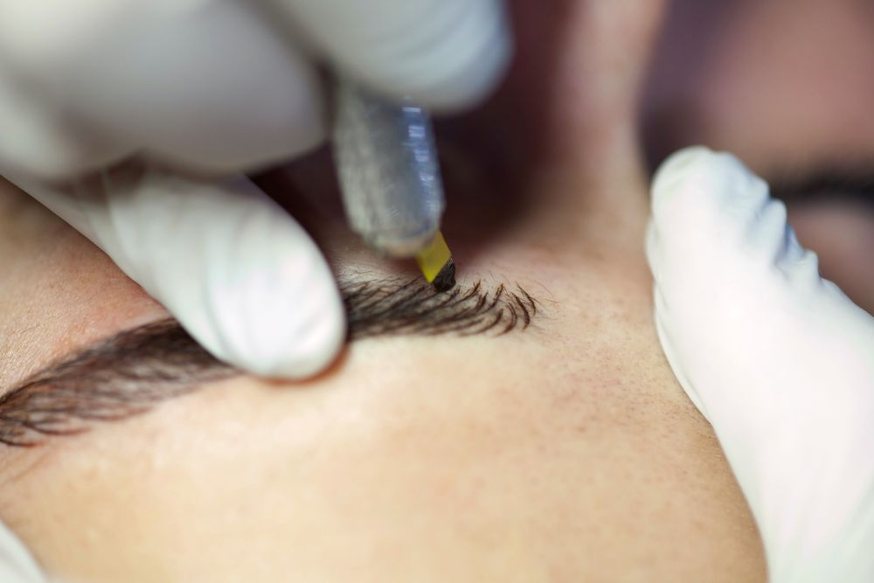
‘What’s the risk of infection?’ (4)

Slide 18
Summary
Fit for purpose and easy to clean
Maintenance
Single use symbol, examples of single use items
Stock rotation ‘FIFO’
Manufacturers instructions
Reputable suppliers
Aseptic techniques
Sterile products and equipment based on risk

Slide 19
True/False Quiz
Question | True/False
This symbol means never use more than twice
Good stock rotation ensures that products are used before their expiry date
Aseptic techniques ensure that the treatment room is sterile
Products can be used after their expiry date if they are still sealed
FIFO means ‘First in First out’
An autoclave is an example of a single use item
Reputable suppliers should supply traceable products of a consistent quality.
Equipment should be fit for purpose and easy to clean and maintain.

Slide 20
Quiz - Answers
Question | Answer
This symbol means never use more than twice | False
Good stock rotation ensures that products are used before their expiry date | True
Aseptic techniques ensure that the treatment room is sterile | False
Products can be used after their expiry date if they are still sealed | False
FIFO means ‘First in First out’ | True
An autoclave is an example of a single use item | False
Reputable suppliers should supply traceable products of a consistent quality | True
Equipment should be fit for purpose and easy to clean and maintain | True

