Slide 1
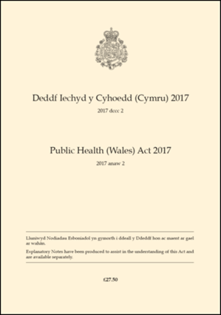
Section 6: Legal requirements for special procedures practitioners and business owners
Notes:
Part 4 – Mandatory licensing scheme

Slide 2
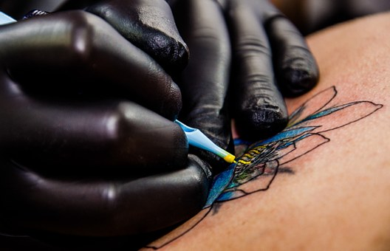
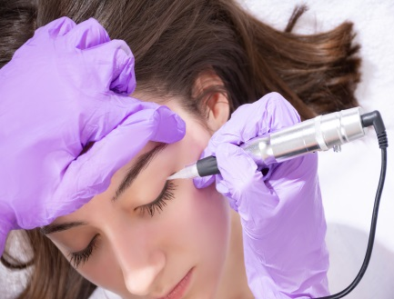
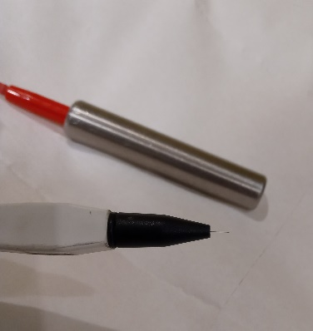
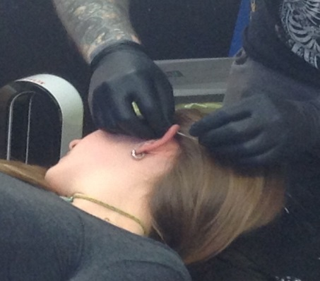
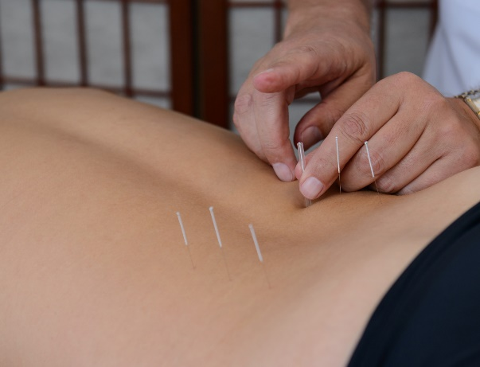
Special Procedures designated under the Act 2017 Tattooing – body piercing – electrolysis - acupuncture

Slide 3
What does the law say for practitioners? If you undertake a designated special procedure in Wales you will need a licence
3 year or 7 day licence
You will be required to have a licence whether you operate a business or not
You only need one licence to operate anywhere in Wales
You will be required to demonstrate a knowledge of
Infection control
First aid
Requirements of the Act
When you submit an application you will need to submit your infection control certificate and an application fee
The licence conditions will be commensurate with risk of the procedure
Notes:
‘Not more than 7 days’
Licence criteria – demonstration of knowledge and a fee

Slide 4
What does the law say about premises?
The premises where you operate from will need to be approved
Set of criteria which the premises must comply before approval authorised
Criteria will be commensurate with risk
‘Premises’ includes domestic premises, tent, commercial building
A special procedures register required to be maintained by local authorities
Notes:
Guidance will be provided on compliance for both the practitioner and LA.
Present or could present
LAs have agreed to work to a national register

Slide 5
Enforcement
Licences and approval will be revoked where non compliance of conditions present a significant risk of harm to human health
Prosecution by the local authority, unlimited fines
A practitioner operating without a licence will be liable to an unlimited fine (on summary conviction)
Service of legal notices – ‘Stop’ notices and RANs (Remedial Action notices)
Notes:
Much stricter enforcement powers

Slide 6
Summary(1)
Designated Special Procedures (S.57)
Licence Criteria
Application fee
Infection control certificate
Demonstrate knowledge of
Infection control and first aid in context of the special procedure practised
Duties imposed under the Act
Individual Licence
Duration
Variation
Premise Approval Certificate
Criteria and conditions

Slide 7
Summary (2)
Summary conviction
Following successful prosecution unlimited fines
Offences
Operating without a licence
Operating from a premises that doesn’t have an a premises approval certificate
Legal notices
Stop notice
RAN – remedial action notice

Slide 8
True or False Quiz
Question | True/False
Designated special procedures include tattooing, body piercing, laser removal and acupuncture
To perform a designated special procedure in Wales an individual must have a licence whether or not he operates as a business
Premises includes any place or temporary structure
An individual licence can be for a duration of 3 years or not more than 7 days
To apply for an individual licence a practitioner is required to demonstrate a knowledge of infection control, first aid and customer service
On summary conviction, a practitioner will be liable to a fine of £5,000
An applicant applying for a Premises Approval Certificate must include an application fee with the submission
Local authorities are required to keep a register of licensed practitioners and approval premises

Slide 9
Question | True/False
Designated special procedures include tattooing, body piercing, laser removal and acupuncture | False
To perform a designated special procedure in Wales an individual must have a licence whether or not he operates as a business | True
Premises includes any place or temporary structure | True
An individual licence can be for a duration of 3 years or not more than 7 days | True
To apply for an individual licence a practitioner is required to demonstrate a knowledge of infection control, first aid and customer service | False
On summary conviction, a practitioner will be liable to a fine of £5,000 | False
An applicant applying for a Premises Approval Certificate must include an application fee with the submission | True
Local authorities are required to keep a register of licensed practitioners and approval premises | True

