Slide 1


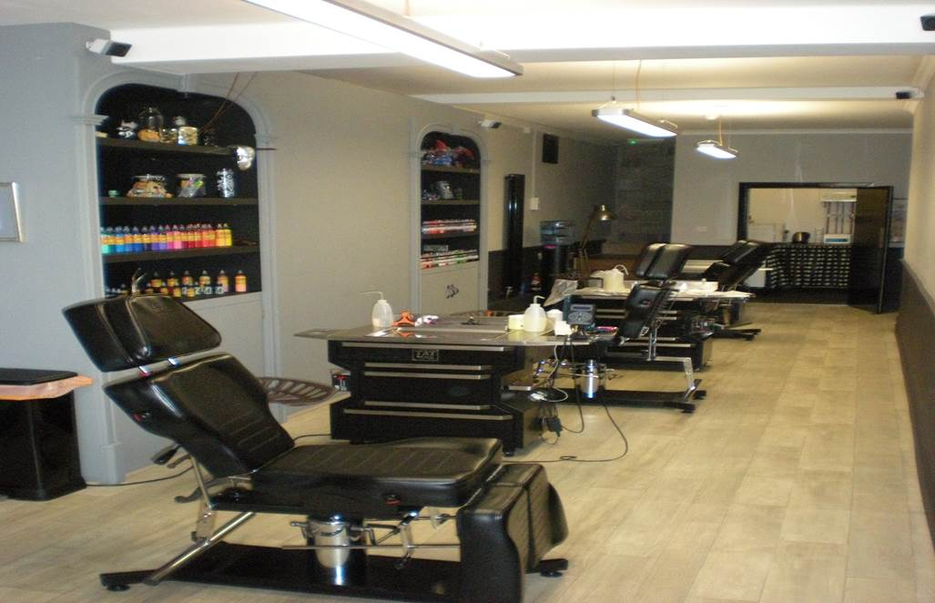
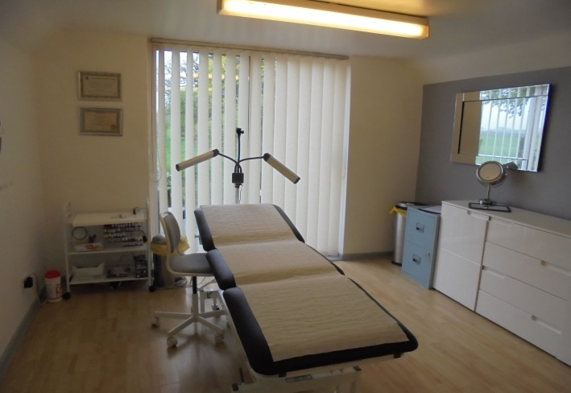
Section 12: Management of a Special Procedures Environment

Slide 2
Special Procedures Environment
Structure and design
Fixtures, fittings, finishes
Workstation
Reception
WC accommodation
Storage area
Utilities
Lighting and ventilation
Ingress and egress
Etc
Workflow
What about locations?
Permanent, temporary, mobile?

Slide 3
What’s the standard?
Minimise the risk of infection
Must not be capable of causing harm to human health
Capable of being easily cleaned
Good state of repair
Impervious/durable
‘Suitable and sufficient’
Walls, doors, windows, partitions, floors, floor coverings, ceiling or any part of the structure in any part of the premises used by the client and practitioner must be kept and be capable of being kept in good order, repair and condition to facilitate effective cleaning.
The environment should be designed and of sufficient size to minimise this risk of cross infection or contamination and facilitate effective cleaning and when appropriate disinfection.

Slide 4
What about managing those standards?
Workflow
  Location of facilities
Designated areas
  Treatment room
  Reception
Fit for use/purpose/rules

Slide 5
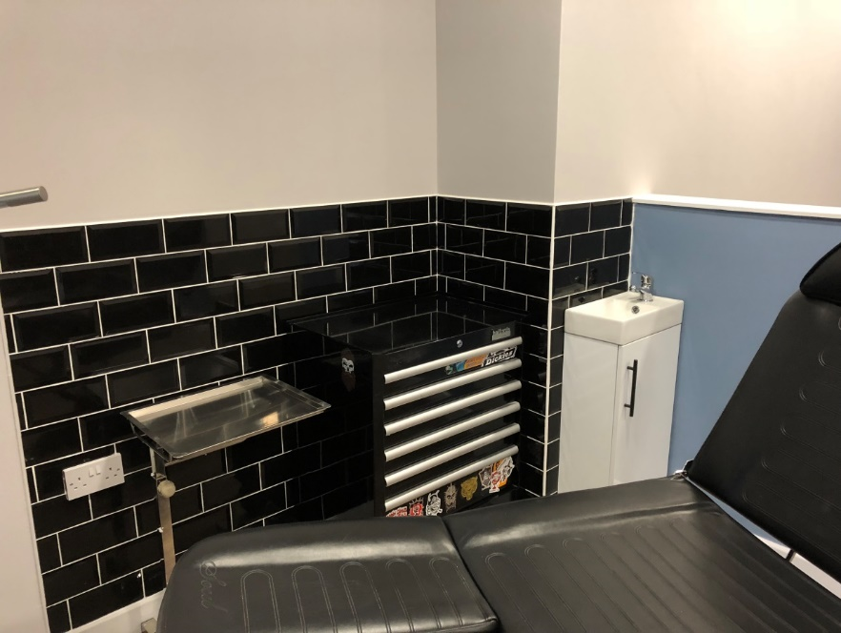
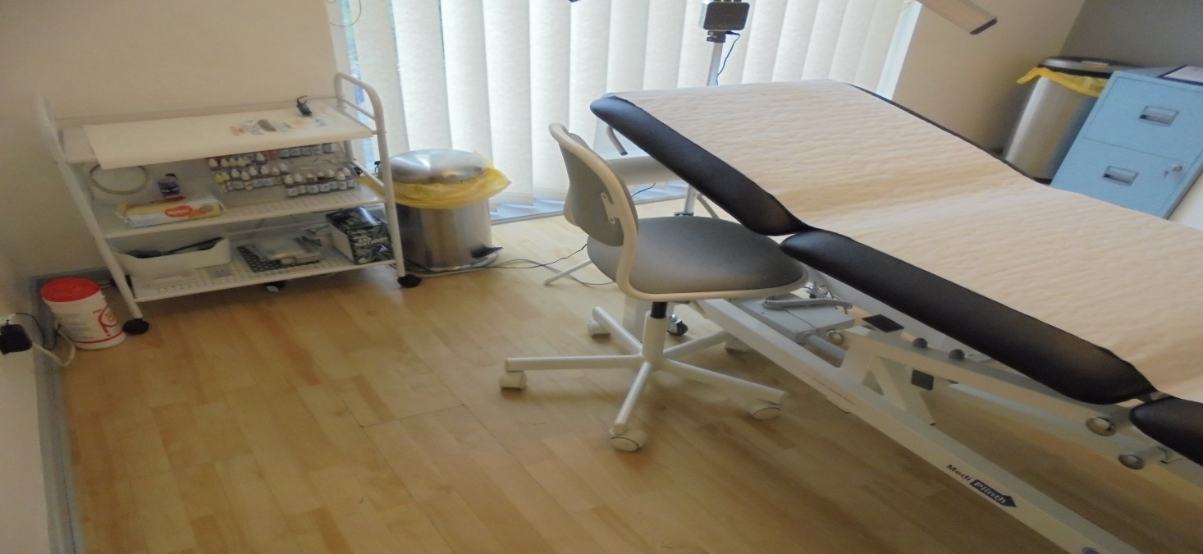
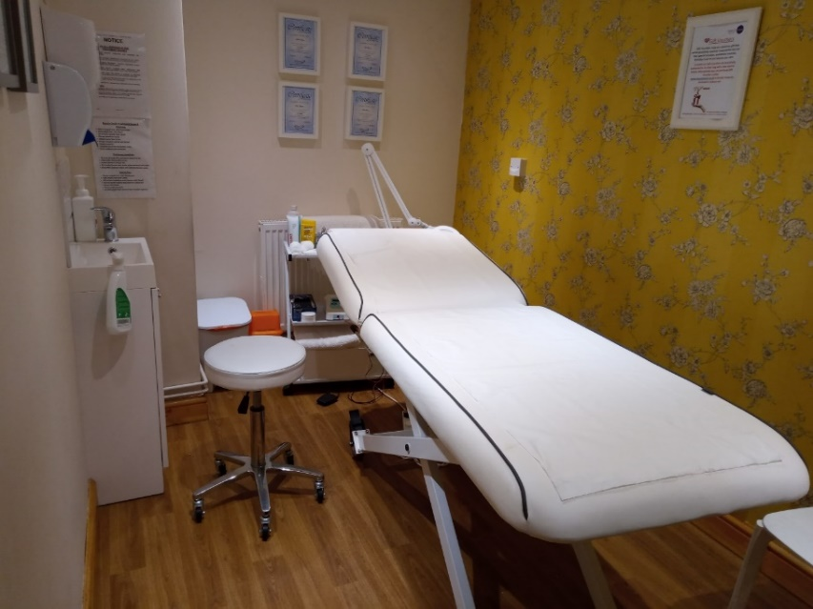
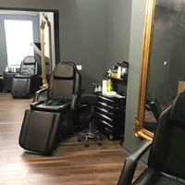
Workstations/treatment rooms

Slide 6
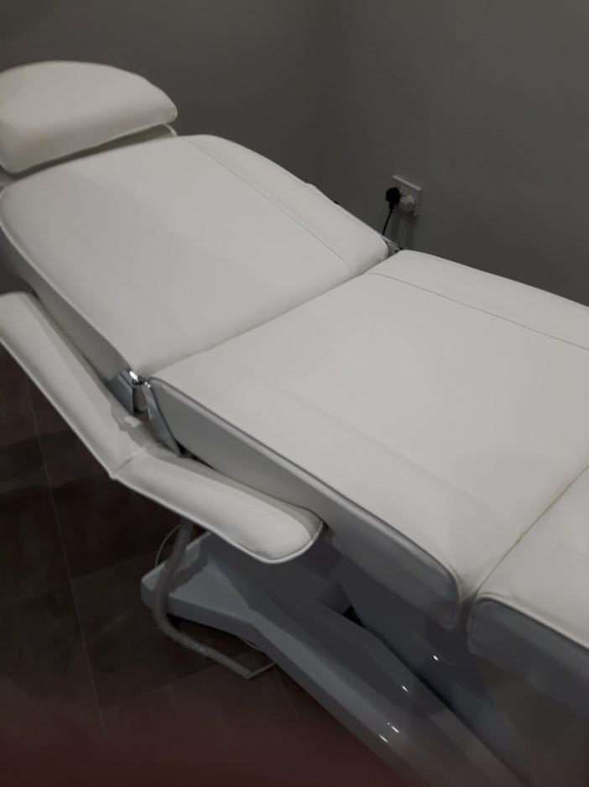
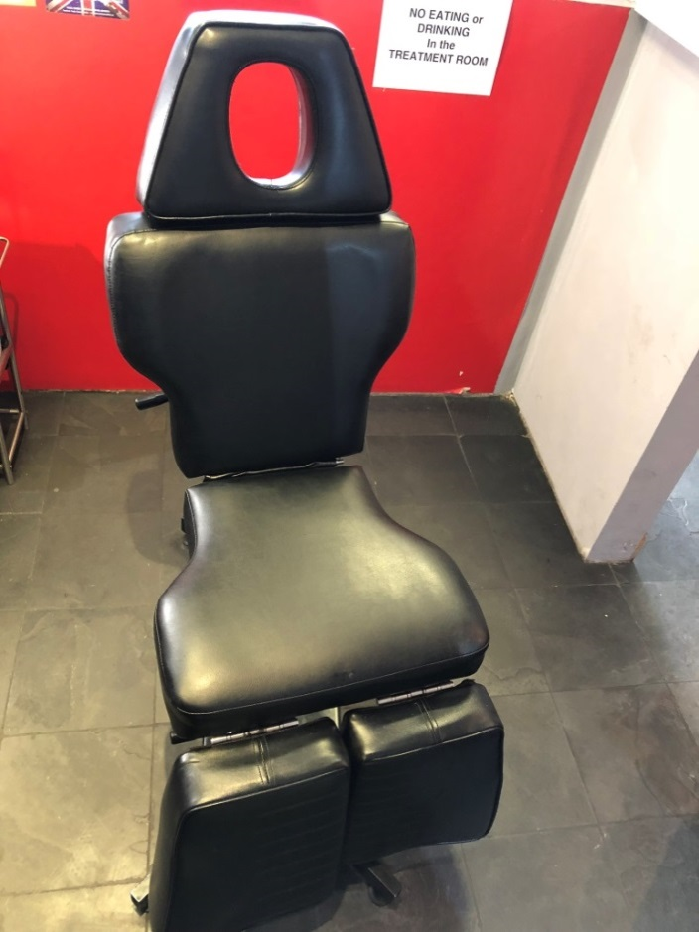
Client chairs

Slide 7
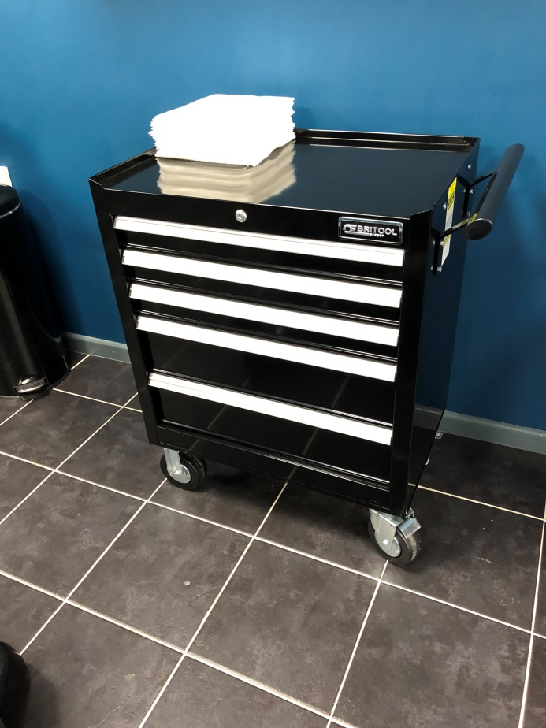
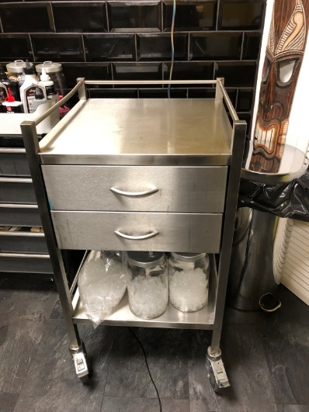
Storage facilities

Slide 8
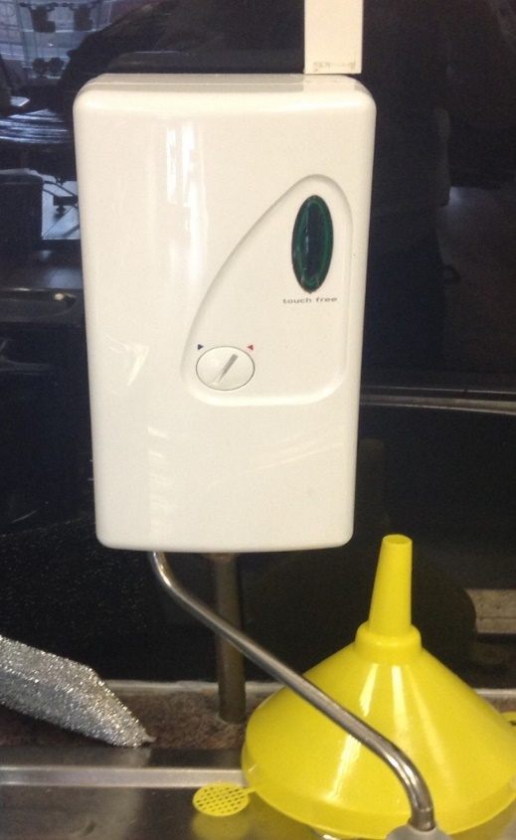
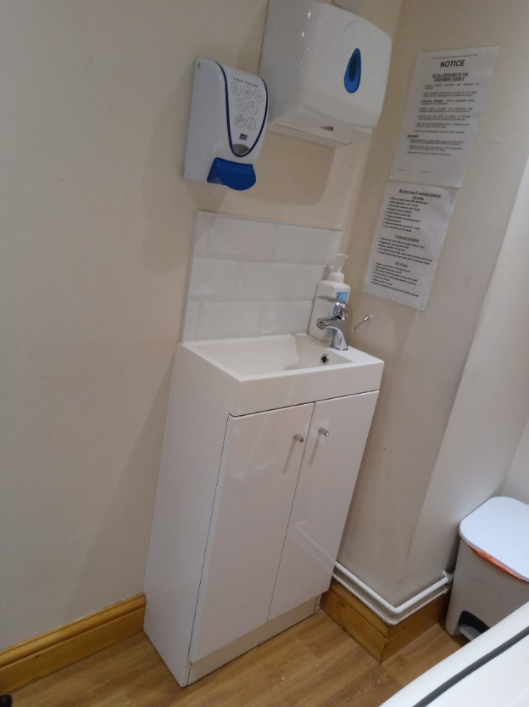
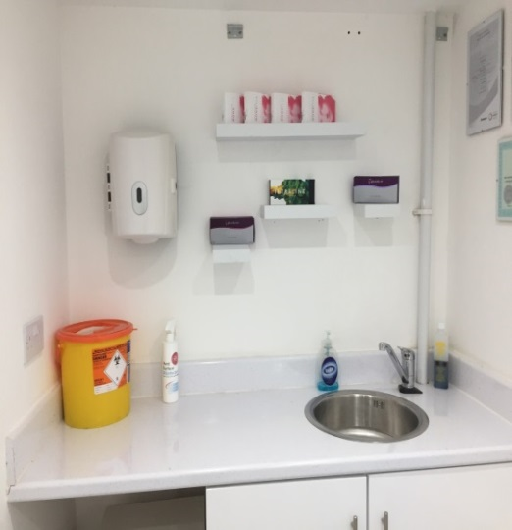
Hand washing facilities

Slide 9
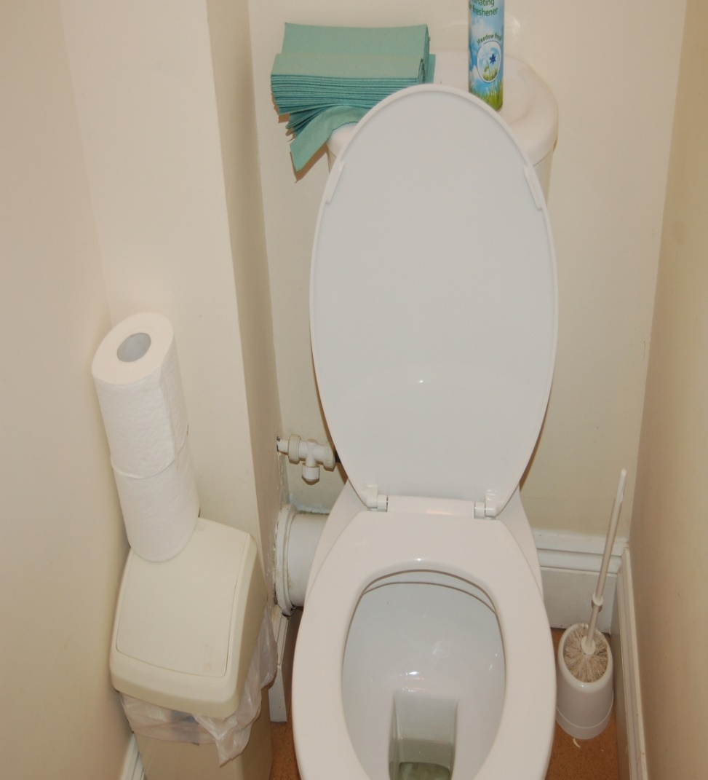
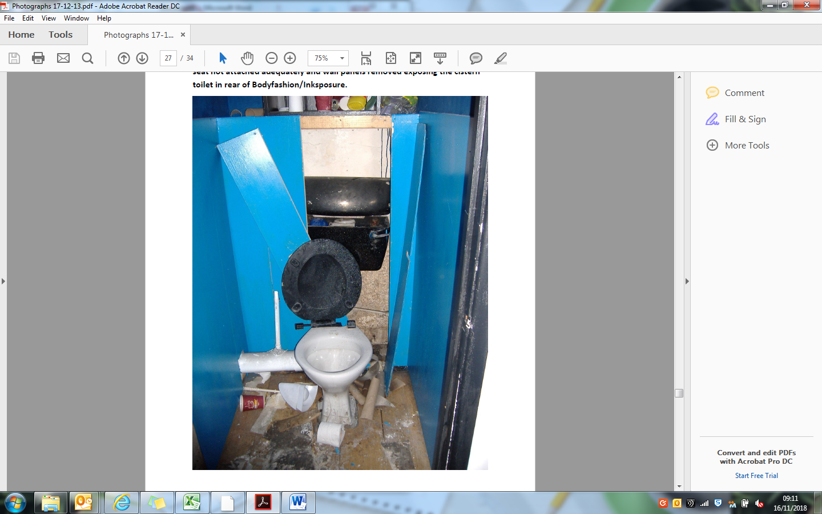
Toilets

Slide 10
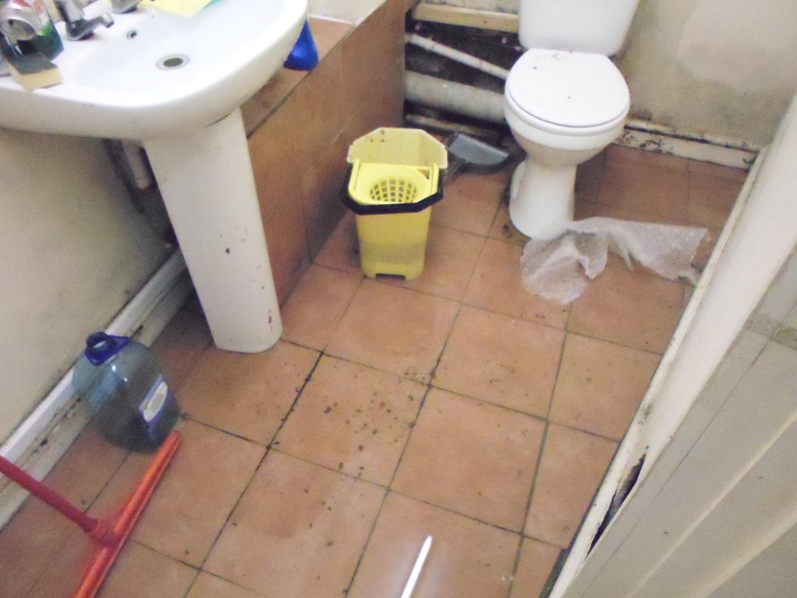
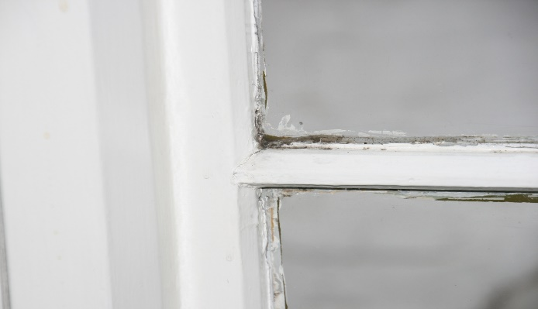
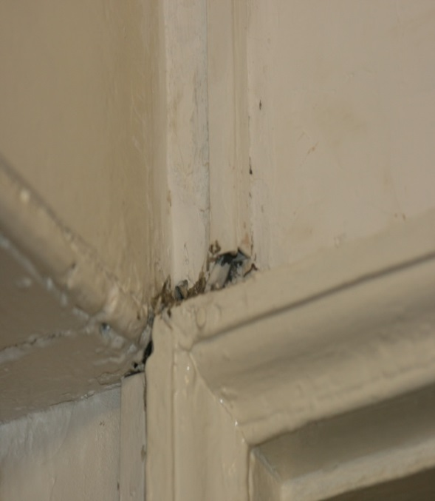
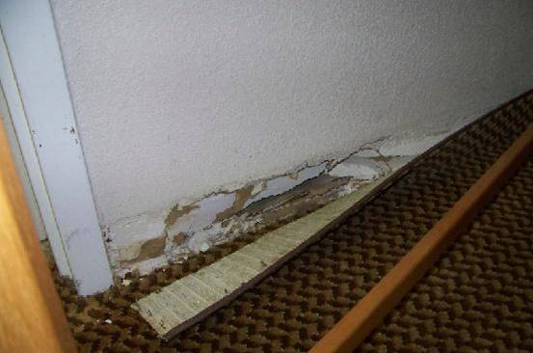
Structure - Walls, floors, ceilings

Slide 11
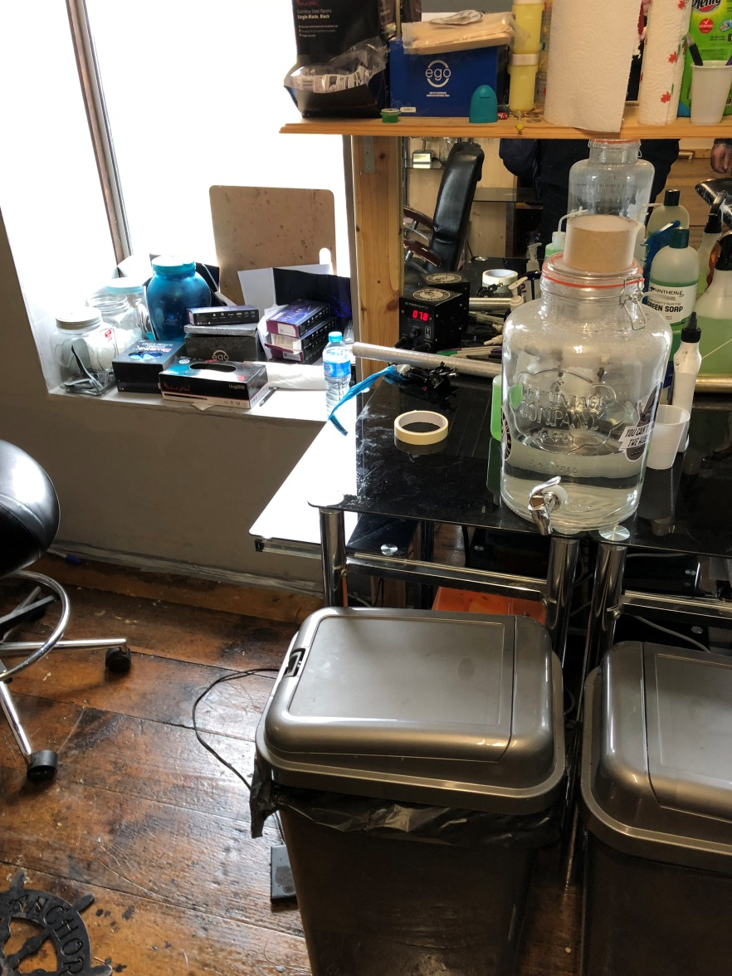
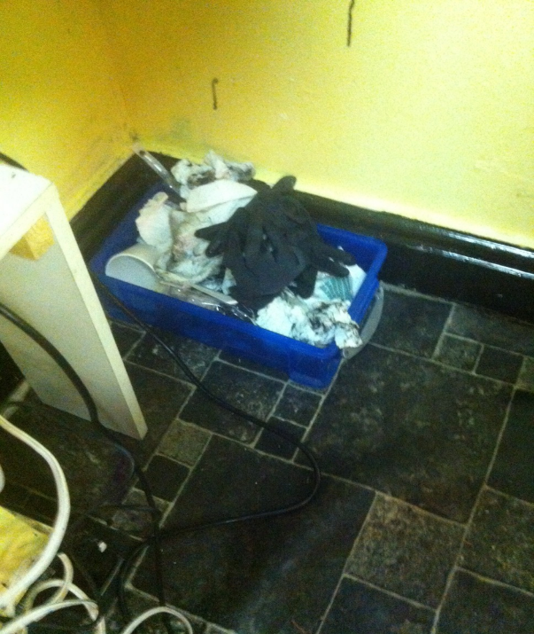
General Environment

Slide 12
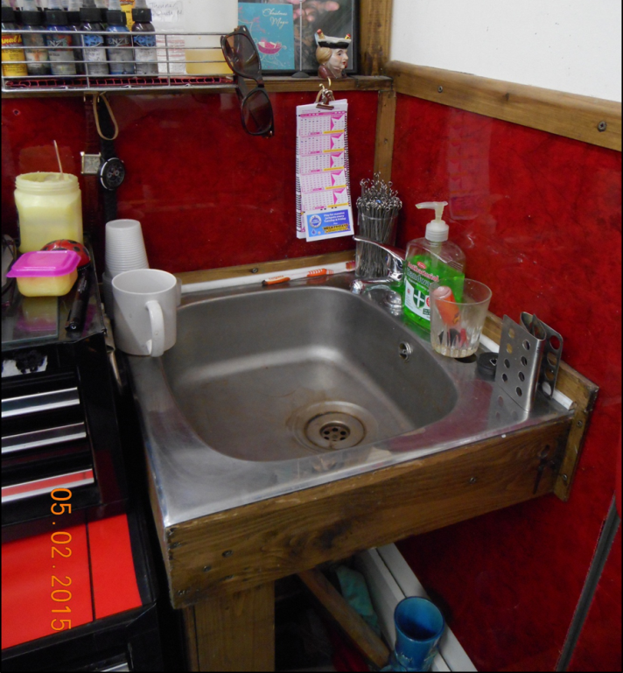
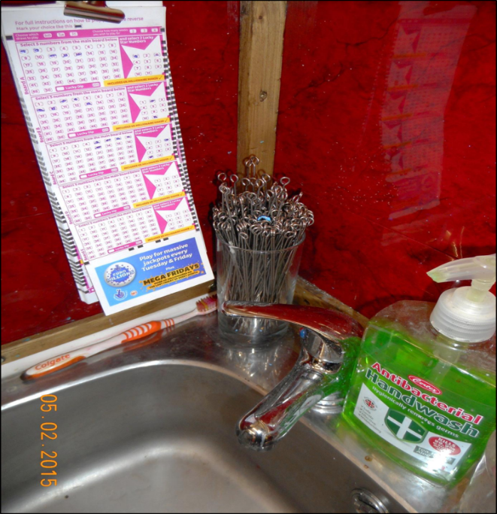
Cleaning facilities

Slide 13
Summary (1)
Different working environments = different level of infection control: temporary event v. purpose built studio.
Fit for purpose
Materials/surfaces/finishes that can be easily cleaned and good state of repair/impervious
Design/structure/fixtures/fittings
  Minimise the risk of cross infection
  Must not be capable of causing harm to human health

Slide 14
Summary (2)
Good workflow (clean to dirty, minimal cross overs)
Designated areas
  Dirty/clean areas
  Storage
  Staff room/WC
  Waiting room
  Location of WHBs/sinks
Fixtures and fittings used for designated purpose

Slide 15
Case Studies
You have decided to convert your double garage into a purpose built studio.
You have been asked to design a mobile unit intended to be used for undertaking special procedures.
You have bought a pre 1919 end of terrace domestic property comprising 2 reception rooms, a large rear kitchen with access to a bathroom.

Slide 16
Match the correct answer to the question
Question | Answer
A wash hand basin should | at a temporary event than a permanent venue
Walls and floors should be | of a material and design that enables easy cleaning
A special procedure premises should be | Clean to dirty
To prevent cross contamination an equipment sink should | in a good state of repair and capable of being easily cleaned
Special procedures work flow should be from | not be used to wash hands.
Fixtures and fittings in the treatment room should be | designed to minimise the risk of cross infection
A greater level of precautions should be taken | have an adequate supply of hot and cold water, liquid soap and paper towels

Slide 17
Answers
Question | Answer
A wash hand basin should | have an adequate supply of hot and cold water, liquid soap and paper towels
Walls and floors should be | in a good state of repair and capable of being easily cleaned.
A special procedure premises should be | designed to minimise the risk of cross infection
To prevent cross contamination an equipment sink should | not be used to wash hands.
Special procedures work flow should be from | Clean to dirty
Fixtures and fittings in the treatment room should be | of a material and design that enables easy cleaning
A greater level of precautions should be taken | at a temporary event than a permanent venue

