Slide 1
Unit 3 – Deliver a Health Improvement Message

Slide 2
Learner Outcomes
By the end of this module, you will:
Understand why peer advice is important for the delivery of health improvement messages
Carry out preparations for delivering a health improvement message
Deliver a health improvement message
Carry out a review of the delivery of the health improvement message

Slide 3
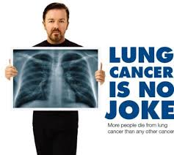
Health Promotion Campaigns

Slide 4
Peer Advice

Slide 5
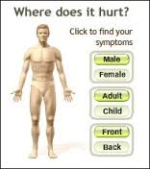
Peer Advice vs Authority Figure Advice

Slide 6
Choosing a Health Improvement Message

Slide 7
Choosing a Health Improvement Message

Slide 8
Choosing a Health Improvement Message
Delivering Campaigns
Campaign topics can be decided by using information from:
Data from your local Joint Strategic Needs Assessment
http://www.lewishamjsna.org.uk/
Public Health Local area priorities
http://fingertips.phe.org.uk/profile/health-profiles
School/College/local community health priorities
Your knowledge of young people’s issues within your local area
Your personal experience of a health and wellbeing issue
Current national campaigns

Slide 9
Explaining your role as a Young Health Champion
Delivering Campaigns
What is your role as a Young Health Champion?
What is it that as a Young Health Champion, you can do to the support the person or audience receiving your health improvement message?
What can you not do as a Young Health Champion? What are the boundaries of the role?

Slide 10
Choice of Health Improvement Message
Delivering Campaigns
What are the key behaviours you are looking to address?
Is there one specific type of behaviour which you should look to address as a priority?
What can you not do as a Young Health Champion? What are the boundaries of the role?

Slide 11
Key Points
Delivering Campaigns
What are the short and long-term effects of those behaviours upon the individual’s health and wellbeing?
What are the short and long-term effects of those behaviours upon wider society?
Where can you signpost the audience member to if needed?

Slide 12
Health Improvement Resources
Delivering Campaigns
What are the materials you need to successfully make the case to your audience member?
Where can you acquire these resources from?
Are there any resources which you can prepare and develop by yourself which are more suitable?

Slide 13
Style of Delivery
Delivering Campaigns
How could the language you use impact upon how successfully you communicate with your audience?
How could you vary the style of delivery to make it suitable fro the target group?
How could the tone of voice you use in your delivery impact upon how successful your message is?

Slide 14
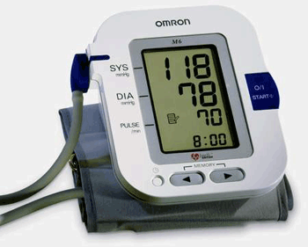
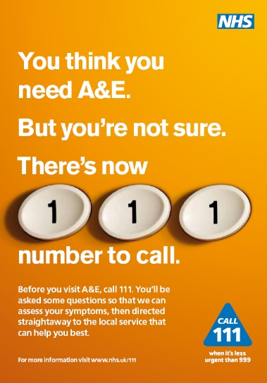
Feedback and Signposting
Delivering Campaigns

