Slide 1
Unit 2 – Research Health Improvement Services

Slide 2
Learner Outcomes
By the end of this module, you will:
Carry out a search of your local area to locate health improvement services
Determine the resources available from a local health improvement service
Carry out a review of local health improvement services

Slide 3
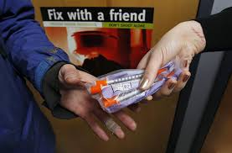
What is a health improvement service?

Slide 4
Where do we get reliable information from?

Slide 5
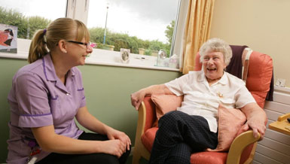
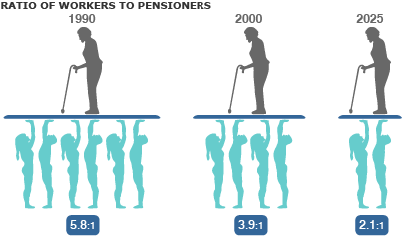
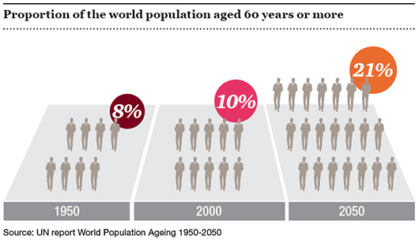
Pressure on health improvement services

Slide 6
Referral to health improvement services – Patient 1

Slide 7
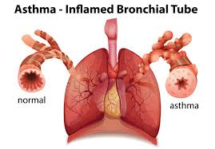
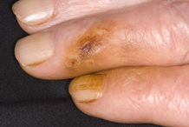
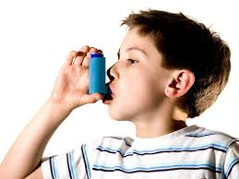
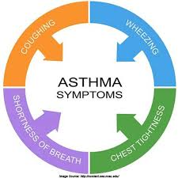
Referral to health improvement services – Patient 2

Slide 8
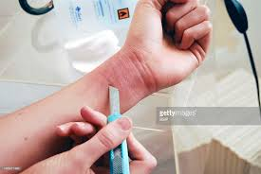
Referral to health improvement services – Patient 3

Slide 9
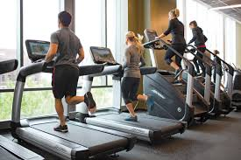
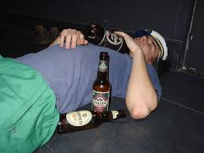
Referral to health improvement services – Patient 4

Slide 10
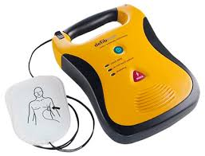
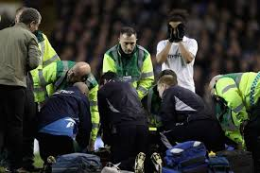
Referral to health improvement services – Patient 5

Slide 11
Referral to health improvement services
Delivering Campaigns
Identify the transport links and directions, distance and eligibility or registration requirements for any health improvement service
Select which patients you are going to refer to each health improvement service
Give the name and address of the service you have identified in your local area
Briefly describe any problems you can foresee with the patients accessing the service. This can include things like problems with disabled access, restricted opening hours or whether the service is free or chargable

Slide 12
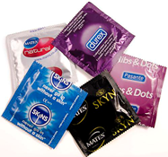
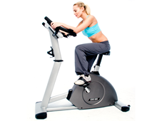
Health improvement resources
Delivering Campaigns

Slide 13
Suitability of health improvement resources
Delivering Campaigns

